Slide 1
渭南简介
Brief Introduction to Weinan
渭南市发展改革委主任 杨武民
Yang Wumin, Director of the Weinan development
and Reform Commission
2018年7月
July 2018

Slide 2
枢纽
渭南
Hub Weinan

Slide 5
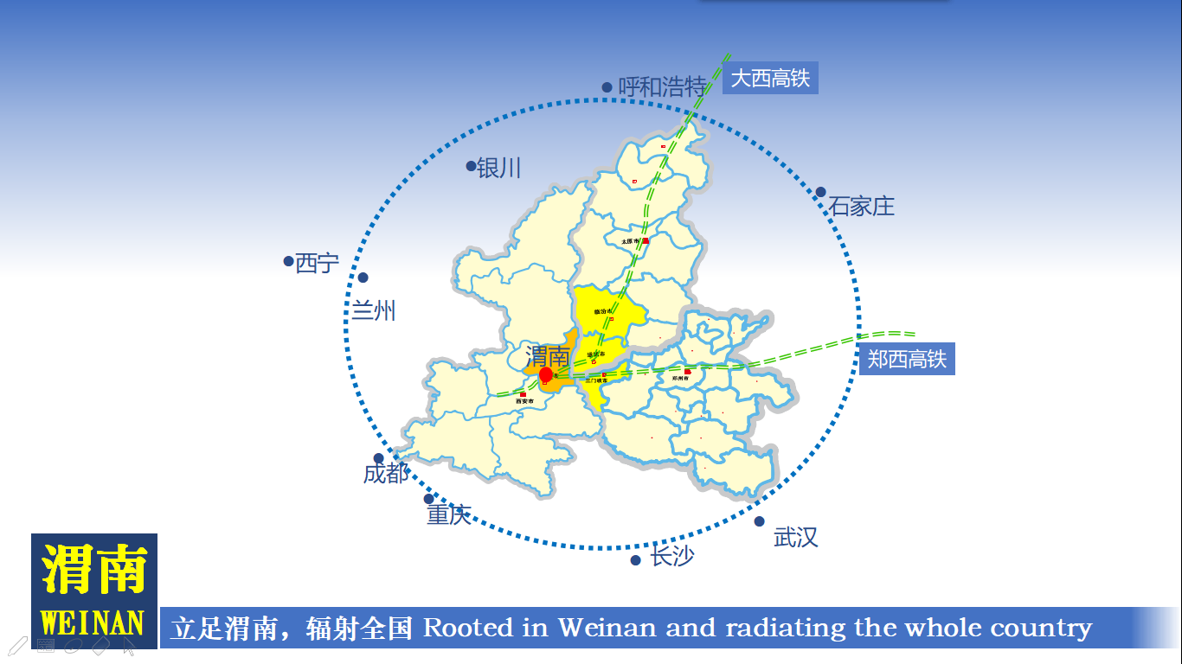

Slide 6
Humanity and
culture of Weinan

Slide 9
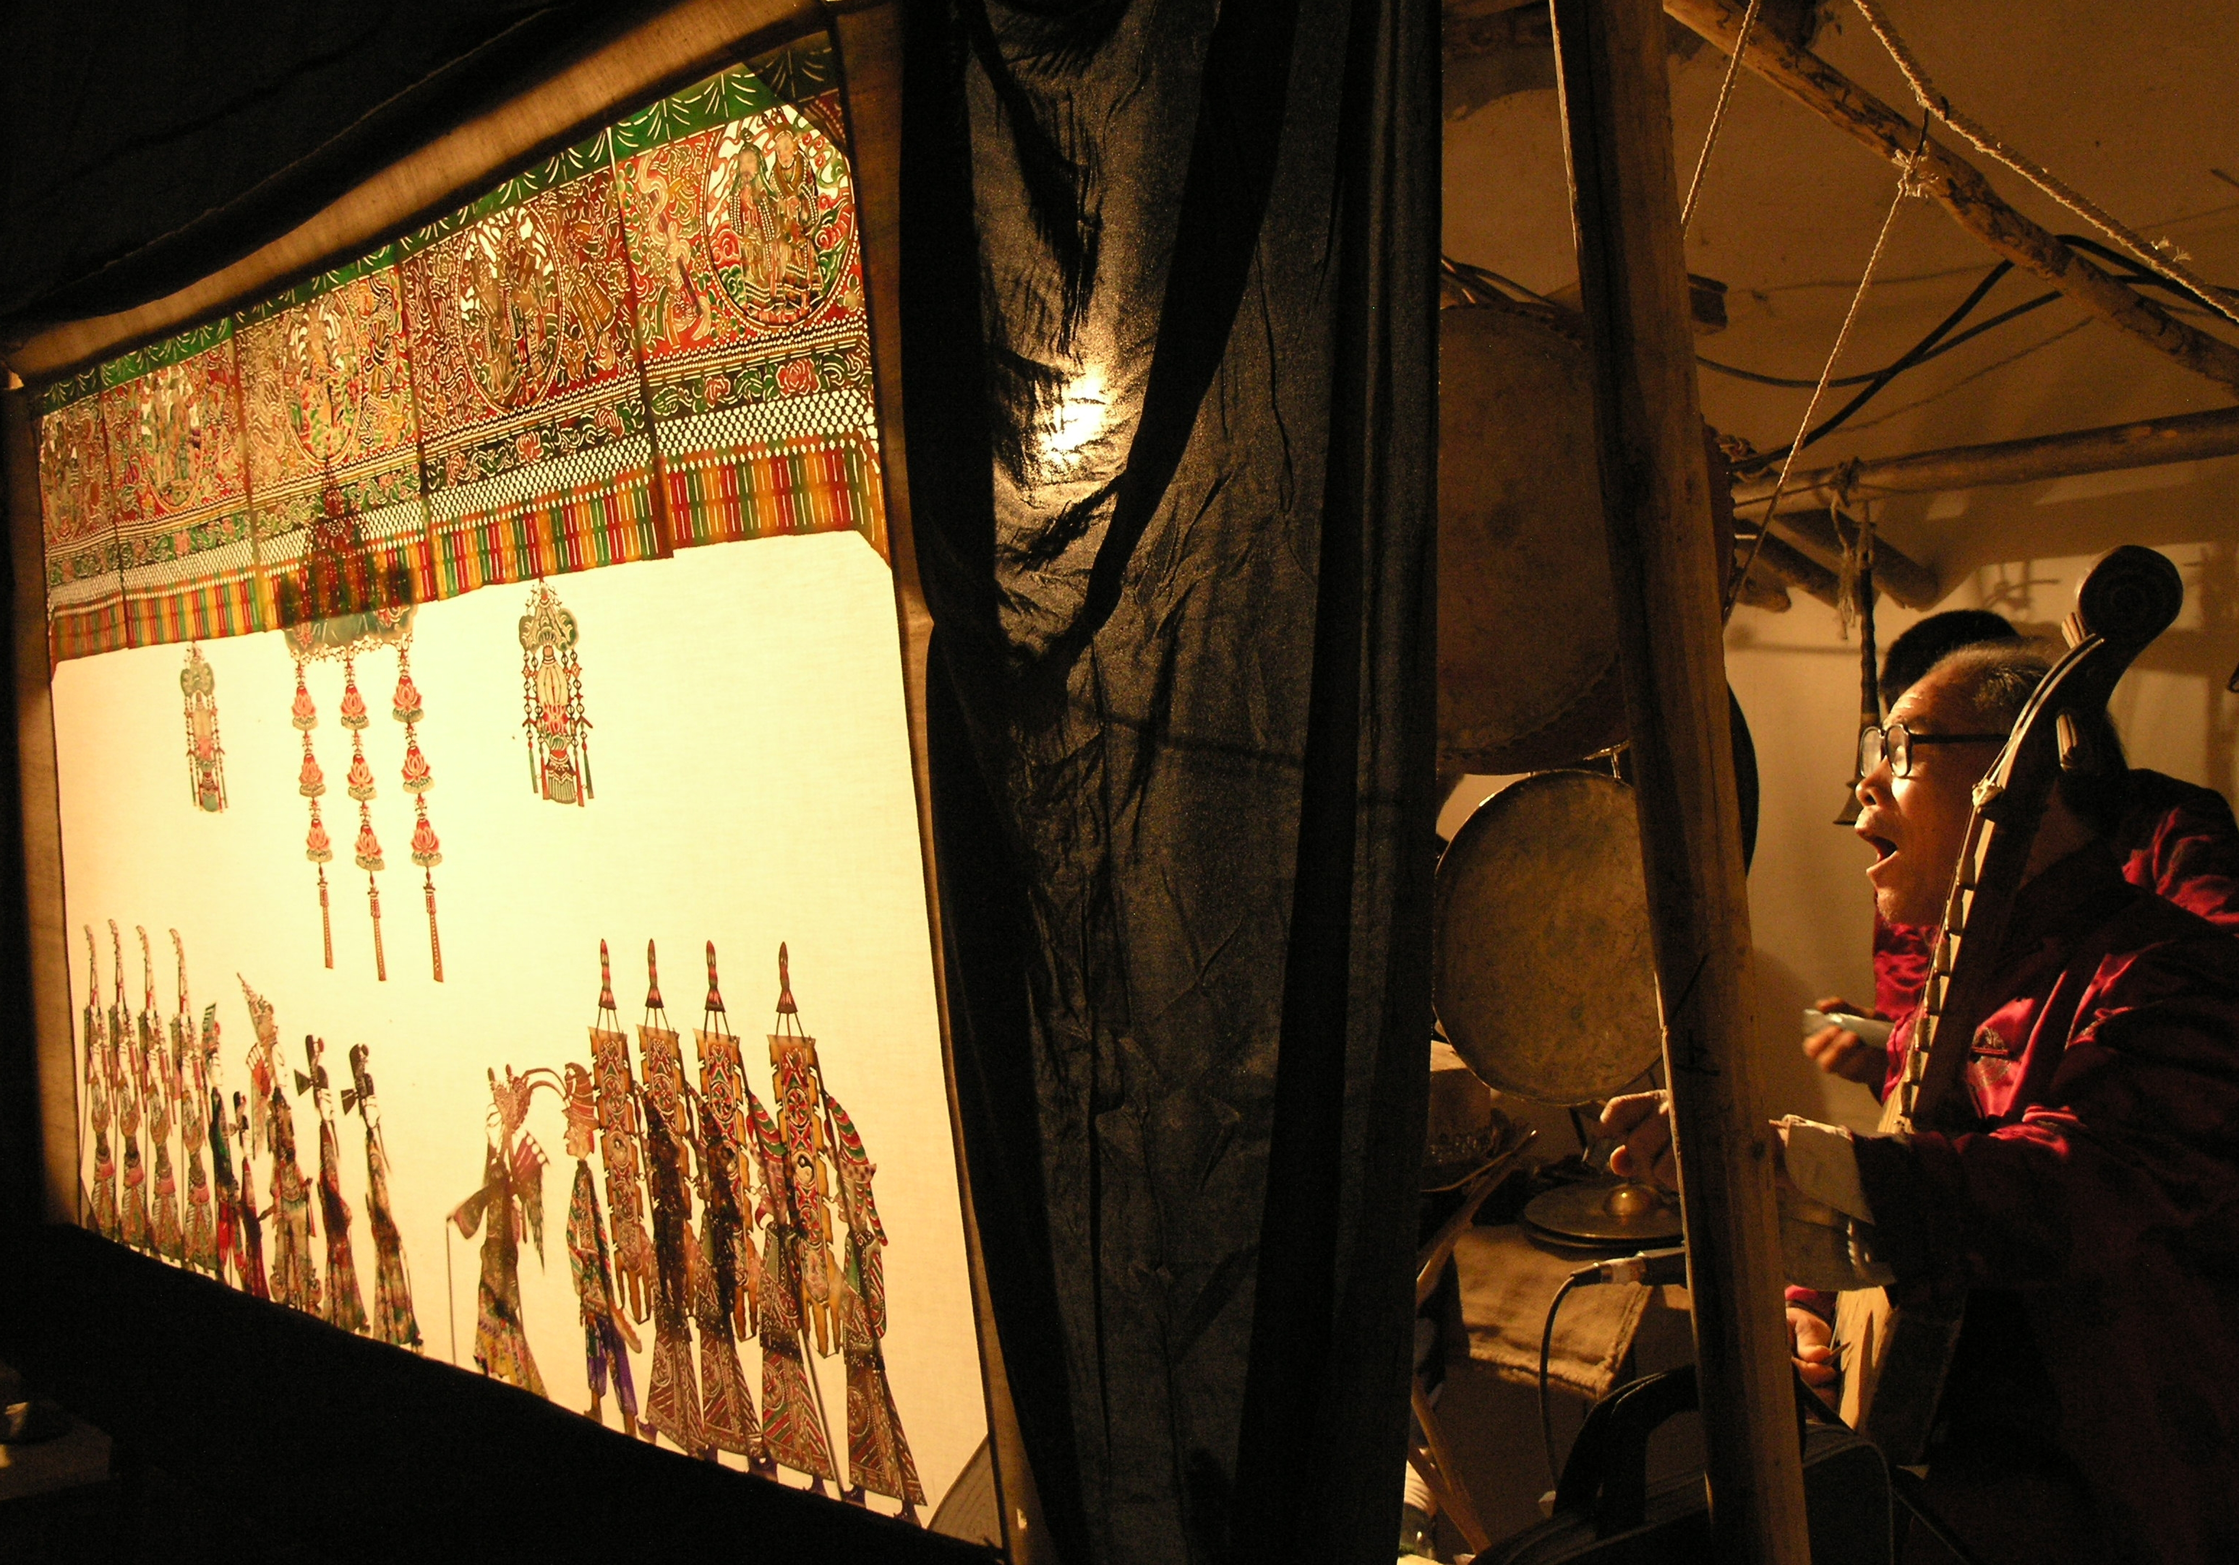
华州皮影戏—中国最古老的电影 Huazhou shadow play-the earliest film of China
非遗文化 丰富多彩 Rich and colorful intangible culture heritage

Slide 11
11
禀赋
Gift of Weinan

Slide 17
開放
渭南
The Opening Weinan

Slide 22
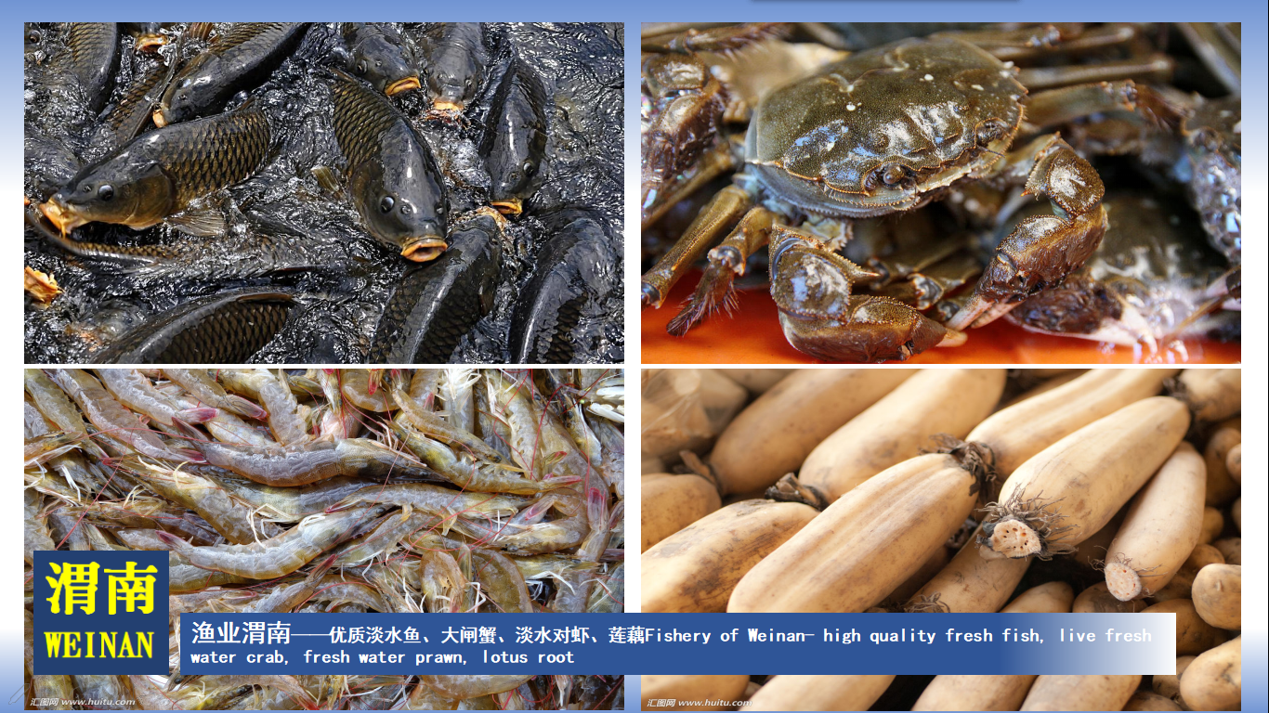

Slide 25
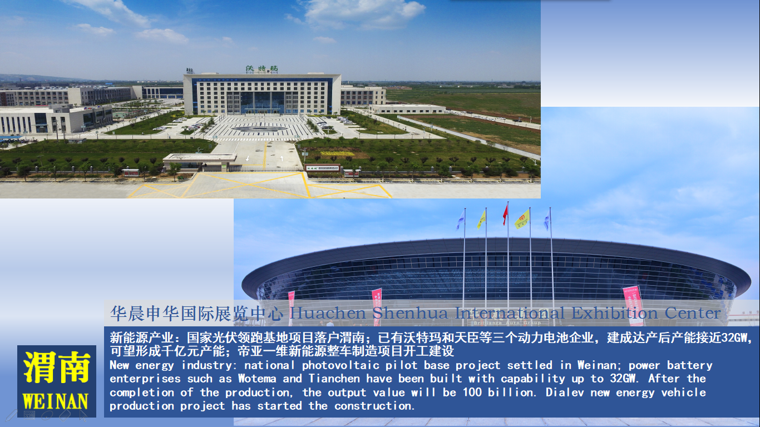

Slide 32
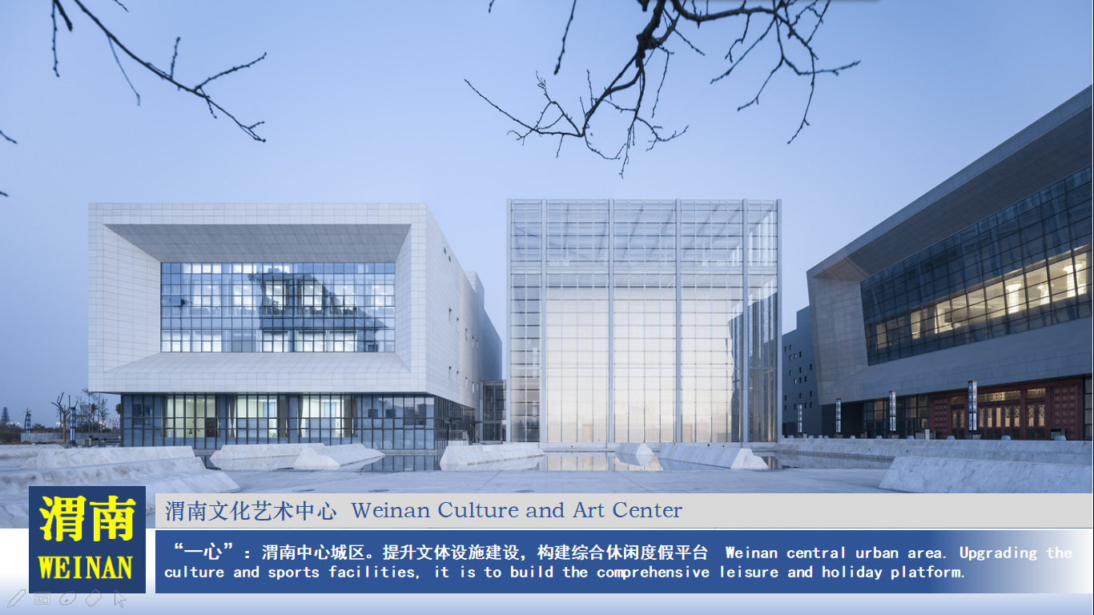

Slide 34
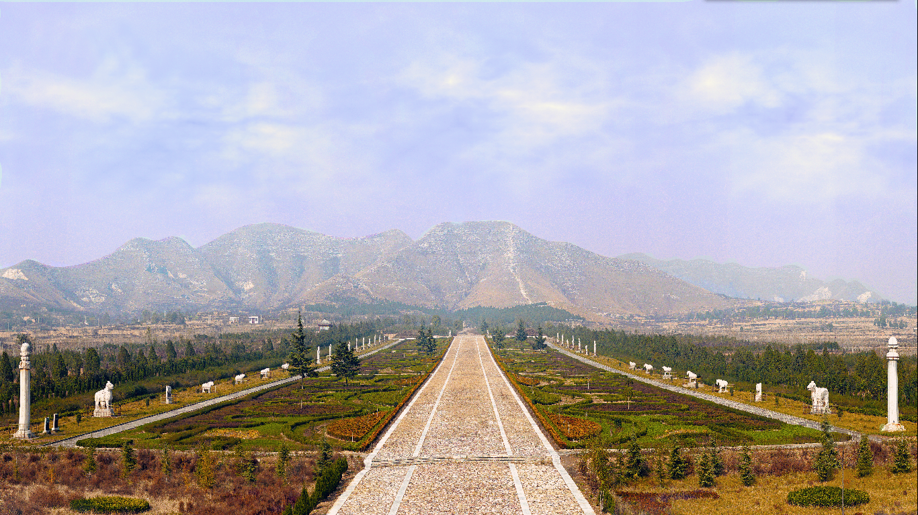
唐帝陵—蒲城桥陵全景Tang Emperor Mausoleum - the panorama of Pucheng Qiao Mausoleum
“四带”之二：渭北人文旅游带 The second of “four belts”: Weibei human culture tourism belt

Slide 37
魅力
渭南
Charming Weinan

