Slide 1
OPC UA for Industrie 4.0 in the mechanical engineering industry
Dr. Christian Mosch
Project Manager Industrie 4.0 Standardization
EUCC High Level Innovation Conference
Nanjing Tech Week, June 19, 2019
Forum Industrie 4.0
Notes:
It is my great pleasure and honor to be in my second time at this Flagship I40 B2B Conference. I appraciate the opportunity to give you an overview on VDMAs activities to support the digital transformation of the machine builders.

Slide 2
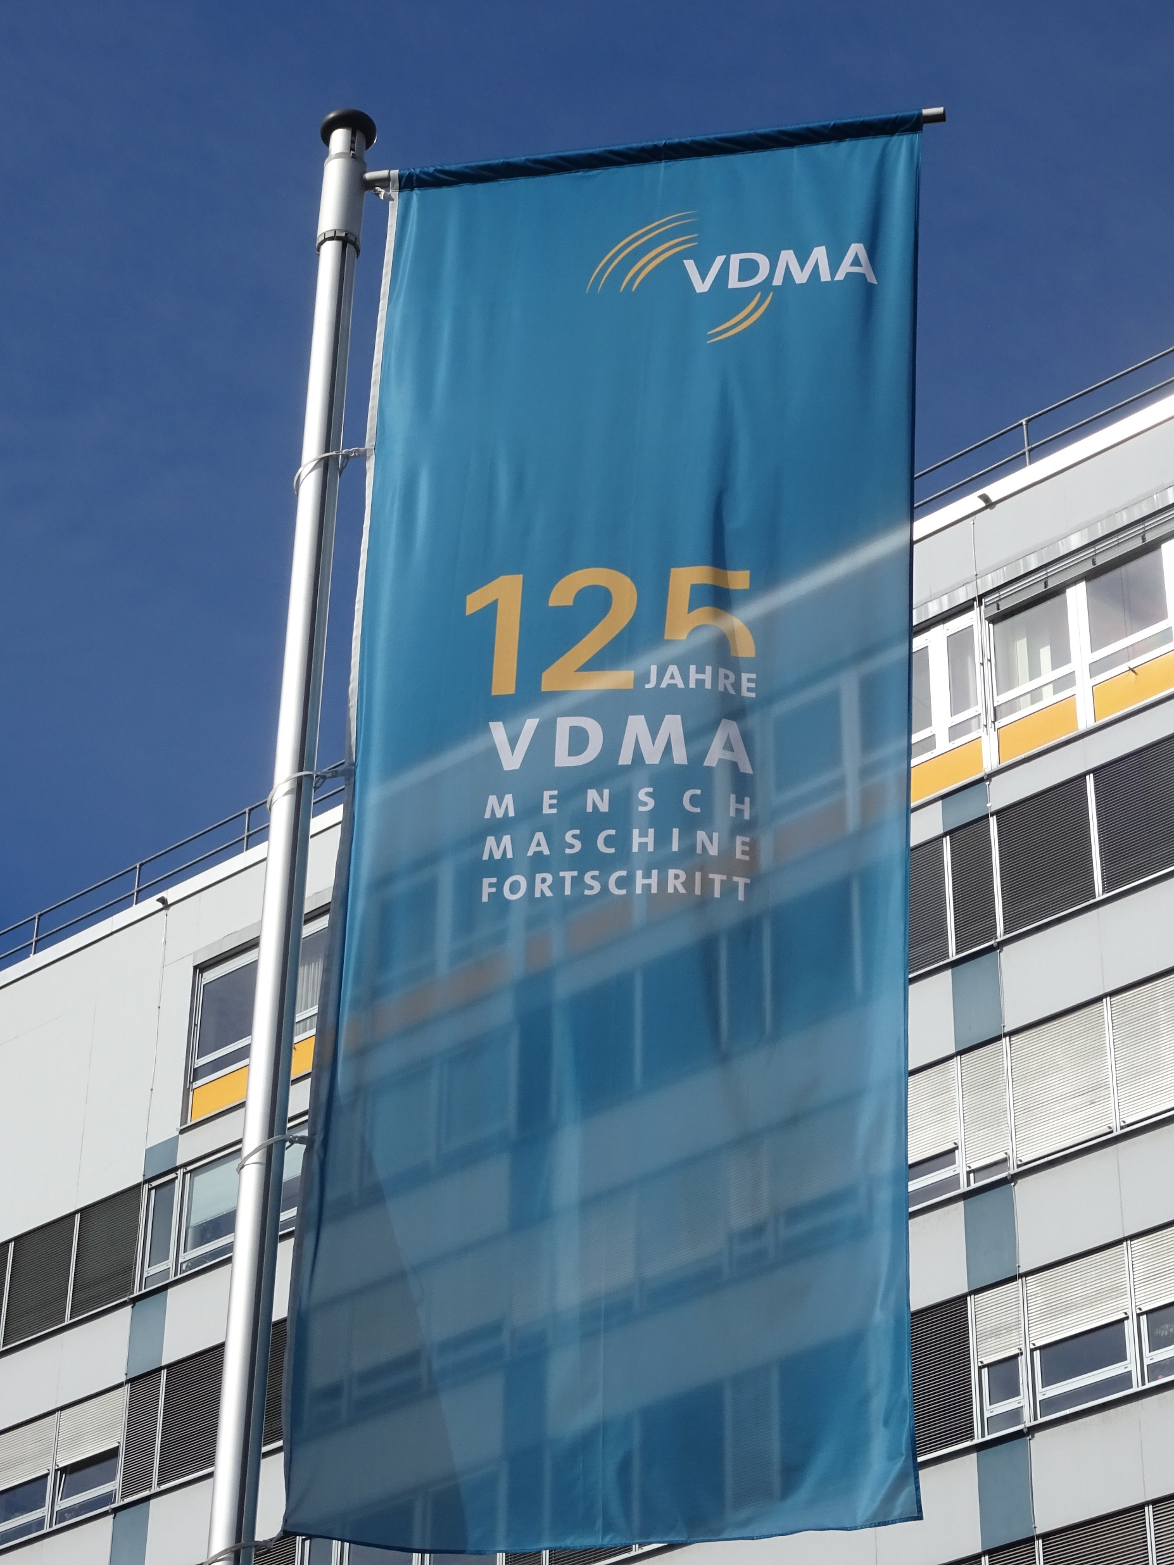
The VDMA – Facts and Figures
Most important industrial association in Europe.
The VDMA represents over 3,200 member companies in the engineering industry
The VDMA is structured in
38 trade associations,
6 regional subsidiaries,
Berlin, Brussels and foreign subsidiaries (Brazil, China, India, Japan, Russia, Austria)
The VDMA is host of several European and global sector committees
Communication
Information
CONTENTS
OPC UA Companion Specification
Standardized data and information

Slide 3
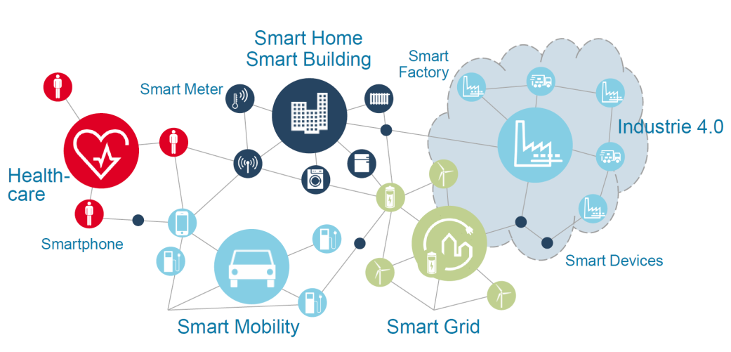
Industrie 4.0 Internet of Things and Services in the smart production
Graphic: Bosch-Rexroth

Slide 4

Need for machine interfaces
OPC UA is the favorite interface standard
Open Platform Communication Unified Architecture
The requirements of mechanical engineering are met
Communication on an open platform
Uniform architecture
Protocol independence
Based on Internet technology
Benefits for mechanical engineering
Plug & Work
Condition monitoring and predictive maintenance
Optimization of production
Retrofit of existing machines
Communication
Information
CONTENTS
OPC UA Companion Specification
Standardized data and information

Slide 5

VDMA focuses on OPC UA Companion Specification
Vendor Specific Extensions
OPC UA Companion Specifications
Built-in Information Models
OPC UA Meta Model
designed by Freepik

Slide 6

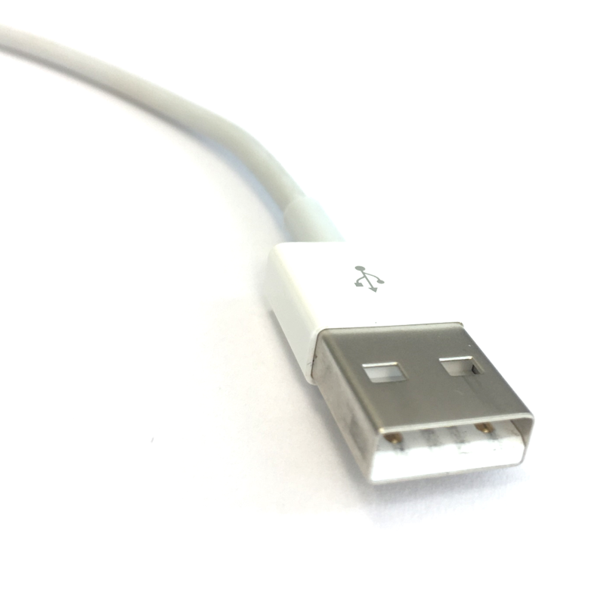
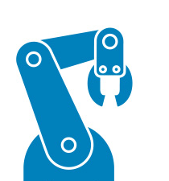
OPC UA Companion Specification define the semantic used in the data communication
Who are you?
Serve interoperability
Standardized information about machines from different manufacturers
Reduction of interfaces
Reduction of integration effort (plug & work)
Increase sales
SME can more easily integrate and position themselves as solution providers
Opening of closed production and system landscapes
Early and efficient Implementation of new digital business models
What job can you offer?
OPC UA Companion Spec.
Injection Moulding Machine
Move product with 110 kg.
I am a robot from KUKA.
I can move products.
I can move max. 150 kg.
OPC UA Companion Spec.
Robotics
Enabler technology for AI

Slide 7
Today's position on OPC UA in the VDMA organizational units
Agricultural Machinery
Air Conditioning and Ventilation
Air Pollution Control
Air-handling Technology
Building Control and Management
Cleaning Systems
Compressors, Compressed Air and Vacuum Technology
Construction Equipment and Building Material Machines
Drying Technology
Electrical Automation
Electronics, Micro and Nano Technologies
Engine Systems for Power and Heat Generation
Engines and Systems
Fire Fighting Equipment
Fluid Power
Food Processing Machinery and Packaging Machinery
Foundry Machinery
Gas Welding
Glass Industry
Hydro Power
Integrated Assembly Solutions
Large Industrial Plant Manufacturing
Lifts and Escalators
Machine Tools and Manufacturing Systems
Machine Vision
Materials Handling and Intralogistics
Measuring and Testing Technology
Micro Technologies
Mining
Plastics and Rubber Machinery
Power Systems
Power Transmission Engineering
Precision Tools
Printing and Paper Technology
Process Plant and Equipment
Productronic
Pumps + Systems
Refrigeration and Heat Pump Technology
Robotics
Security Systems
Software and Digitization
Surface Treatment Technology
Textile Care, Fabric and Leather Technology
Textile Machinery
Thermal Process Industry
Thermal Turbines and Power Plants
Valves
Waste Treatment and Recycling
Wind Energy
Woodworking Machinery
OPC UA CS Release (Candidate)
OPC UA CS under development
Awareness existent

Slide 8
Today's position on OPC UA in the VDMA organizational units
Agricultural Machinery
Air Conditioning and Ventilation
Air Pollution Control
Air-handling Technology
Building Control and Management
Cleaning Systems
Compressors, Compressed Air and Vacuum Technology
Construction Equipment and Building Material Machines
Drying Technology
Electrical Automation
Electronics, Micro and Nano Technologies
Engine Systems for Power and Heat Generation
Engines and Systems
Fire Fighting Equipment
Fluid Power
Food Processing Machinery and Packaging Machinery
Foundry Machinery
Gas Welding
Glass Industry
Hydro Power
Integrated Assembly Solutions
Large Industrial Plant Manufacturing
Lifts and Escalators
Machine Tools and Manufacturing Systems
Machine Vision
Materials Handling and Intralogistics
Measuring and Testing Technology
Micro Technologies
Mining
Plastics and Rubber Machinery
Power Systems
Power Transmission Engineering
Precision Tools
Printing and Paper Technology
Process Plant and Equipment
Productronic
Pumps + Systems
Refrigeration and Heat Pump Technology
Robotics
Security Systems
Software and Digitization
Surface Treatment Technology
Textile Care, Fabric and Leather Technology
Textile Machinery
Thermal Process Industry
Thermal Turbines and Power Plants
Valves
Waste Treatment and Recycling
Wind Energy
Woodworking Machinery
Rapid increase of new OPC UA CS working groups
More than 16 VDMA sector branches under discussion
Over 17 VDMA sector branches in active (international) implementation
About 23 OPC UA CS working groups existing
Over 350 companies are involved
ME, ET, IT, Automotive, ...
OPC UA CS Release (Candidate)
OPC UA CS under development
Awareness existent

Slide 9


If you think of OPC UA – Get in touch with the VDMA!
We need ONE worldwide ACCEPTED standard!
Machine builders do not need borders – they need free flow of information
The “one-stop-shop” of standards is the real benefit
Build the basis for a smooth AI integration of machines
Contradictory standards lead to heterogeneity again
Use the network in the VDMA
Save the work-intensive coordination
Save the acceptance of chinese developments also in Europe
Use the representative offices in China
Daniel Yoo, Chief Representative Shanghai

Slide 10
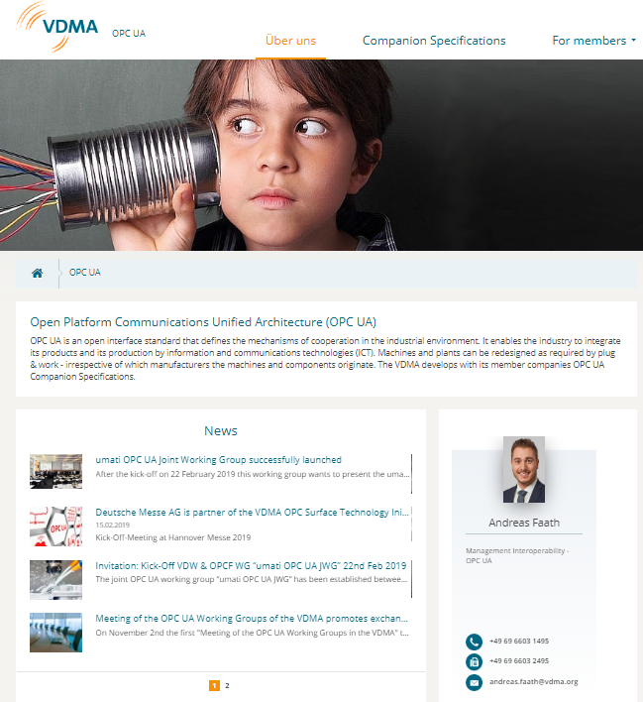
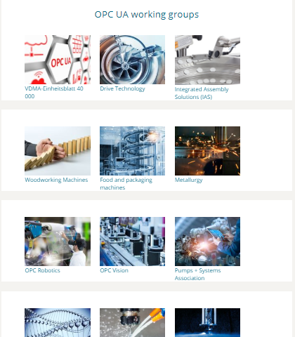
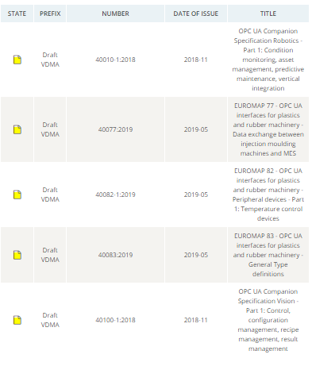

Stay informed at http://opcua.vdma.org

Slide 11

Guideline Industrie 4.0 Communication with OPC UA
Benefit
VDMA positioning to OPC UA
Favor development of OPC UA Companion Specifications
Designed for small and medium-sized enterprises of the VDMA
Content
Benefit: Why should manufacturers implement OPC UA
Migration path: How should manufacturers implement OPC UA
Guideline shows the steps that companies must take to ensure interoperability in the industrial environment.
Guideline available in Chinese and English
https://opcua.vdma.org/
Industrie 4.0-Kommunikation mit OPC UA

Slide 12


Thank you for your attention!
Dr. Christian Mosch
Project Manager Industrie 4.0 Standardization / Interoperability
VDMA Forum Industrie 4.0
christian.mosch@vdma.org

Slide 13

iStock Sadeugra

