Slide 1
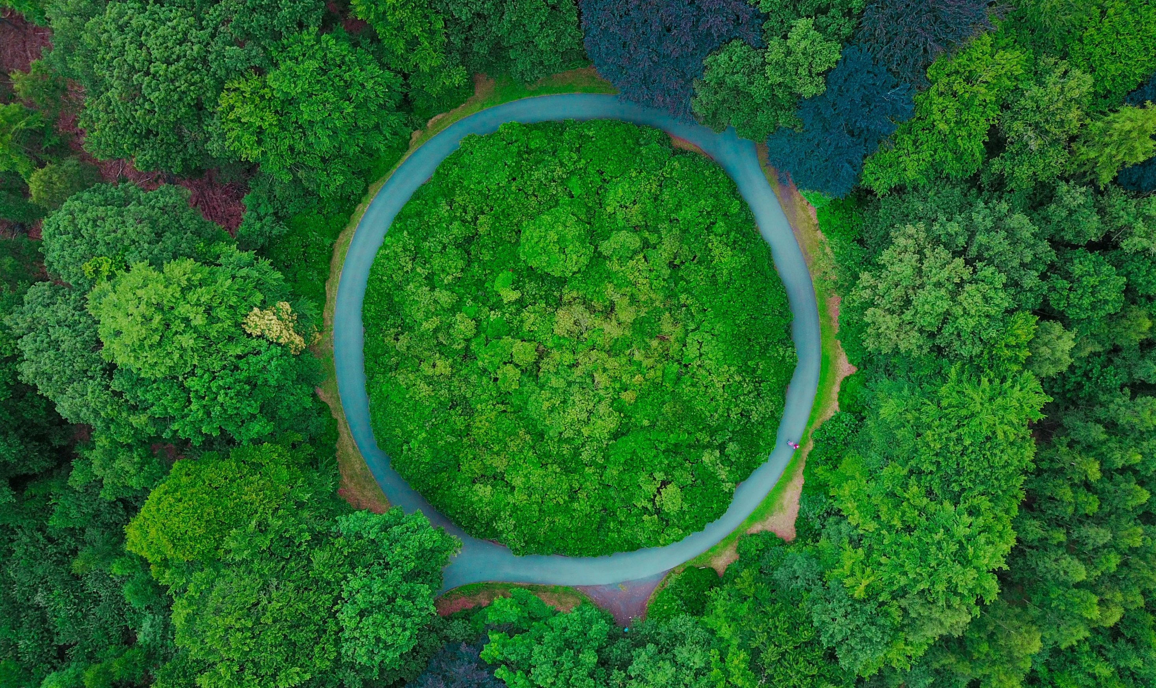
How blockchain can be used in Circular Economy developments?
2nd Webinar: Circular Economy and Blockchain Innovations
IUC Pilot Project Granada Competitive Fund
Thursday, 4th November 2020
Mr. Raul Daussa, Climate and Cities Expert
IUC Asia Programme

Slide 2
AGENDA
WHAT IS THE CIRCULAR ECONOMY?
TECHNICAL and biological LOOPS
BIOGAS AND BYCICLES
KEY DRIVERS and ENABLERS
WIN-WIN solution for all actors
BLOCKCHAIN TECHNOLOGY
WASTE MANAGEMENT

Slide 3
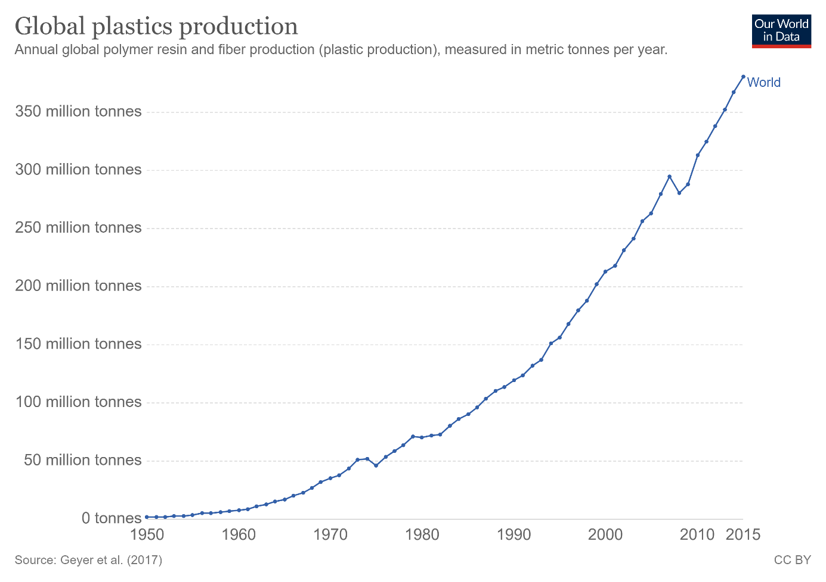

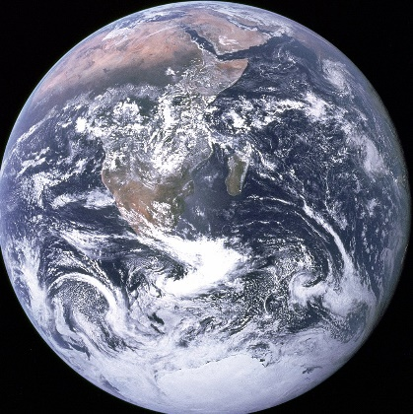
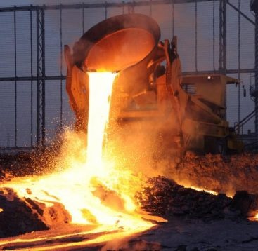
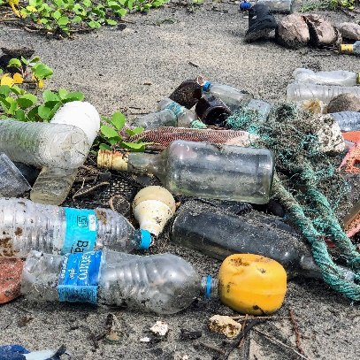
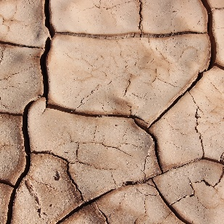
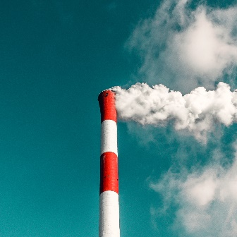
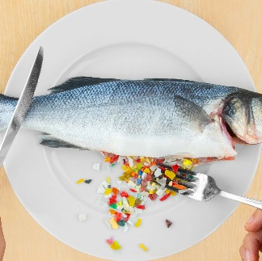
WE LIVE IN A LINEAR ECONOMY….
TAKE MAKE WASTE
VALUE
LEAKAGE

Slide 4
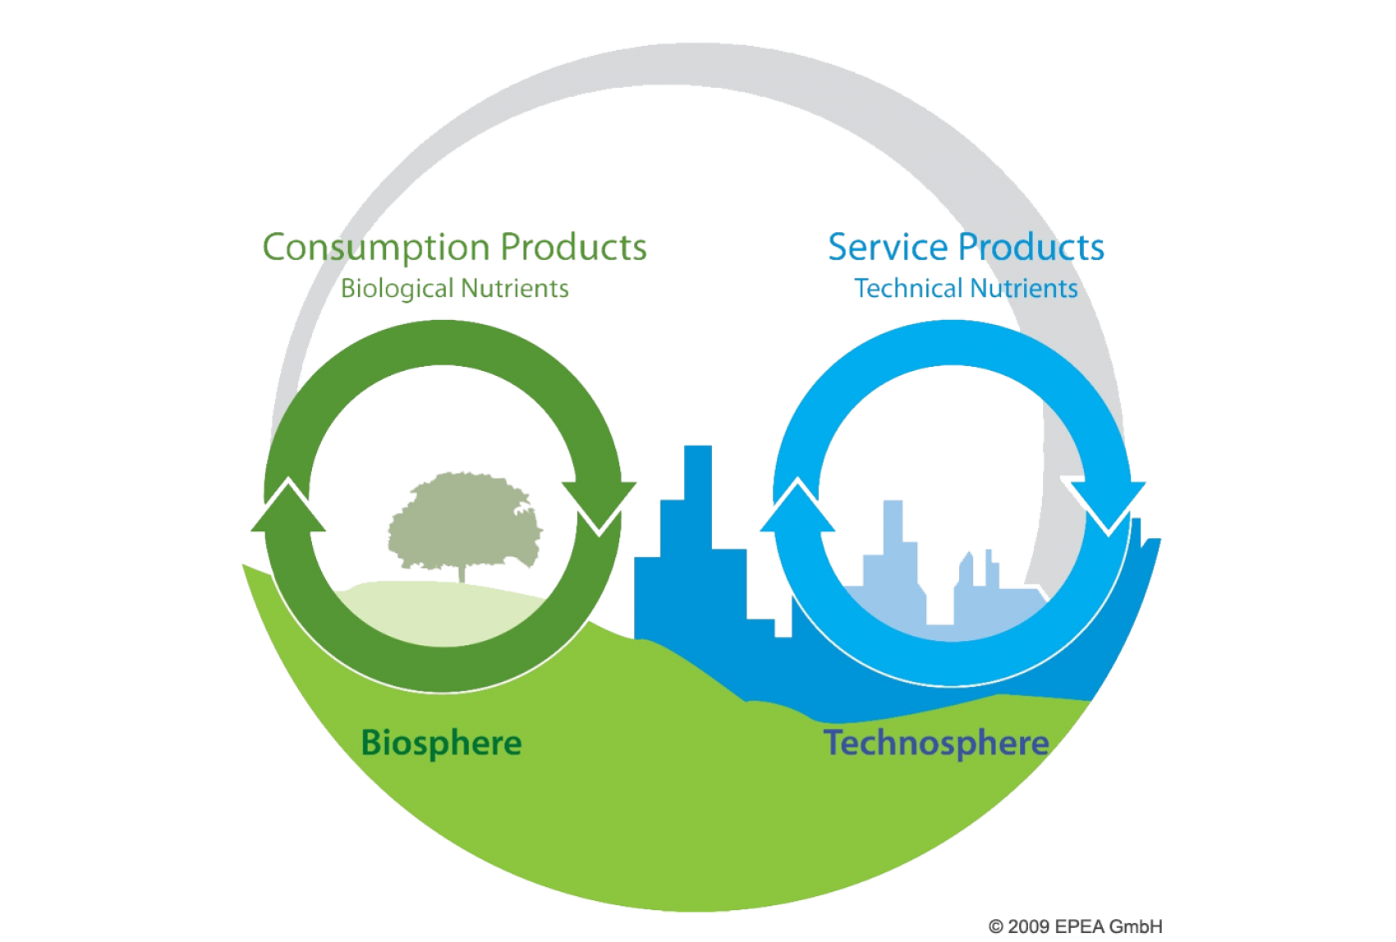
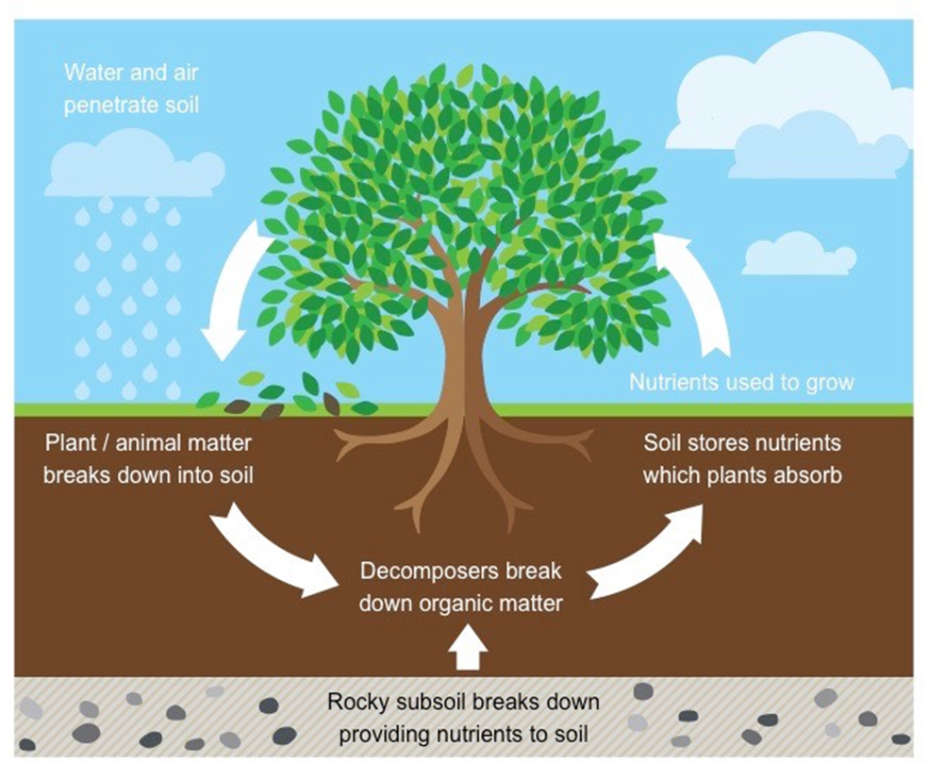
WHILE NATURE WORKS IN CICLES…
SCHOOLS OF THOUGHT
CRADLE TO CRADLE
PERFORMANCE ECONOMY
BIOMIMICRY
ELLEN MCARTHUR FOUNDATION

Slide 5
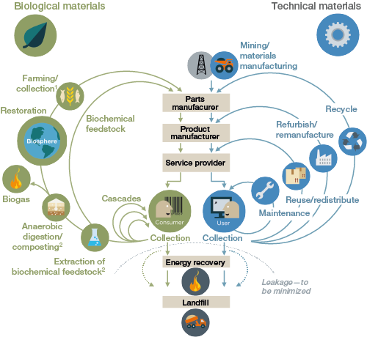
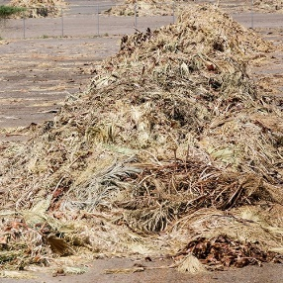
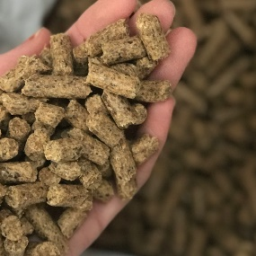
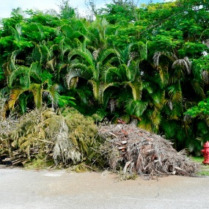
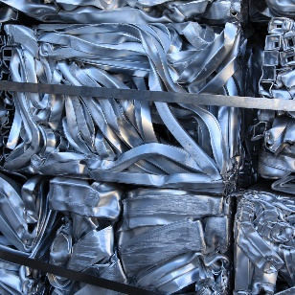
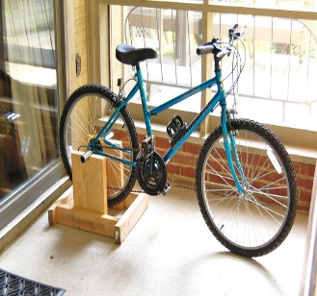
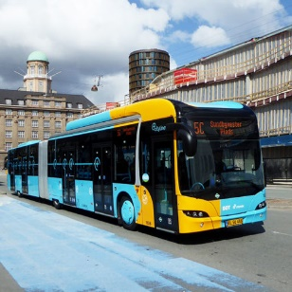
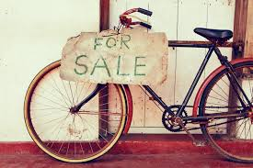
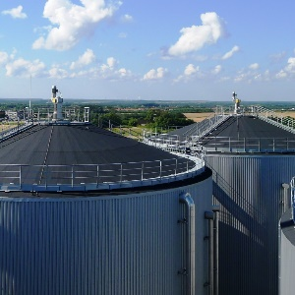
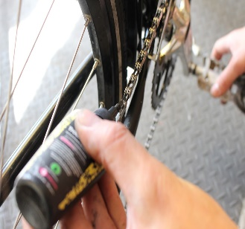
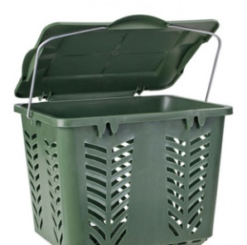
TECHNICAL LOOPS
BIOLOGICAL LOOPS

Slide 6
KEY DRIVERS
Climate change
Resource scarcity
Fourth Industrial Revolution
Customer expectations
Regulation, legislation

Slide 7
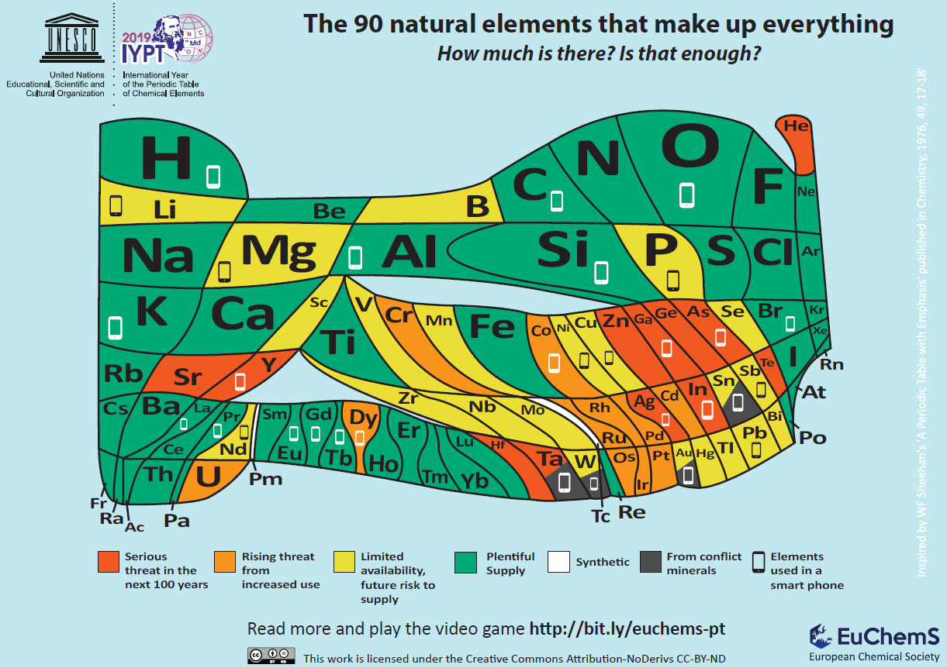
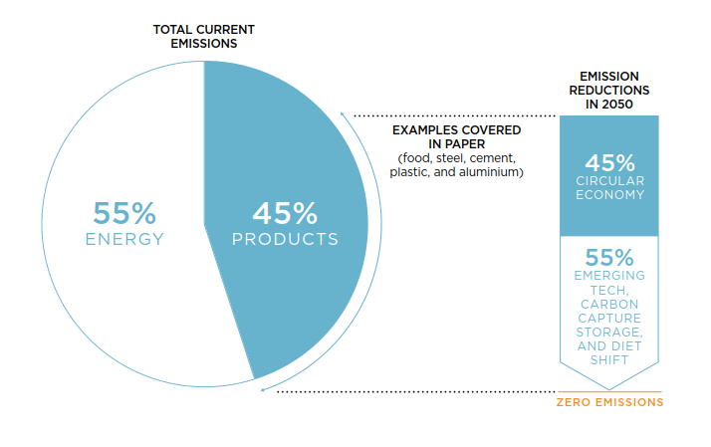
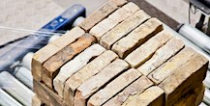
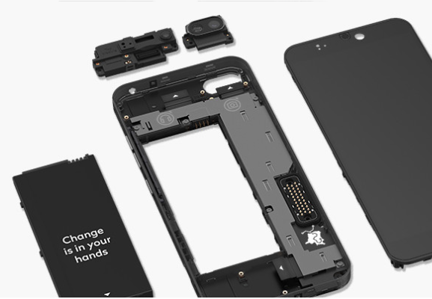


Climate Change and RESOURCE SCARCITY
Source: Ellen Macarthur Foundation "Completing the Picture: How the Circular Economy Tackles Climate Change)

Slide 8
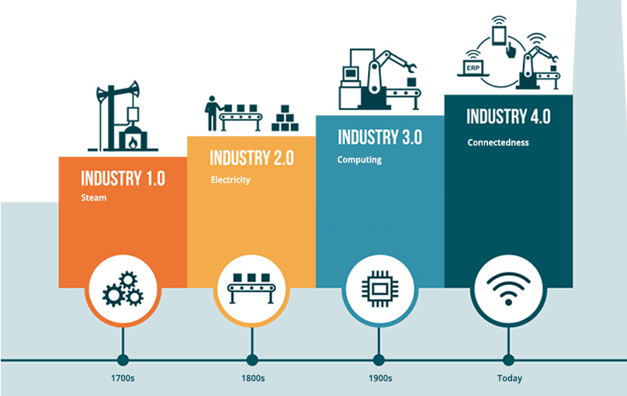
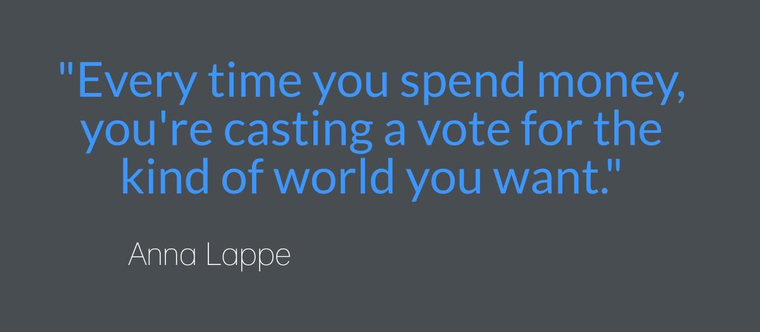
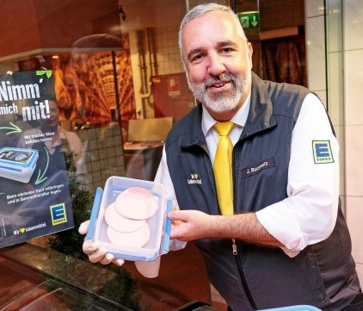
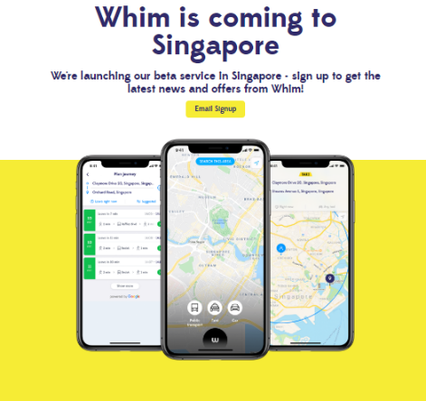


4th Industrial Revolution and Customer Expectations

Slide 9

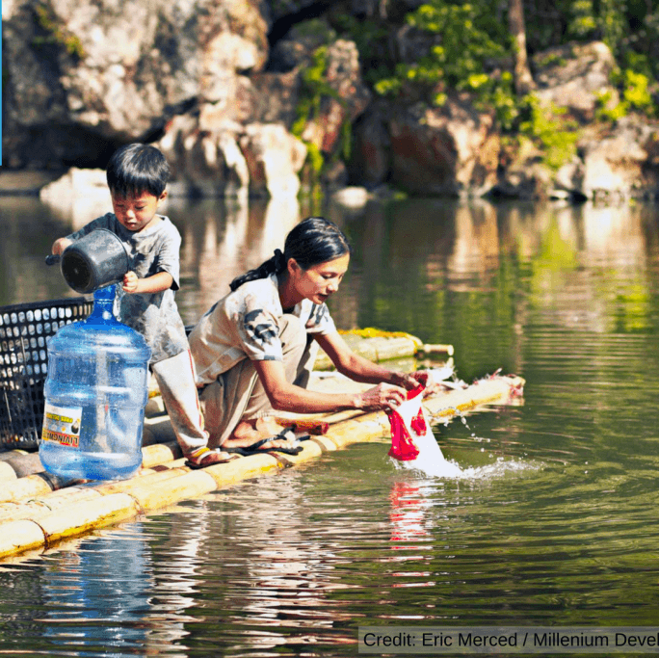

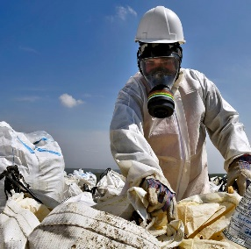

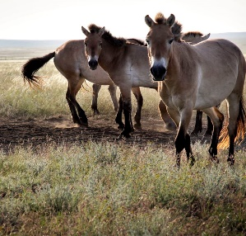

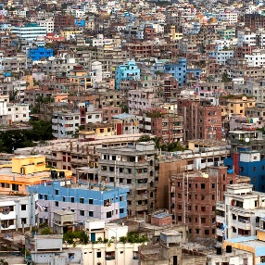
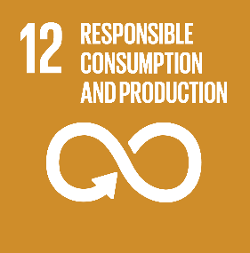


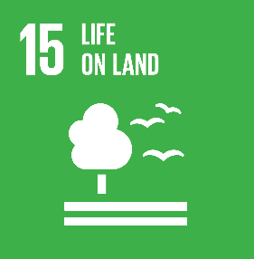

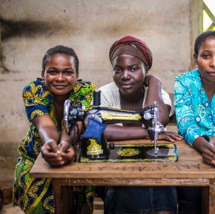

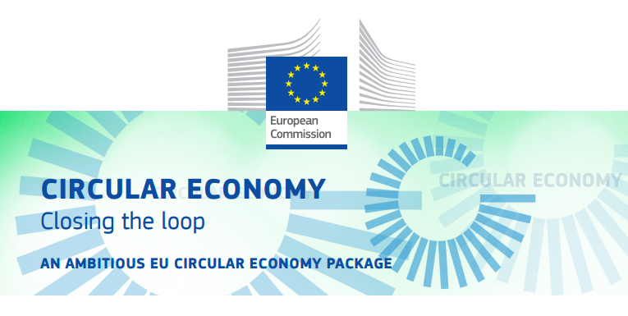
Key Driver – REGULATION AND LEGISLATION
.
Sets targets for National Governments:
To recycle 70% of packaging waste by 2030
To recycle 65% of municipal solid waste by 2035
To reduce landfill to a maximum of 10% of municipal solid waste by 2035

Slide 10
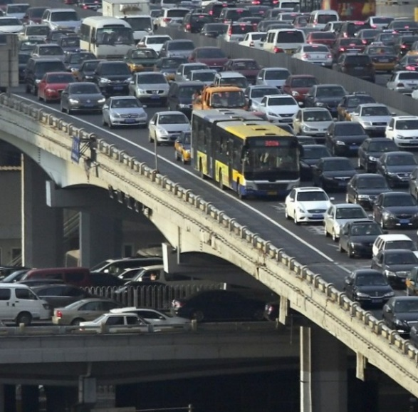
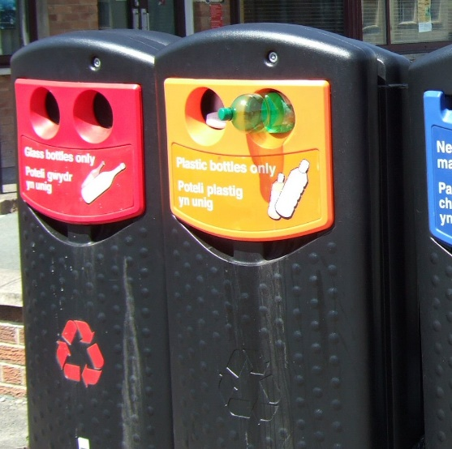
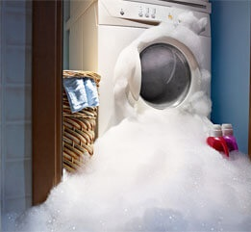
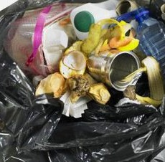
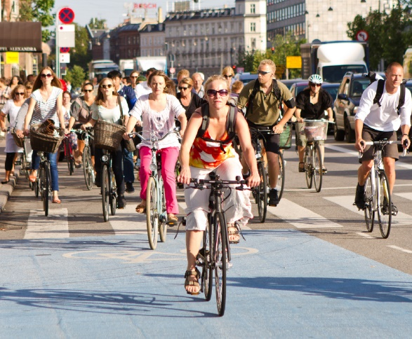
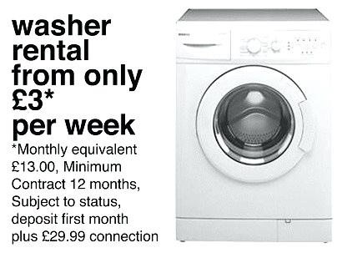
WIN-WIN solution for all actors
POLICY MAKERS
From Regulator to Enabler
PRIVATE SECTOR
From producer to service provider
CONSUMERS
From passive user to active citizen

Slide 11
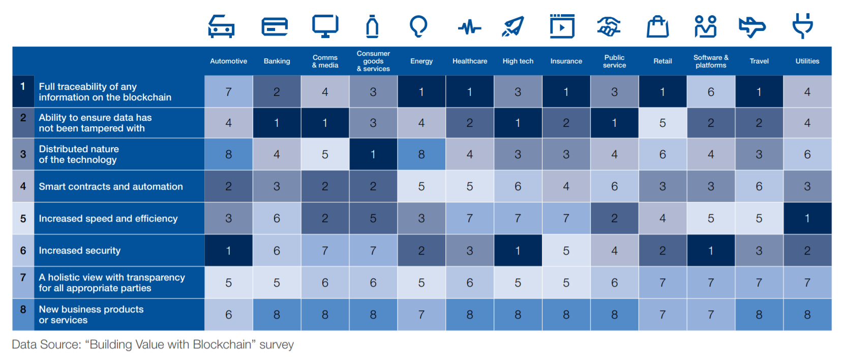
Blockchain - maintain the supply chain continuity

Slide 12
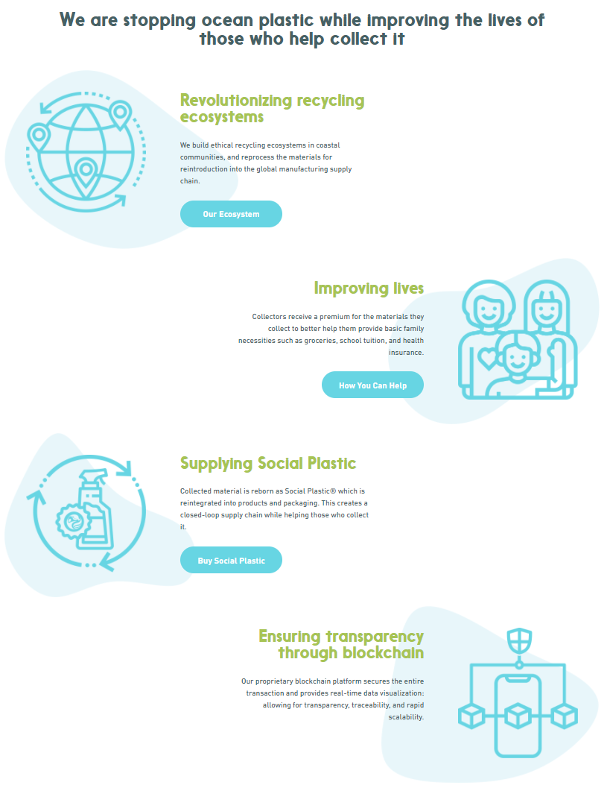

Blockchain – WASTE MANAGEMENT
Collect, Sort, Transport & Treat
Identifying Materials for Recycling
Notes:
Blockchain allows real-time tracking of waste management. It helps to track the amount of waste collected, who collected it, and where it is being moved for recycling or disposal

Slide 13
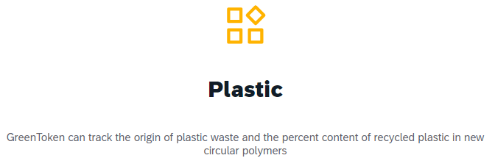

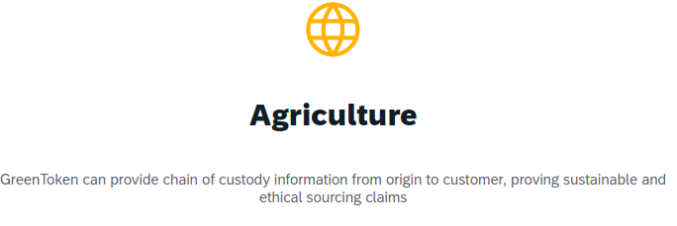
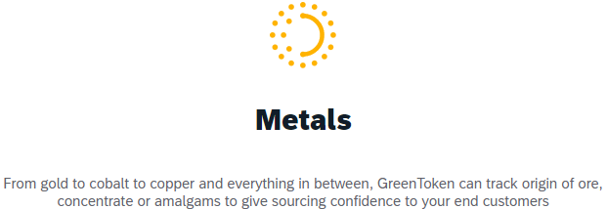
Blockchain – WASTE MANAGEMENT
Extended Producer Responsibility
Notes:
GreenToken is a supply chain solution that offers companies a new level of transparency in their complex raw material supply chain. We help consumers make ethical buying decisions and improve people’s lives.

Slide 14
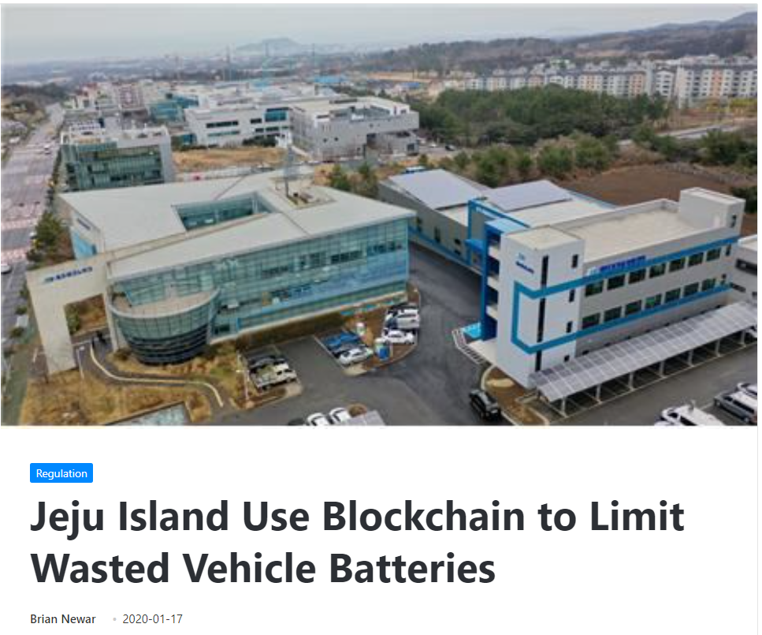
Blockchain – WASTE MANAGEMENT
Classifying and Tracking Hazardous Materials
Notes:
The management system tracks the history of the receipt of waste-batteries collected at the Jeju Technopark Electric Vehicle Battery Industrialization Center, which opened last June. The data collected will include information about various inspections, classifications, and releases, and will be recorded via blockchain.

