Slide 1
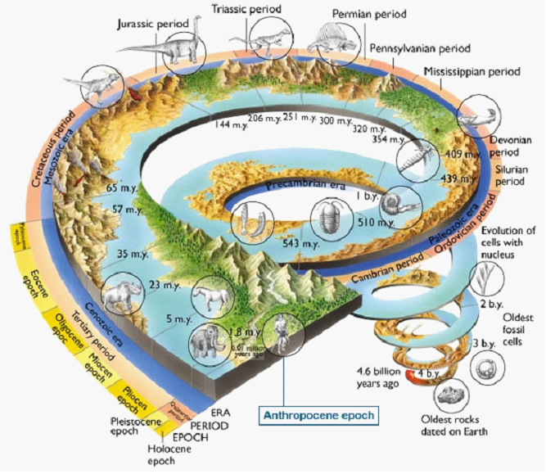
Using Blockchain Technology
in Risk Governance of Circular Economy Development
YE Qian
叶谦
Integrated Risk Governance Project
Beijing Normal University
IUC 2nd Webinar 2020.11.5

Slide 2
Outline
Background: Anthropocene - New Challenge
Circular Economy: a Systematic Analytic Framework
Blockchain technology: Risk Credit
Some thoughts

Slide 3
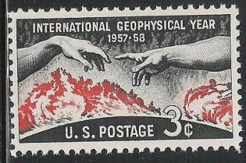

Background
International Geophysical Year(1957-1958)
In 1952, proposed by International Council of Scientific Unions (ICSU) and finally became the first international cooperation program including 67 countries.
ONLY 60 YEARS: Understanding our Earth at Global scale using modern technologies

Slide 4
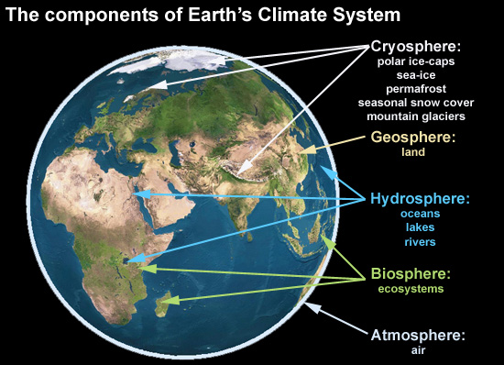
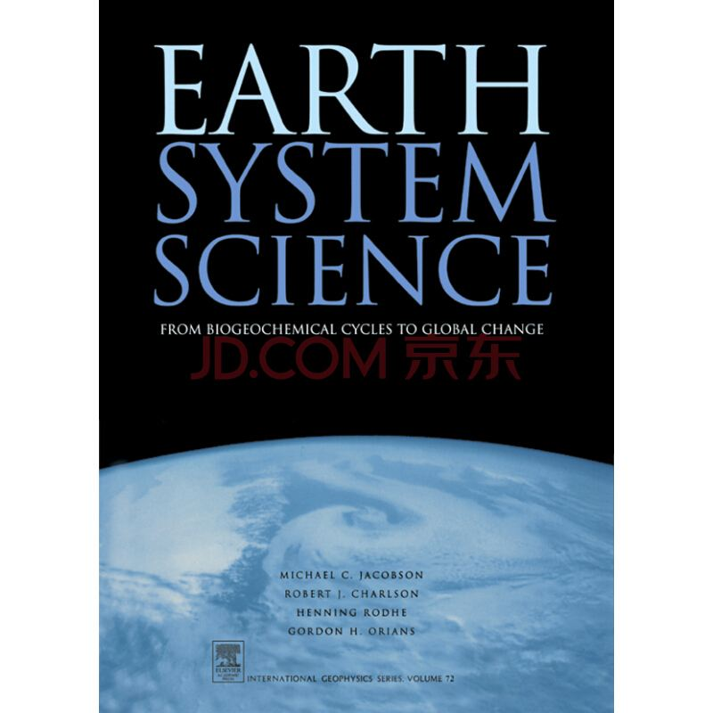
Earth Sytem Science（1987): a new Earth Science

Slide 5
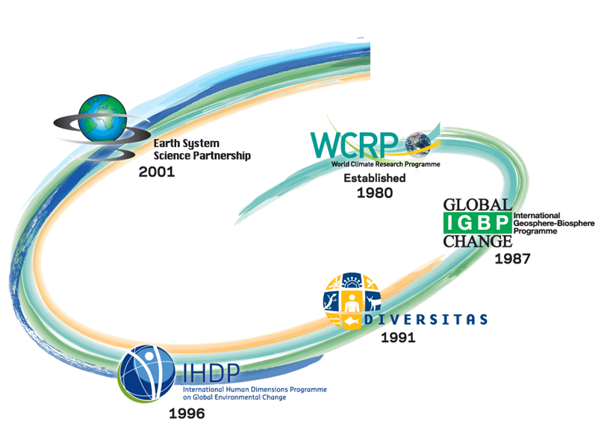
International Cooperative Research Programs

Slide 6
Anthropocene: a new Geological Era
（Proposed in 2000 and approved in 2019）

Slide 7
Fact and Challenge 1: Great Acceleration

Slide 8
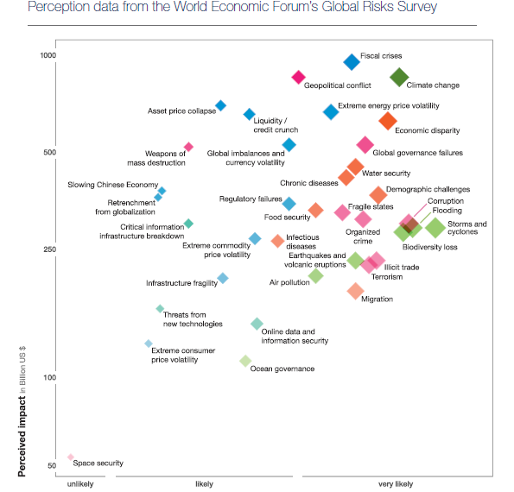
Fact and Challenge 2:
Complex and High Connetivity
引自世界经济论坛

Slide 9
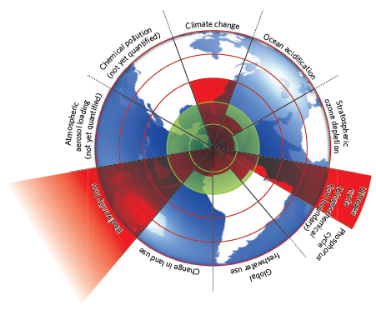
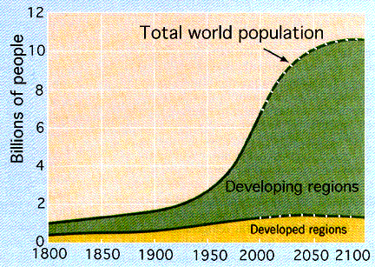

：
Fact and Challenge 3:
Irreversible Processes and Tipping Point
Planet Boundary
Demography
Urbanization

Slide 10
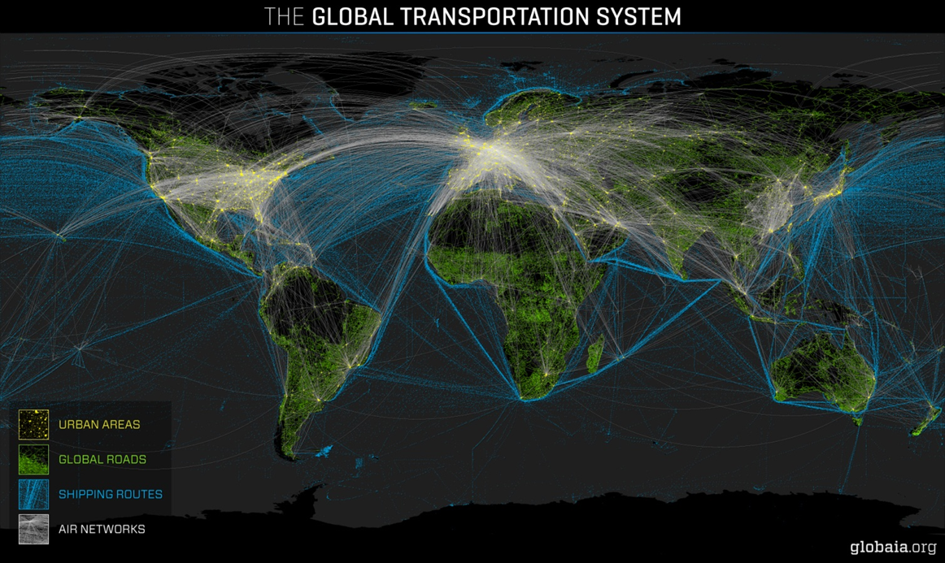

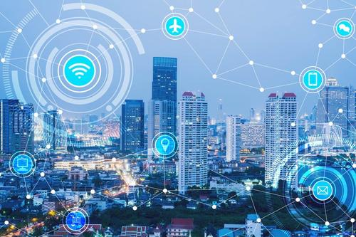
Fact and Challenge 4: New Technology
Smart City
Digital City
Circular Economy
....

Slide 11
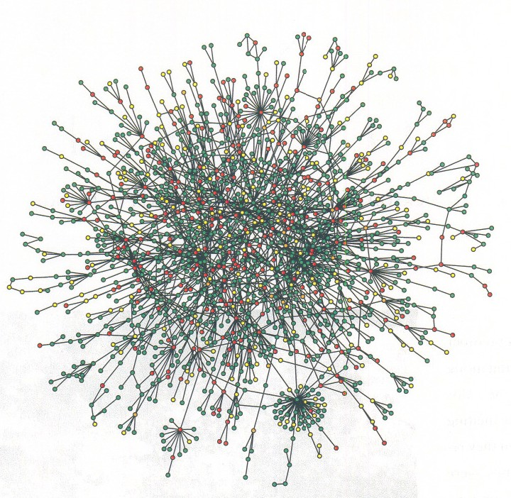
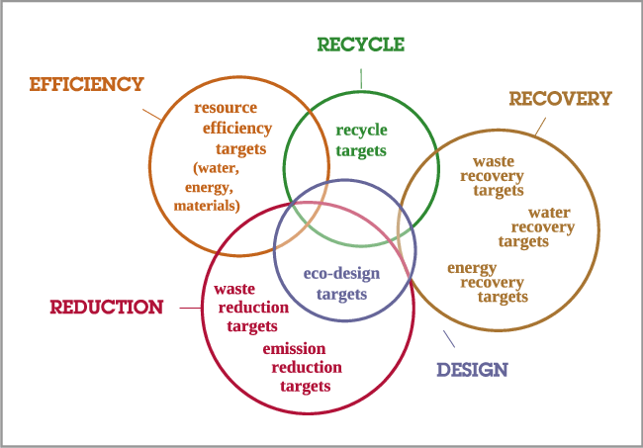
Circula Economy from concept to reality

Slide 12
Commoner’s “4 Laws of Ecology”
Everything is connected to everything else.
Everything has to go somewhere or there is no such place as away.
Everything is always changing.
There is no such thing as a free lunch.

Slide 13

Circula Economy and Risks
Economy
CE
Ecosystem
(ISEETS)
An Analytic Framework
Earth Systems
Emergence
Emergence
Institutional Systems
Complexity and Connectity
Economic Systems
Emergence
Emergence
Emergence
Sociological Systems
Technological Systems

Slide 14
Institutional-Socio-Earth-Economical-Technical-Systems
ISEETS Framework
Factors Inducing Systematic Risks in
Development of Circular Economy
Complexity: Elements in five intrinsically interlinked sub-systems in the Anthropocene
Connectivity: Non-linear DYNAMIC relationships among the elements lead to ‘‘tipping points’’ which commonly refers to a critical threshold at which a tiny perturbation can qualitatively alter the state or development of a system (Lenton et al. 2012).
Emergence: Ability of individual components of a large system to work together to give rise to dramatic and diverse behavior and new features.
Earth Systems
Emergence
Emergence
Institutional Systems
Tipping Points
EconomicSystems
Emergence
Emergence
Emergence
Sociological Systems
Technological Systems

Slide 15
Key Risk
The lesson learned from successful experiences is that the transition towards CE comes from the involvement of ALL ACTORS of the society and their CAPACITY to link and creat suitable collaboration and exchange patterns.
-Ghisellini, et al, 2016: A review on cicular economy: The expected tranistion to a balanced interplay of environmental and economic systems

Slide 16
New mechanism to deal with three issues
How to get all stakeholders' involvement (Trust)
How to strengthen their capacity (Self-learning)
How to creat collaboration/exchange patterns (Awarding)

Slide 17
Blockchain Technology to support Systematic Risk Governance in the Development of CE

Slide 18
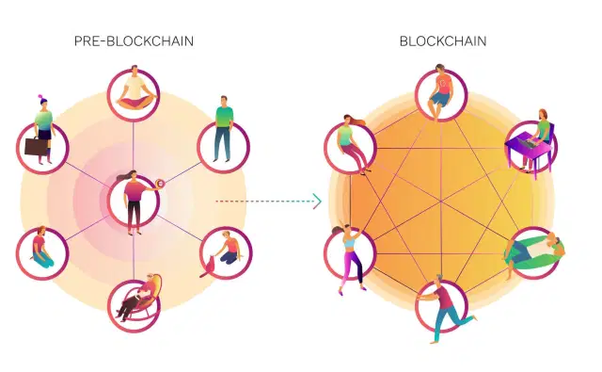
Three Pillars of Blockchain Technology
  Decentralization:
  Transparency
  Immutability

Slide 19
A “Risk Credit” system build-upon Blockchain Technology
Step 1: Identify and Co-design actions needed from all stakeholders for development of CE
Step 2: Put value on actions, especially on involvement, capacity building and collaboration/exchange
Step 3: Setup rules to award or punish the action taken by the stakeholder
Step 4: Using Blockchain technology to monitor and measure actions and progress of development of CE

Slide 20
Summary: Anthropocene
We are NOW in the era of Anthropocene, to meet the challenges from systematic risks which are induced by high complexity and connetivity, having an ability of system think is a MUST

Slide 21


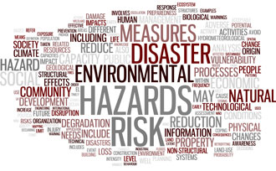
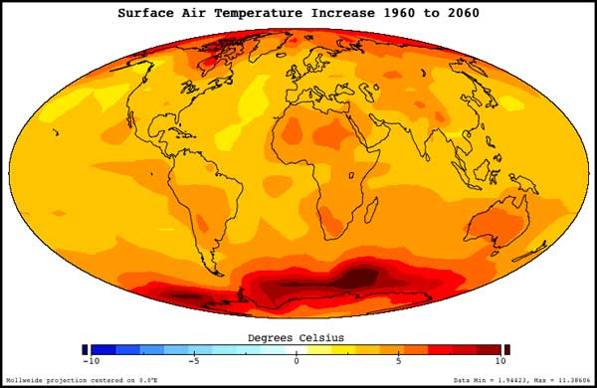

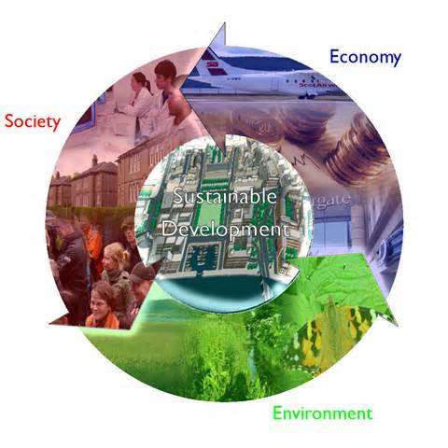
Summary : Incorporating DRR, CCA and SDG in the development of Circular Economy
2015: The Peak Year for Global Environment
New Global Governance
Future Earth Program
International Scientific Community

Slide 22
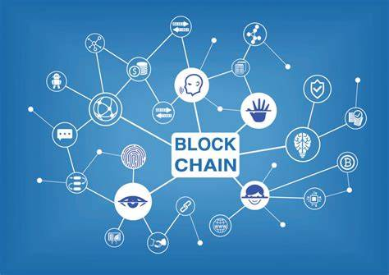
Summary : “No Free Lunch” in Risk Society
Utilizing blockchain technology with the support system science theory, analytic framework such as ISEET could help dealing with emerging risks in the development of CE

Slide 23
Last but the Most important
It is REALLY, REALLY, REALLY urgent to educate and train Knowledge Brokers with multidisciplinary, interdisciplinary and interdisciplinary abilities

Slide 24
Thank you!

