Slide 1

SEMiLLA IPStar
Terrestrial Applications of the MELiSSA Space research Consortium
© 2020, SEMiLLA IPStar –

Slide 2
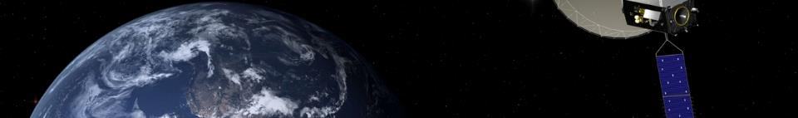
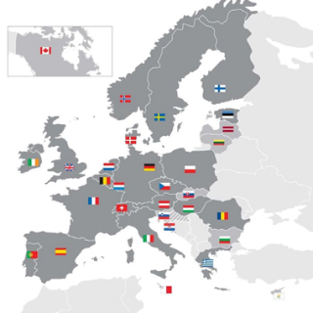
ESA
E U R O P E A N S P A C E A G E N C Y
founded in 1975
executes European space policies
22 member states
cooperation with NASA, Russia, Japan et cetera
yearly budget > 5.7 billion EURO (2019)
ESTEC/ESA: largest research facility (Noordwijk, The Netherlands)

Slide 3
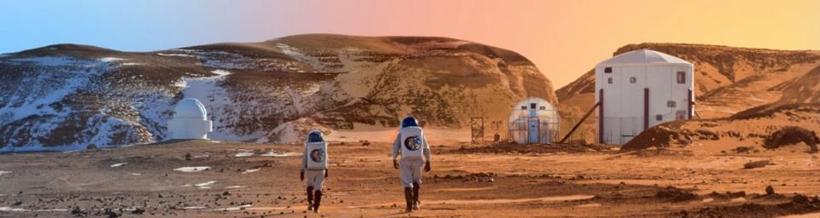
t h e c h a l l e n g e
A round trip to Mars takes approximately: 1000 days
Crew of 6 requires 5 kg per day of food, water and O₂ as the bare minimum (each)
Total minimum required supplies: 30.000 kg

Slide 4
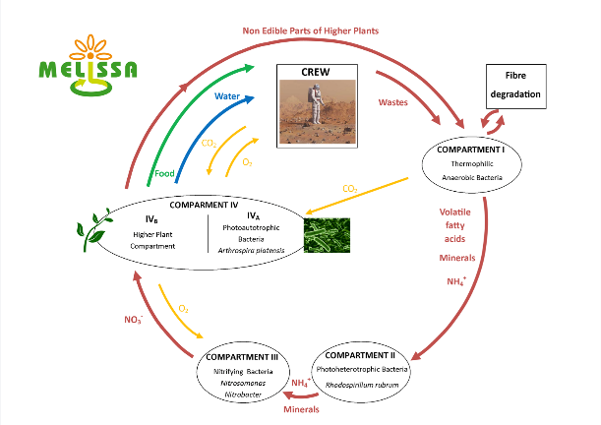
Why is MELiSSA unique?
The only initiative that has adopted a system approach

Slide 5













MELiSSA partners

Slide 6
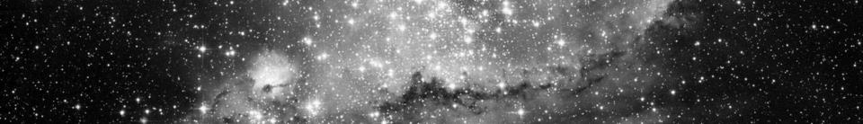
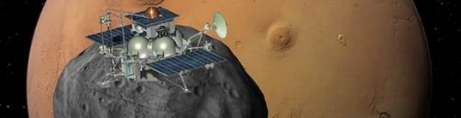
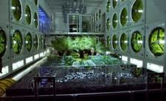
SEMiLLA IPStar
founded in 2005 to identify technology transfer opportunities
Formal member of the MELiSSA consortium which brings a priviliged position
  access to all know-how and technology developed over decades
  2 x per year MELiSSA meeting
  frequent contacts with members and ESA
  use of facilities ESA (meeting / conference rooms and labs)

Slide 7
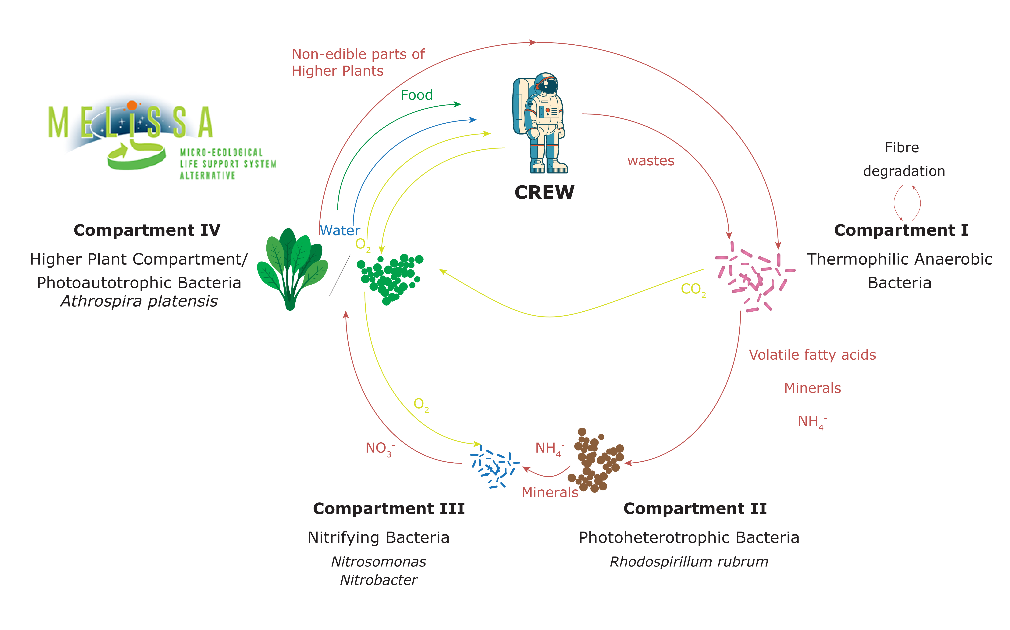
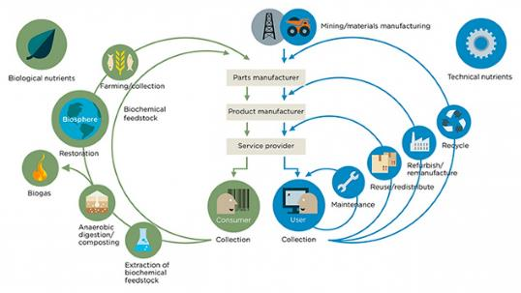
From space...
...to Earth

Slide 8
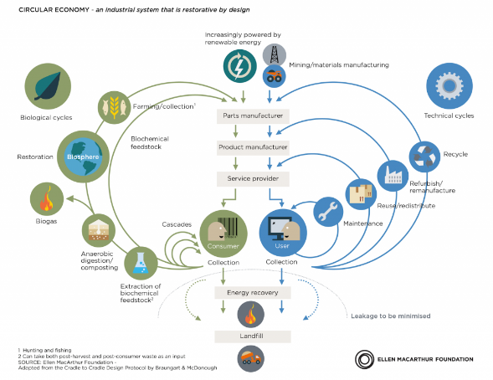
What’s Circular Economy?

Slide 9
And what about blockchain?
Blockchain is a powerful tool to help achieving the Circular Economy goals
Circular Economy needs a robust infrastructure to share information
Some examples:
  Industrial Symbiosis: Exchange of byproducts
  Supply chains: localization, agility and digitalization
  Traceability of materials

Slide 10
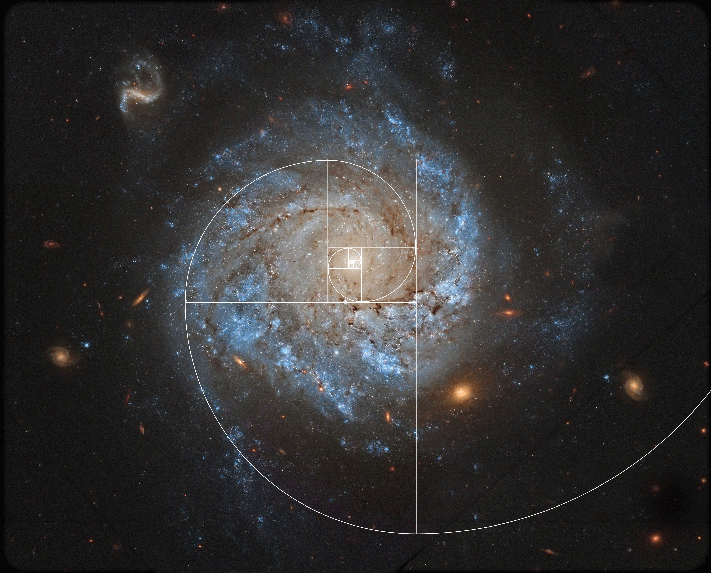
Thank you
Clara Plata Ríos
clara.plata@semilla.io
cplata@uma.es
www.semilla.io
info@semilla.io

