Slide 1


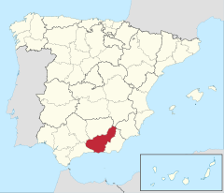


Granada Water Company (Emasagra)
Gonzalo Jiménez Espinosa
Sustainable Development and Research & Innovation Director - Coordinator for Circular Economy

Slide 2



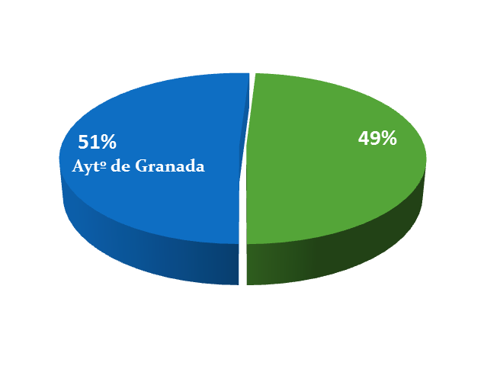
Shareholders
Emasagra
Empresa Municipal de Abastecimiento y Saneamiento de Granada

Slide 3
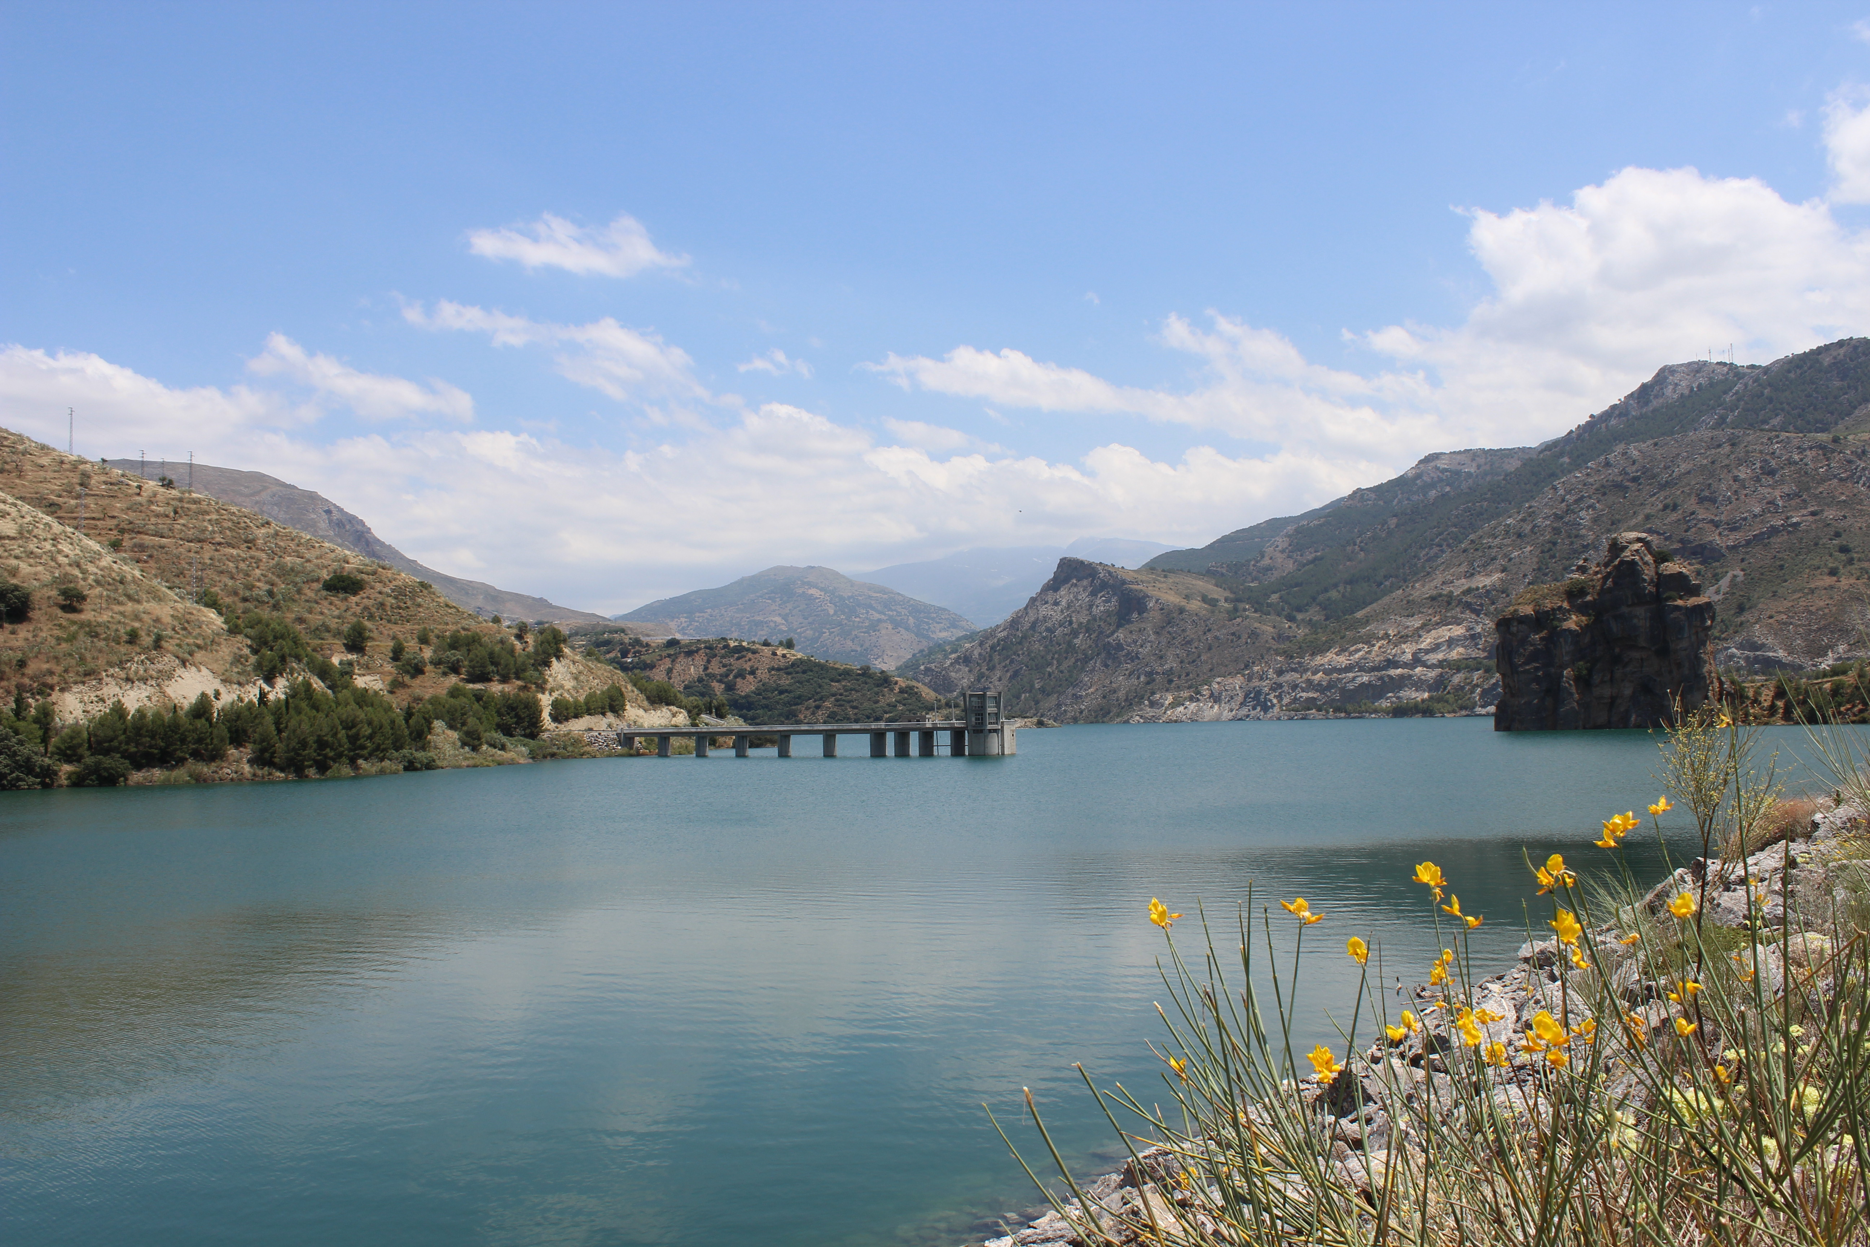
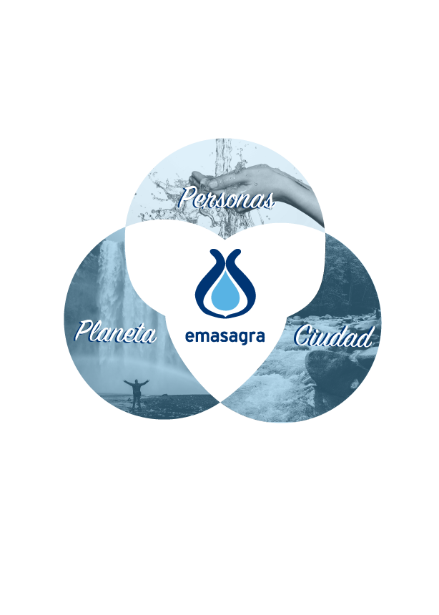
MAIN FIGURES
7.159 tCO₂e
15
Emissions avoided
Municipalities
Digital
Innovator
Social
Sustainable
213
385.677
Citizens we serve
Direct employees
221.926
WWTP treated water
25.147.608 m³
Clients
31.921.141 m³
37.338.119 m³
Production WTP 2018
Water Supplied

Slide 4

CIRCULAR ECONOMY
Commitment 1.
We are leading the fight against climate change in water management.
Commitment 2.
We preserve water as a
source of life.
Commitment 3.
From linear to circular.
Commitment 4.
We protect and recover natural spaces.
Water Management
Trough the Strategic Plan for Sustainable Development (2017-2021), Emasagra DISS, we reinforce the circular economy model in our activity

Slide 5

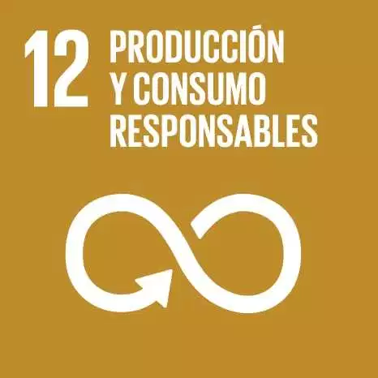










CIRCULAR ECONOMY
New Paradigm: Biofactory
To achieve a circular model through energy generation, water reuse and recovery of waste resulting from the purification process thus generating a positive impact on society and biodiversity
Old Paradigm: Sewage Treatment Plant
Purify waste water to preserve the environment and people`s health
Water Management
Generators of renewable electric power
Valorization of sands and Grease for compost
Waste Water
Waste Water
Change of paradigm in sewage treatment. Starting point of the Circular Economy in Granada
Energy consumers
Valorization of sludges for agriculture
Waste generators:
Sands
Sludges
Grease
Rags and large objects
Etc.
Generators of biofuels and thermal energy​
Return clean wáter to the environment
Water reuse for different uses

Slide 6
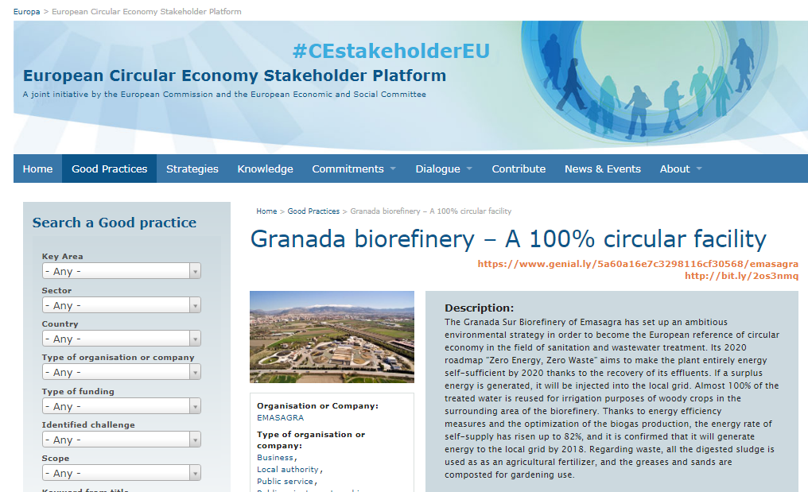


CIRCULAR ECONOMY
Water Management
Change of paradigm in sewage treatment. Starting point of the Circular Economy in Granada
CASE STUDY
SUEZ facilities have potential to generate alternative resources,
including water, energy and secondary raw materials, and contribute
to the protection of natural resources. In Spain, SUEZ’s Granada
wastewater treatment plant has become a biofactory, where all of
the treated wastewater and sewage sludge is used in agriculture. The
grease and sand produced are converted into compost and, after 2020,
the surplus electricity generated by the plant will be injected back into
the distribution network. In Chile, the wastewater treatment plants of
Aguas Andinas have been awarded the Momentum for Change Award
of the United Nations Framework Convention on Climate Change for
their balanced benefits on people’s quality of living and on the health of
the ecosystem.

Slide 7
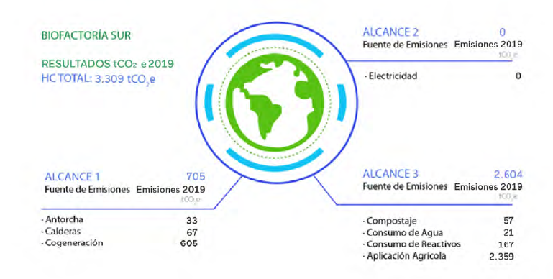
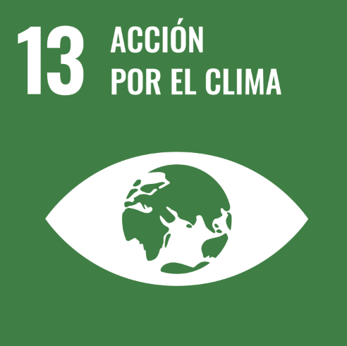
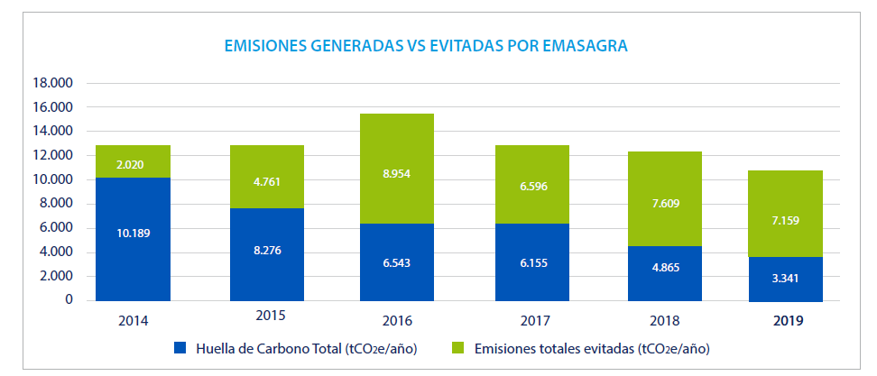
CIRCULAR ECONOMY
SOUTH BIOFACTORY
SCOPE 2
Source of Emissions Emissions 2019
RESULTS
Electricity
SCOPE 1
SCOPE 3
Source of Emissions Emissions 2019
Source of Emissions Emissions 2019
Water Management
Torches
Boilers
Cogeneration
Composting
Water consumption
Reagent Consumption
Agricultural application
Carbon footprint
2019 Data
EMISSIONS GENERATED VS AVOIDED BY EMASAGRA BIOFACTORY
Total Carbon Footprint
Total emissions avoided

Slide 8

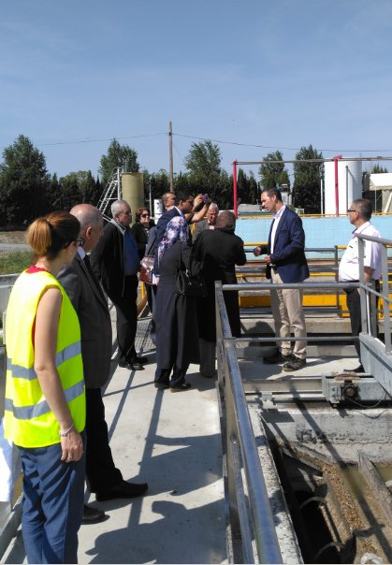
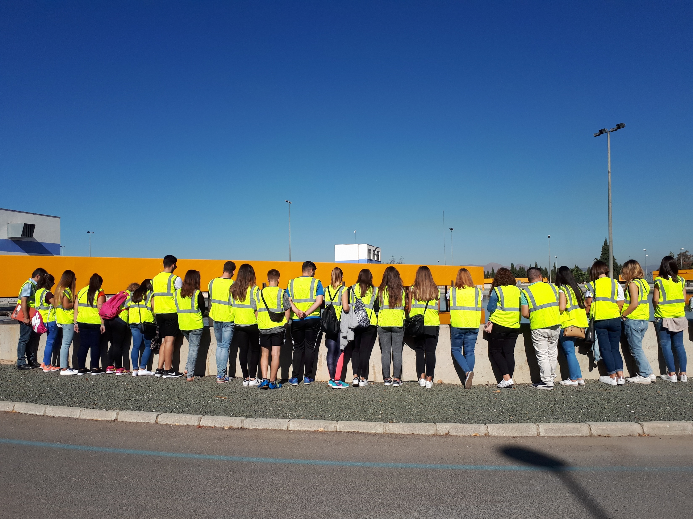

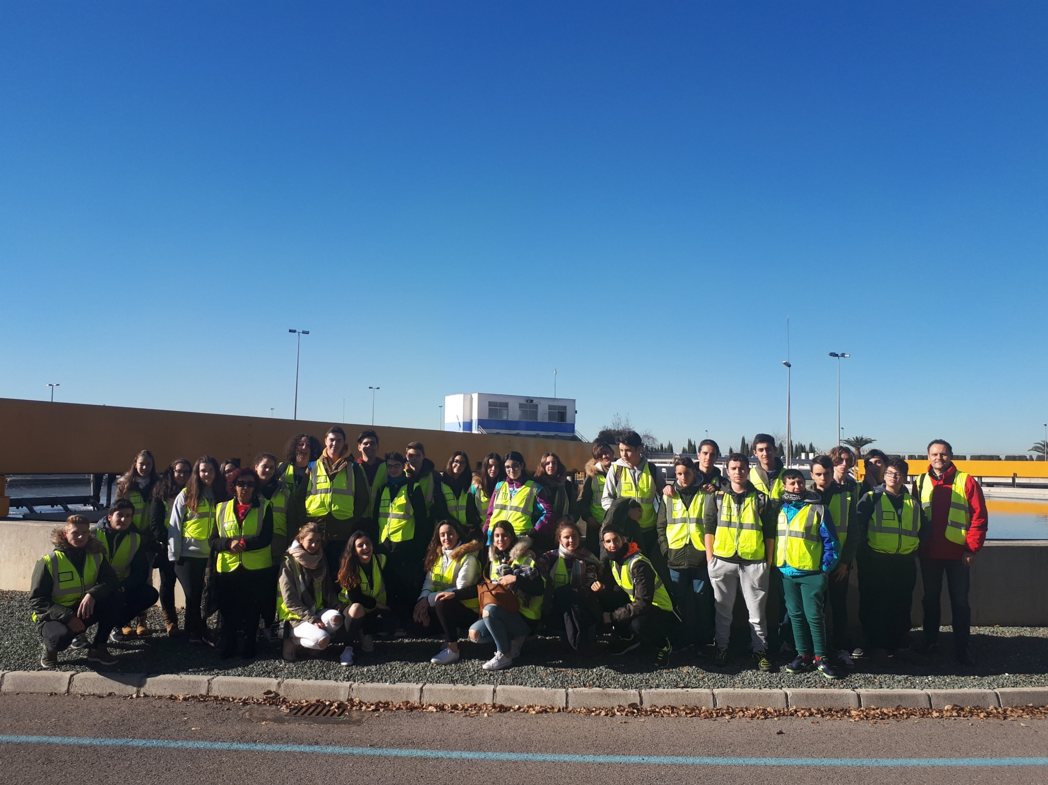
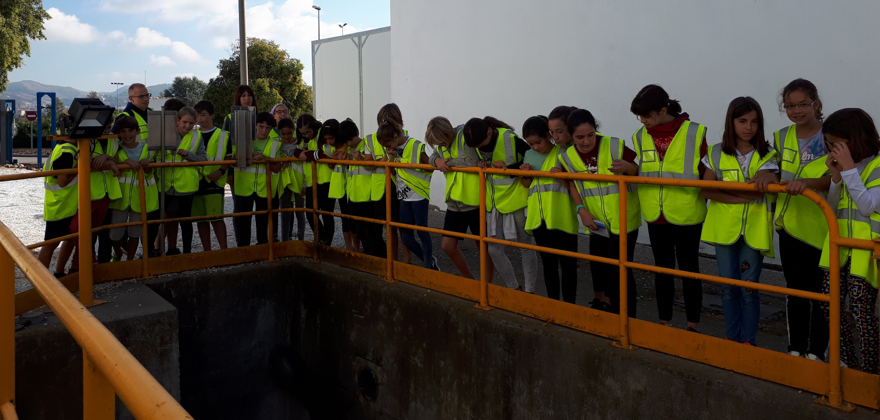
Water Management
Annually, Granada´s South Biofactory receives more than 2000 people

Slide 9

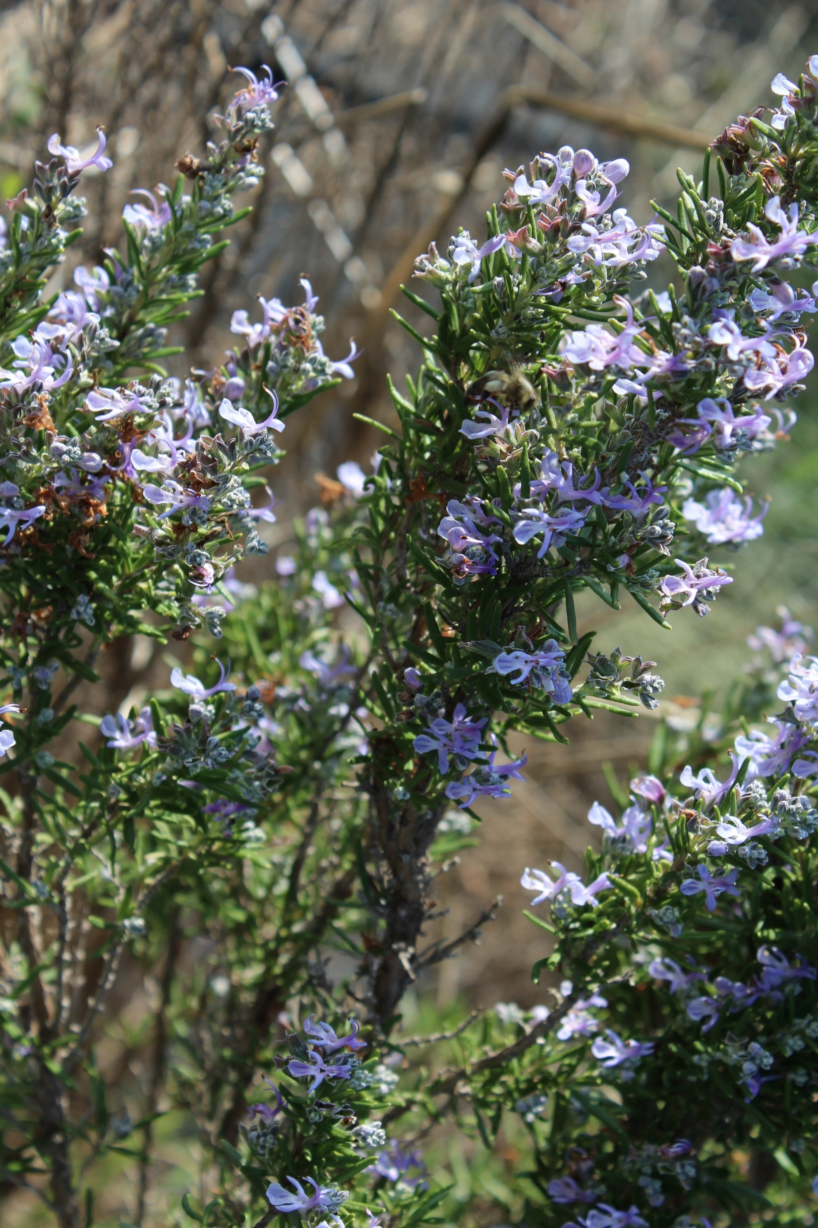
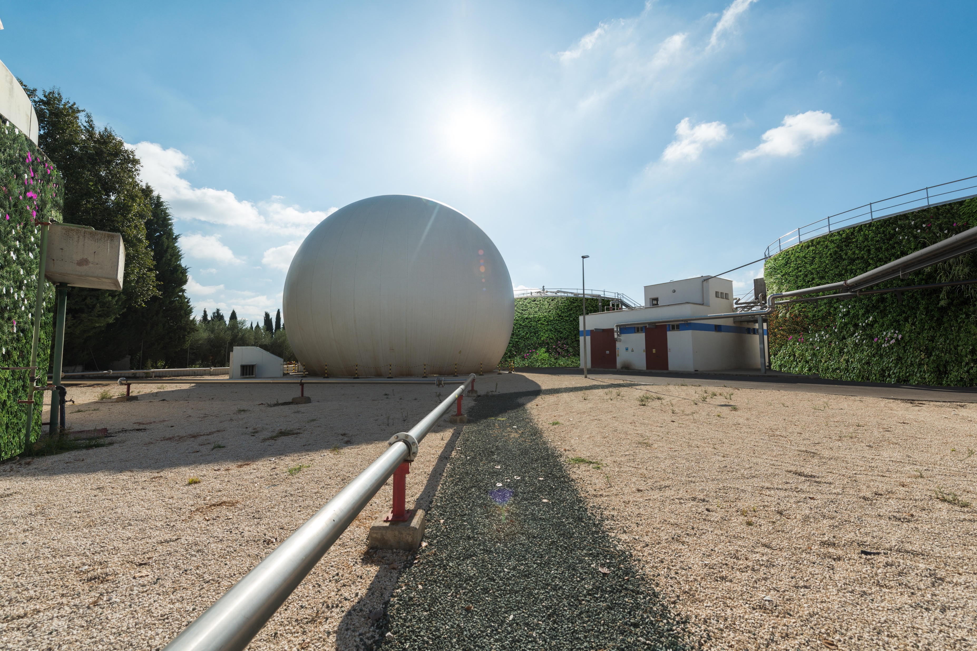
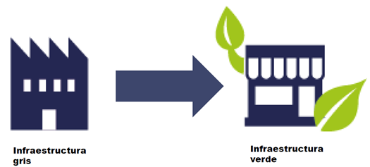
CIRCULAR ECONOMY
Lines of action
- Biodiversity diagnosis and implementation of action plans
- Elimination of the use of pesticides
- Incorporation of action protocols against invasive alien species
Water Management
Preserve biodiversity in our treatment plants
In progress:
Creation of a butterfly garden in Granada South Biofactory
- Installation of insect hotels
Renaturation, with autochthonous species

Slide 10

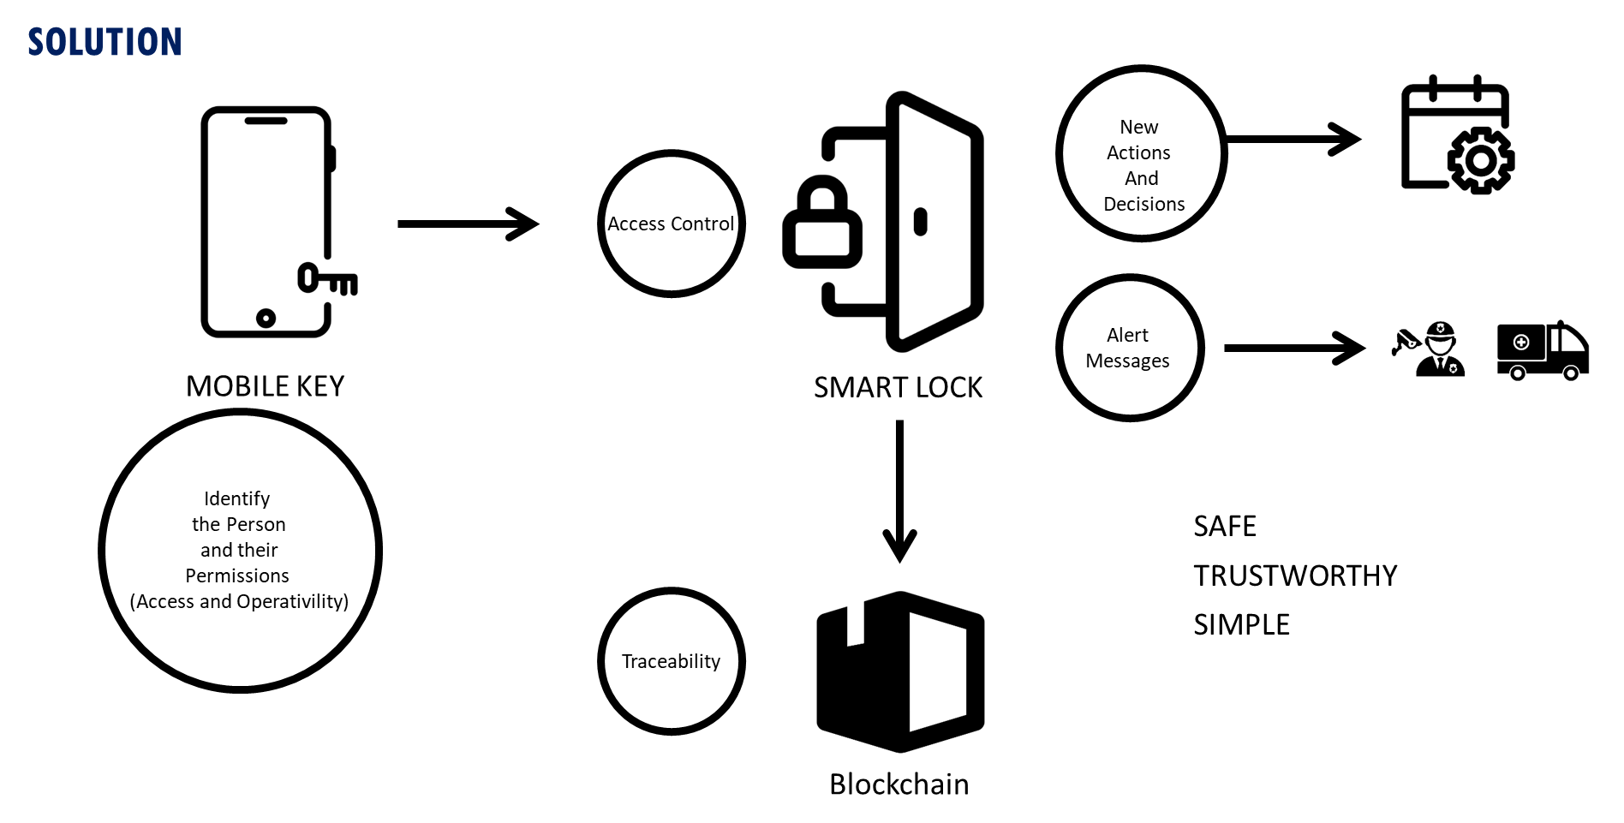

BLOCKCHAIN FIRST STEPS IN EMASAGRA
Lines of action
- Facilitate and improve access control to our facilities
- Improve work safety procedures and interlocks
- Limit de operation according to the profile of the operator´s profile
Water Management
Smart Lock

Slide 11
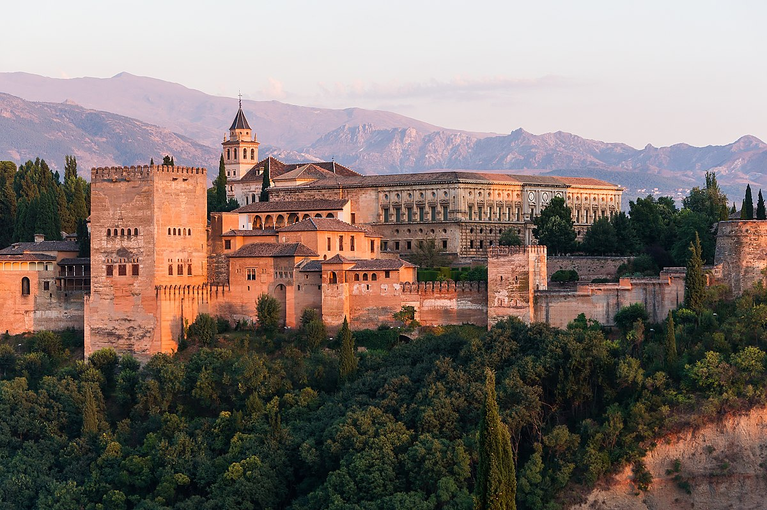


Thank you for your attention

