Slide 1
Energy Communities
Using IoT and Blockchain
Domenico Barra, CTO - Adamantic

Slide 2
Adamantic - Who we are
Innovative startup - founded in 2017
Core business: IOT and Blockchain
Member of the SmartCity Lab Roma & Lazio
More than 10 enterprise-grade blockchain projects to date
Energy
Healthcare
Audiovisual rights management
Automotive and (car/bike) sharing
Baggage tracking
Multi-vendor coin-based marketplace
Art & Cultural Heritage
Cooperating with national institutions (MiBACT, GSE) and universities (La Sapienza, RomaTRE, LUISS, LinkCampus)

Slide 3
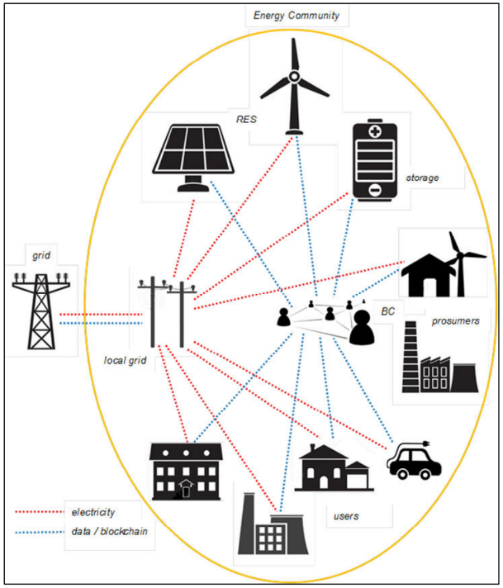
Energy Communities
Chosen model: Energy Cloud
Users are still physically attached to their local energy provider
Energy exchanges are virtual
Blockchain used for transparency and rewards management
Actors:
Consumers
Producers (small plants, solar panels, wind turbines, …)
Prosumers (energy storage, e-cars, …)
Network Manager
Community Manager
External Energy Providers

Slide 4
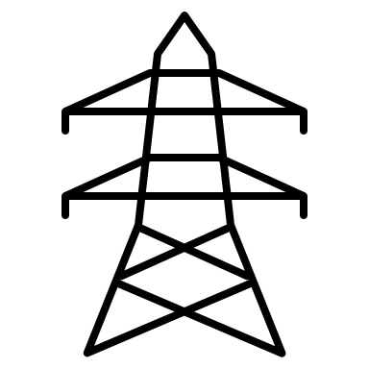
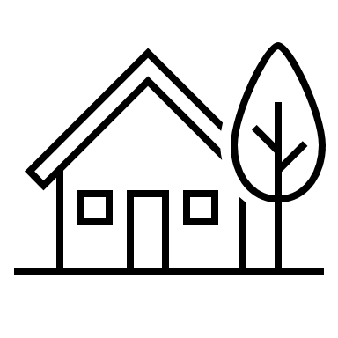
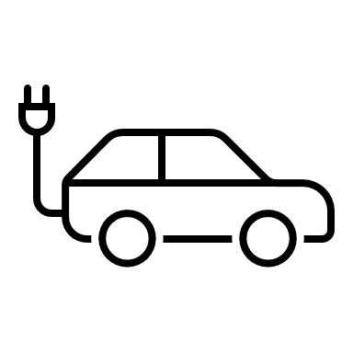
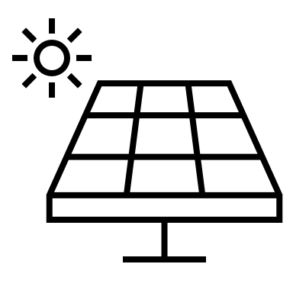
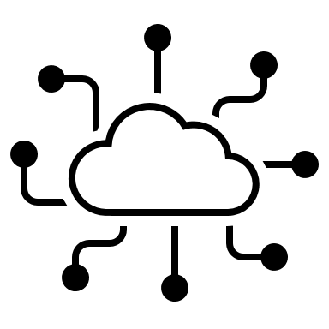
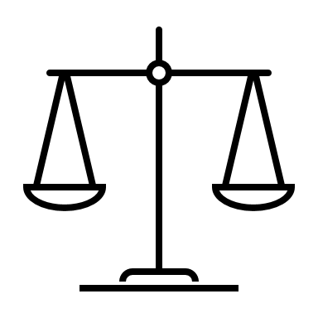
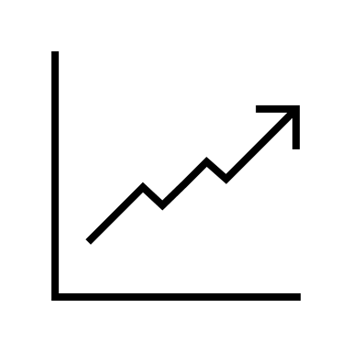
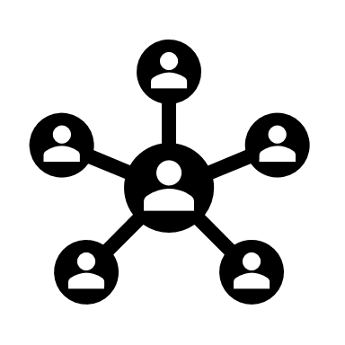
Community Relationships
Consumers / Prosumers /
Producers
External Energy Provider
Users
Billing
Buy & Sell Energy
Blockchain
Community Manager
Network Manager
Community Balance
Incentivize self-consumption
Measurement Aggregation
Physical Delivery & Collection
Community Monitoring and configuration
Internal Contract Facilitation

Slide 5
How we use Blockchain for Smart Energy Grids
Data Certification
Smart-meter Measurement
Notarization of intermediate processing steps by every process stakeholder
Events (Network- or Contract-related)
Rewards Management
Self-consumption is rewarded via coins “minted” on the blockchain
Coins can be expended within the communities or with third-parties on a marketplace
Contract Management
Energy contracts within the community are signed on the blockchain
Contracts may be (partially or totally) paid via Tokens
Hybrid blockchain approach:
Internal processes are shared with stakeholders on a permissioned ledger
Public information and token management on a public blockchain

Slide 6
Thank you
☺

