Slide 1




Assistance on CAP Formulation in Viet Nam Cities
IUC-GCoM Support Final Webinar in Vietnam

Slide 2

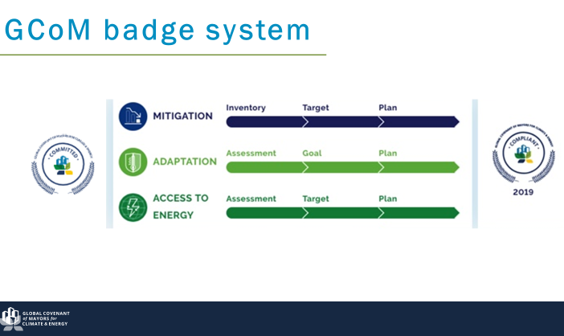


Process of Development
CAP Formulation Technical Support for VN Cities
1.
2.
3.
Background
and Context
CAP
Introduction
CAP
Development
Climate Change and Impacts
The Need for Local Climate Action
GCoM and its partners
What is a CAP?
Process in Developing a CAP?
Contents of CAP?
Inputs, Activities, Outputs:
Adaptation
Mitigation
Stakeholder Engagement and Legitimizing the CAP

Slide 3
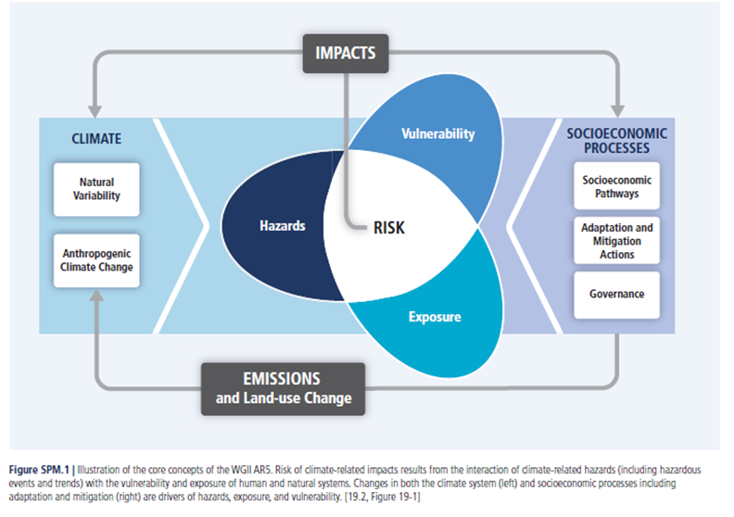
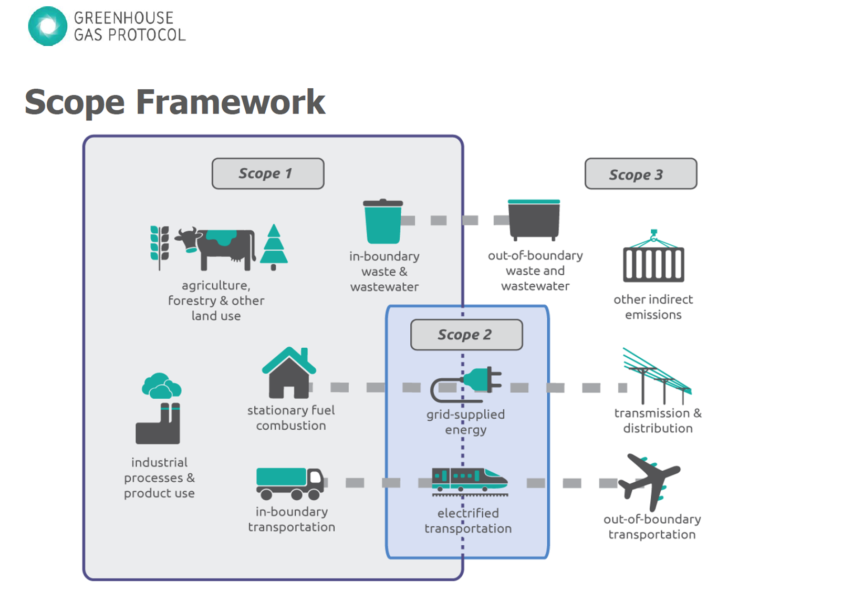

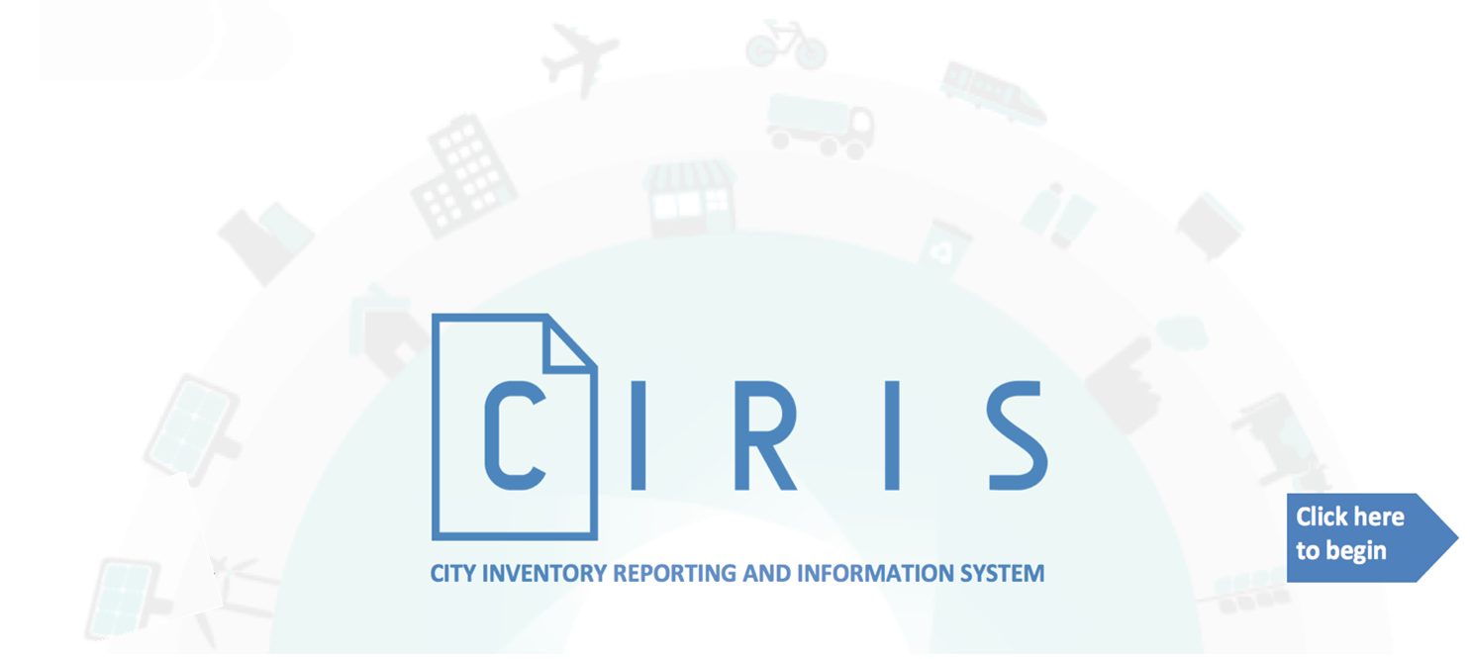
Methodology
Framework and Tools

Slide 4
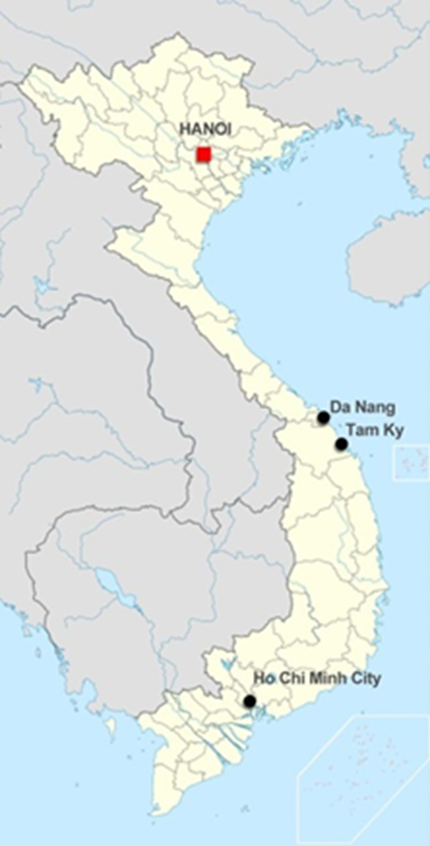

Viet Nam Cities Assisted for the
IUC-GCoM Preparatory Activities
Da Nang City:
Total area is 1285 square kilometers (in which the island district of Hoang Sa is 30,500 ha).
As of 2019, total population of 1,134,310 people
Administratively, the city has 06 urban districts (Hai Chau, Thanh Khe, Son Tra, Ngu Hanh Son, Lien Chieu, Cam Le), Hoa Vang rural district and Hoang Sa island district.
Key economic sectors are textiles/garment, wood processing, mechanics, electrical machines with 2 industrial zones and 4 industrial clusters
Tam Ky City:
Tam Ky currently is urban area Grade II, capital of Quang Nam Province and the provincial center of administration, economic, social, political, education, science and technology;
As of 2019, Tam Ky has a total population of 122,374 people with the population growth of 0.7% annually
Key economic sectors are textiles/garment, wood processing, mechanics, electrical machines with 2 industrial zones and 4 industrial clusters
Can Tho City:
Total area is 1.401 square kilometers
As of 2019, total population of 1,235, 954 people with the population annual growth rate 8.37% (from 2010 to 2019)
Administratively, the city has 9 districts: 5 urban districts and 4 rural districts
Key economic sectors are textiles/garment, wood processing, mechanics, electrical machines with 2 industrial zones and 4 industrial clusters

Slide 5
City CAPs Assistance Results
Highlights

Slide 6
GHG Inventory Results

Slide 7
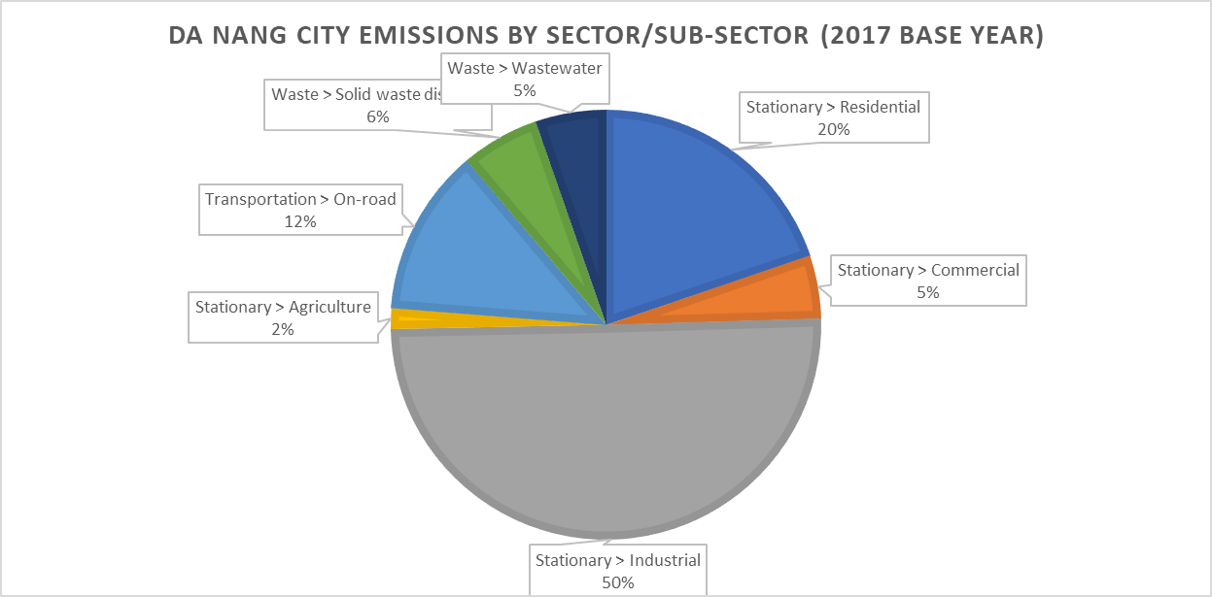
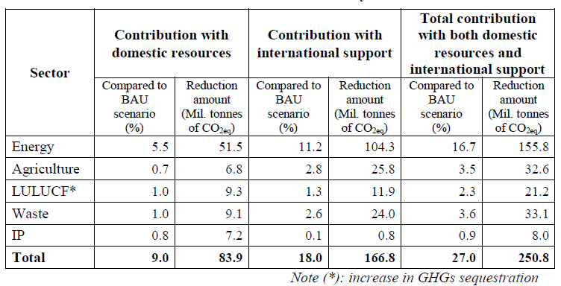
GHG Inventory Results
Key Consideration:
Viet Nam updated NDC -- ”With domestic resources, by 2030, Viet Nam will have reduced total GHG emissions by about 9% compared to the BAU scenario, equivalent to 83.9 million tonnes CO2eq”. (The 9% contribution can be increased by up to 27% compared to the BAU scenario (equivalent to 250.8 million tonnes of CO2eq) with international support)

Slide 8
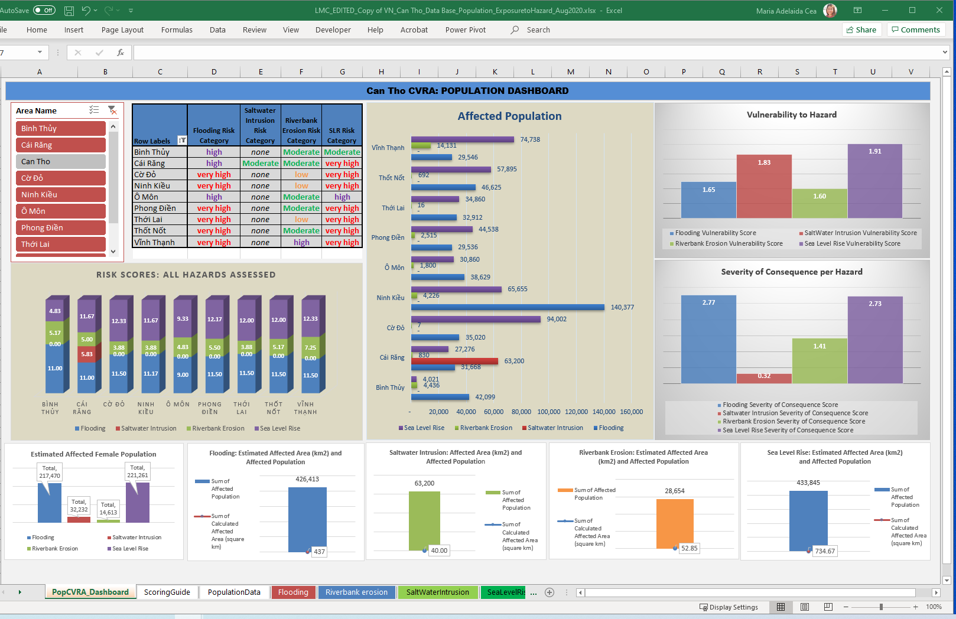
CRVA- Results example from Can Tho
Susceptibility
Likelihood of Occurrence
HAZARDS
Population data
Land Area
Assets
EXPOSURE
Housing Type
Female, Children, Old Population
Income Poverty
Access to basic services
SENSITIVITY
Literacy Rate
Employment data
Area Protective Measure
Access to information services
Capacity of City to make investments
ADAPTIVE CAPACITY

Slide 9
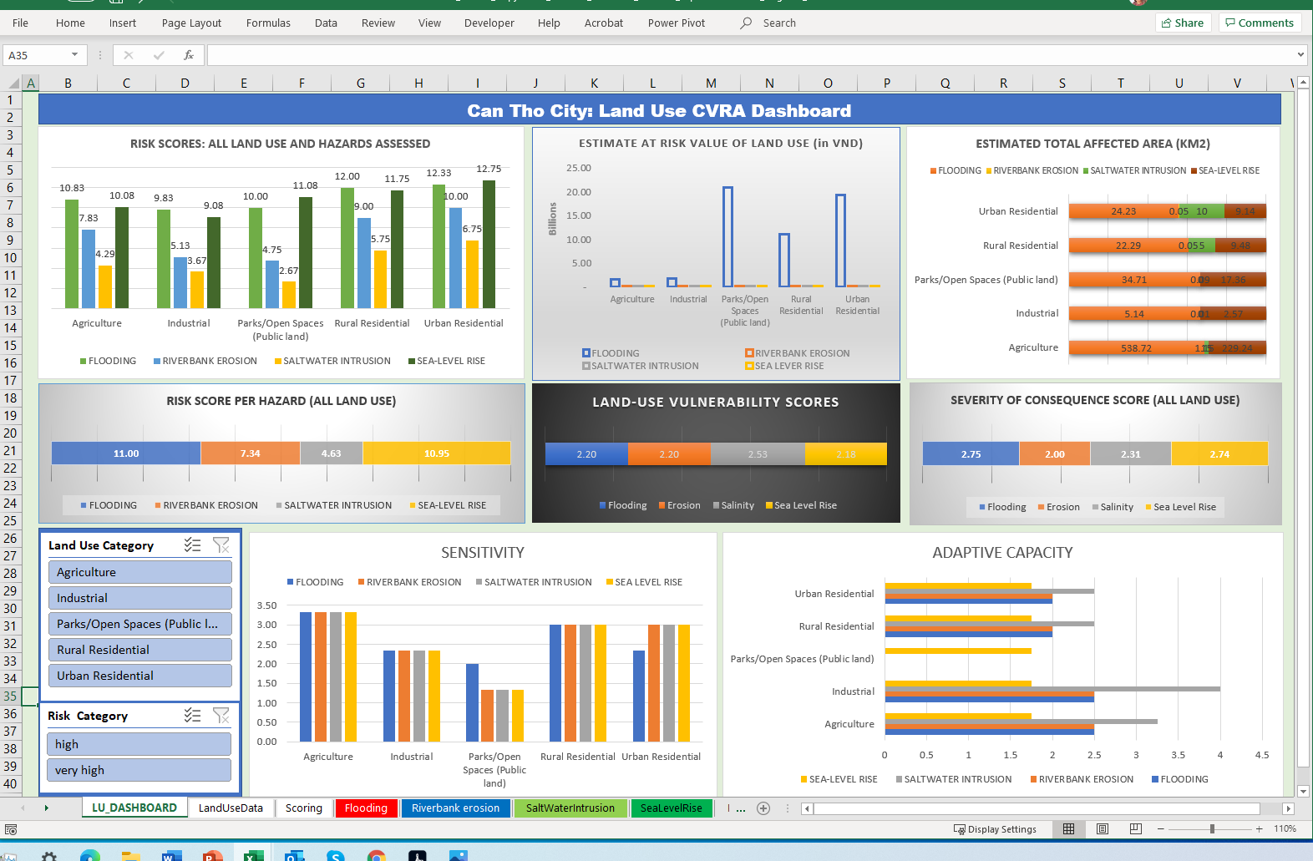
CRVA- Results example from Can Tho
Susceptibility
Likelihood of Occurrence
HAZARDS
Population data
Land Area
Assets
EXPOSURE
Housing Type
Female, Children, Old Population
Income Poverty
Access to basic services
SENSITIVITY
Literacy Rate
Employment data
Area Protective Measure
Access to information services
Capacity of City to make investments
ADAPTIVE CAPACITY

Slide 10
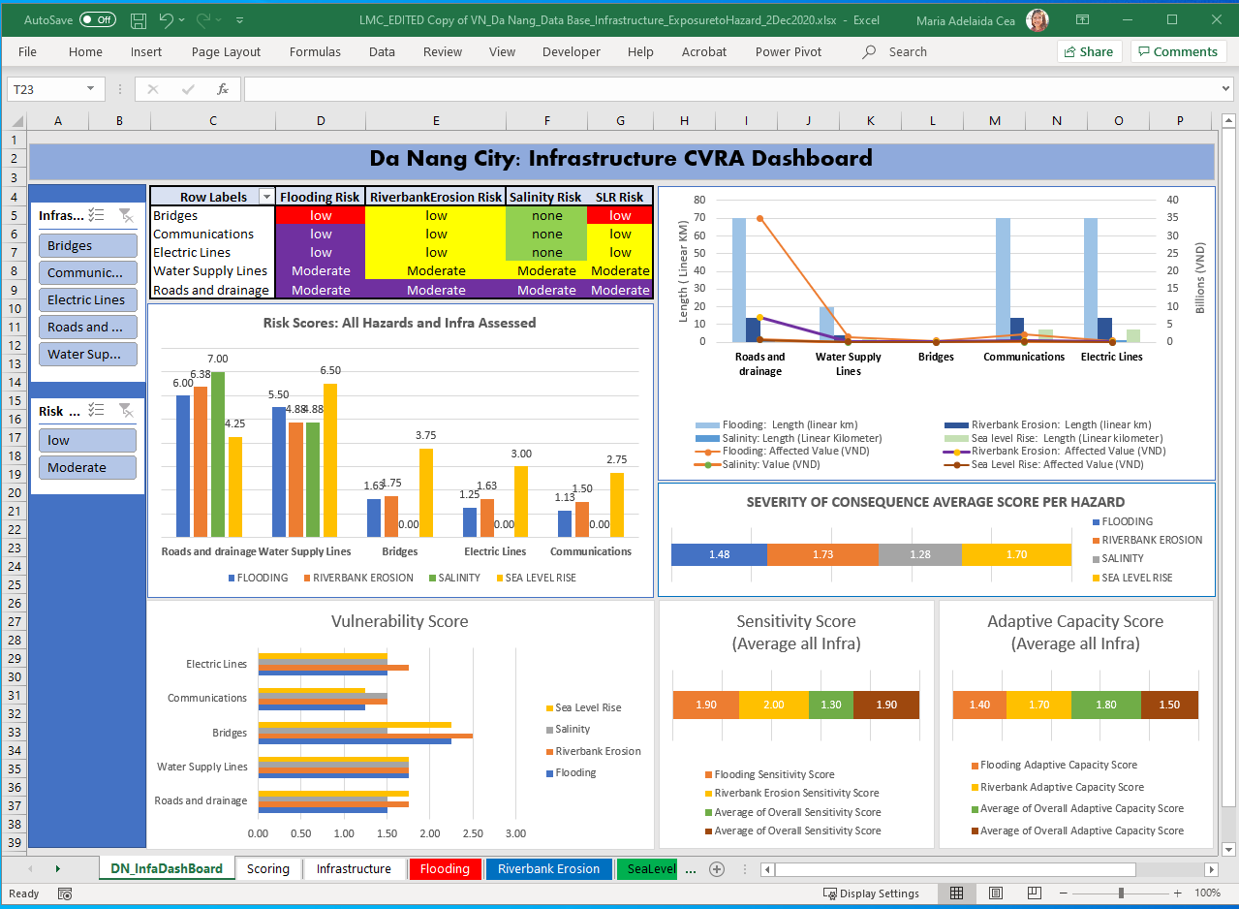
CRVA- Results example from Da Nang
Susceptibility
Likelihood of Occurrence
HAZARDS
Infrastructure size
Cost of development
EXPOSURE
Damage from previous disaster events
Impacts to Industry/Livelihoods
SENSITIVITY
City Regulations on hazard mitigation (e.g. zoning, structural design standards, etc)
Capacity of City to make investments
ADAPTIVE CAPACITY

Slide 11
Insights and Lessons
from the CAP Development Process

Slide 12
Insights and Lessons
With reference to the process for delivering support to pilot cities on CAPs development:
Facilitating factors
The central government has a strong climate change National Target Programme with identified tasks in their PIPA and targets in updated country NDC thus cities have a strong anchor in defining their directions and strategies
Cities have existing climate action plans and SEDP to take-off from in initiating the CAP process
The City PC leadership are committed to advance the CAP process and give the ‘mandate’ for Task Force/Groups to engage and actively participate
City level Task Force/Groups are key in developing and/or update the CAP
  For data sharing and validation
  For cross sectoral analysis
  Ownership of the process and sustainability

Slide 13
Insights and Lessons
With reference to the whole process for delivering support to pilot cities on CAPs development:
Challenges:
Availability/sourcing of data for the GHGI and CRVA. Not all required data would be easily available to a city (e.g Tam Ky as it who doesnt have the mandates as in Can Tho and Da Nang; though the 2 bigger cities have data challenges). The cities, due to Covid 19, have other priorities for now.
COVID-19 impacts limited and challanged the conduct of the training and data gathering, but also limited the interaction and cross-sectoral cooperation during the CAP process. COVID-19 created new priorities and scenario on engagement
Next Steps
Cooperation/coordination/engagement with the higher level of Government (e.g. Province, National Ministry) must be part of the process to address the data and information gaps faced by the cities; this can also facilitate decision making support during the CAP process
In view of the interest of replication to more cities, for which this preparatory activities on CAP could serve as testing/piloting, a programmatic approach on CAP development support could be beneficial. This could likewise give way to strong and clear partnerships with relevant Ministries (e.g. MONRE, MoC, MPI)

Slide 14
END of PRESENTATION.
Thank You!
For more information/questions on this presentation:
Maria Adelaida Mias-Cea
UN-Habitat ROAP CCCI
laids.cea@un.org
Nguyen Quang
Habitat Programme Manager
UN-Habitat Vietnam
Nguyen.quang@undp.org

