Slide 1
Da Nang City Climate Action Planning
Draft Results as of November 2020

Slide 2
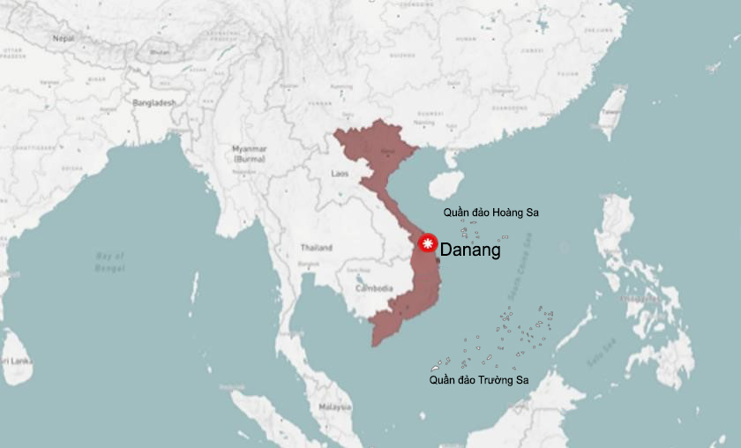
Da Nang City
Total area is 128,488 ha (in which the island district of Hoang Sa is 30,500 ha).
By 2019: Total population of 1,134,310 people, is the largest city in the Central region and the fourth largest in Vietnam.
Administratively, the city has 06 urban districts (Hai Chau, Thanh Khe, Son Tra, Ngu Hanh Son, Lien Chieu, Cam Le), Hoa Vang rural district and Hoang Sa island district.

Slide 3
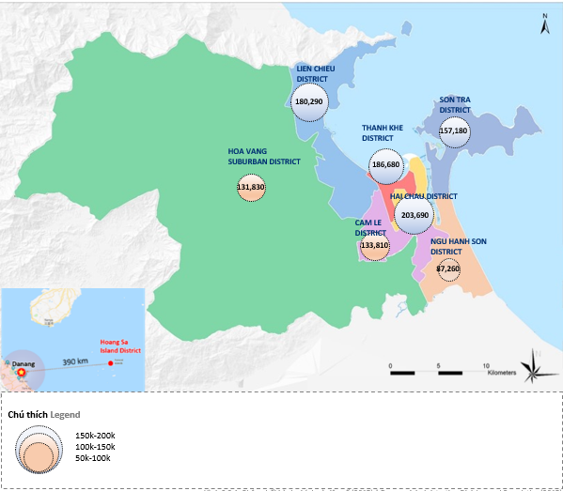
Danang city map (according to the Statistical Yearbook 2018)

Slide 4
Targets and Objectives
For Mitigation and Adaptation

Slide 5
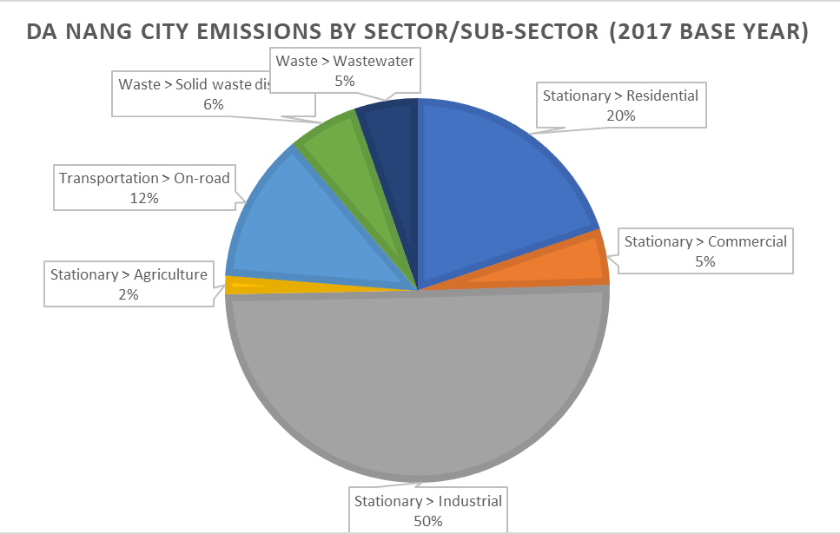
Da Nang City Proposed CAP
Mitigation Targets (period until 2030)
Adaptation Goals
Consistent with the Viet Nam NDC, 9% reduction in total greenhouse gas emissions compared to the BAU scenario
Elements at Risk | Adaptation Goals
Population | Strengthening the adaptive capacity of communities and households in Cam Le and Hoa Vang Districts to minimize flood risks
Economy and Urban Investments | Improve the knowledge and overall capacity to mitigate risks for the agriculture, tourism, construction and urban management at the district and ward levels
Infrastructure | Improve road and drainage and water supply infrastructures to address the impacts of climate hazards particularly flooding and changing precipitation patterns and other extreme events like Typhoons
Land Use | Review and improve land use management in rural and open spaces to address impacts from river and coastal erosion and sea-level rise

Slide 6
Mitigation Specific Actions
Strategies/Projects/Activities

Slide 7
Potential Mitigation Actions
Sector |  | Actions to Achieve the Target
 | Target for the Action for the CAP period: 9% reduction in total greenhouse gas emissions compared to the normal development scenario | Already Planned | Proposed New or Adjusted Actions
Stationary Energy | Propagating and guiding energy efficiency in daily-life activities, households, and city service establishments | x | x
 | Building projects, support businesses to convert and replace outdated energy-consuming equipment with energy-saving ones |  | x
 | Developing and implementing typical models of energy saving and using renewable energy for industries to replicate into large energy consuming business establishments | x | x
 | Deploying the plan to apply cleaner production in the city |  | x
 | Research and developing new energy and renewable energy of the city |  | x
 | Deploy ecological industrial model towards model of sustainable industrial zone |  | x

Slide 8
Potential Mitigation Actions
Sector |  | Actions to Achieve the Target
 | Target for the Action for the CAP period: 9% reduction in total greenhouse gas emissions compared to the normal development scenario | Already Planned | Proposed New or Adjusted Actions
Transportation | Investment and support to convert public vehicles powered by electric motors |  | x
 | Investment for changing existing buses to new ones that meet Euro emission standards | x | x
 | Propagating and mobilizing the use of environmentally friendly means of transport | x | x
Waste | Deploying projects to recover, recycle and treat waste plants | x | x
 | Implementing projects to reuse post-treated wastewater at centralized wastewater treatment stations (Domestic, Industrial) |  | x
 | Deploying waste separation at source, minimizing plastic waste | x | x

Slide 9
Priority Adaptation Actions
Strategies/Projects/Activities

Slide 10
Reducing Vulnerabilities and Managing Risks: Population
Id | Categories | Already Planned/ Doing | New/ enhanced actions
1 | Building the project "Building Da Nang city safe in natural disasters" | Doing | Enhanced
2 | Updating the plans for prevention, fighting and overcoming of consequences for a number of natural disaster scenarios including those due to climate change | Doing | Enhanced
3 | Planning, plans to ensure safety and communication in service of direction and commanding in response to strong storms and super storms; ensure the safety of the information and communication stations in the city |  | New
4 | Training, propagation and dissemination of prevention and control of natural disasters and climate change | Doing | Enhanced
5 | Information and propaganda about natural disaster prevention and control through mass media systems | Doing | Enhanced
6 | Disseminate knowledge and skills on natural disaster prevention and control in schools | Doing | Enhanced
7 | Organizing exercises on natural disaster prevention and control and search and rescue | Doing | Enhanced
8 | Arranging city budget expenditure sources, combining with the socialization of resources to proactively prevent, respond and overcome consequences of natural disasters | Doing | Enhanced
9 | Mobilize external resources to support natural disaster prevention and control and search and rescue |  | New
10 | Promote scientific research, application of solutions and technologies for natural disaster prevention and control and search and rescue. | Doing | Enhanced
11 | Review, developing plans and solutions to support relocation and stabilize the lives of people in areas prone to natural disasters | Doing | Enhanced
12 | To convert plant varieties and animals, apply science and technology in agricultural production in line with natural disasters; planting, protecting and restoring protective forests |  | New

Slide 11
Reducing Vulnerabilities and Managing Risks: Infrastructure
Id | Categories | Proposed Actions (with specific targets)
 |  | Already Planned/ Doing | New/ enhanced actions
1 | Investment in construction and consolidation of dikes and embankments to prevent riverbank and coastal erosion; ensure safety of water reservoirs and irrigation lakes | Doing | Enhanced
2 | Organize warning posts in areas prone to landslides | Doing | Enhanced
3 | Deploy intelligent systems and applications to improve the capacity of natural disaster monitoring, warning, forecasting and prevention |  | New
4 | Formulating regulations on urban and residential planning with area of ecological lakes and regulating lakes in order to store rainwater, reduce pressure on the city's drainage systems; proactively implement plans and solutions to overcome flooding when heavy rain falls in urban areas |  | New
5 | Installing and building a specialized monitoring and monitoring system for disaster prevention (automatic monitoring of rain, water level, monitoring and warning equipment in frequently flooded areas ...) | Doing | Enhanced

Slide 12
Reducing Vulnerabilities and Managing Risks: Land Use
Id | Categories | Already Planned/Doing | New/ enhanced actions
1 | Formulating regulations on urban and residential planning with area of ecological lakes and regulating lakes in order to store rainwater, reduce pressure on the city's drainage systems; proactively implement plans and solutions to overcome flooding when heavy rain falls in urban areas |  | New
2 | Installing and building a specialized monitoring and monitoring system for disaster prevention (automatic monitoring of rain, water level, monitoring and warning equipment in frequently flooded areas ...) | Doing | Enhanced
3 | Developing maps of areas prone to natural disasters such as storms, floods, saltwater intrusion, tsunamis ... taking into account climate change, sea level rise |  | New
4 | Review, developing plans and solutions to support relocation and stabilize the lives of people in areas prone to natural disasters | Doing | Enhanced
5 | To convert plant varieties and animals, apply science and technology in agricultural production in line with natural disasters; planting, protecting and restoring protective forests |  | New

Slide 13
Next Steps
Detailing and Planning for Implementation

Slide 14
Next steps
Id | Contents | Implementation | Participation
1 | Further Review the data and update information to support more detailed for adaptation and mitigation projects plans | DONRE | Experts from sectors, district
2 | Organize the consultation meetings in the city’s sectors and district levels for to validate the needs and relevance of the proposed adaptation and mitigation | DONRE | The city departments
3 | Update and finish the action plan of Da Nang city | DONRE
4 | Submit to Da Nang PC for participating and become a member of GCOM | DONRE | DNPC

