Slide 1
柳州经验:后疫情时代的城市重塑与发展
Liuzhou Experience:
Urban Remodel & Development post COVID-19
中国柳州市 常务副市长 侯刚 先生
Mr. Gang HOU, Executive Deputy Mayor, Liuzhou, China

Slide 2

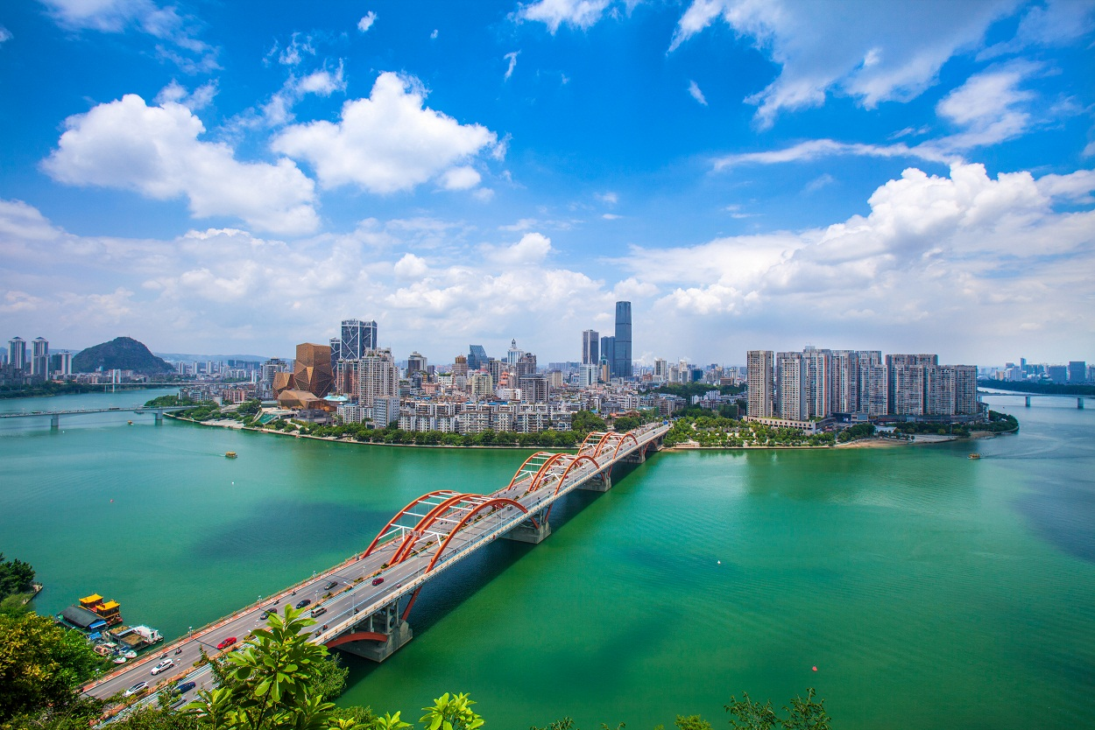
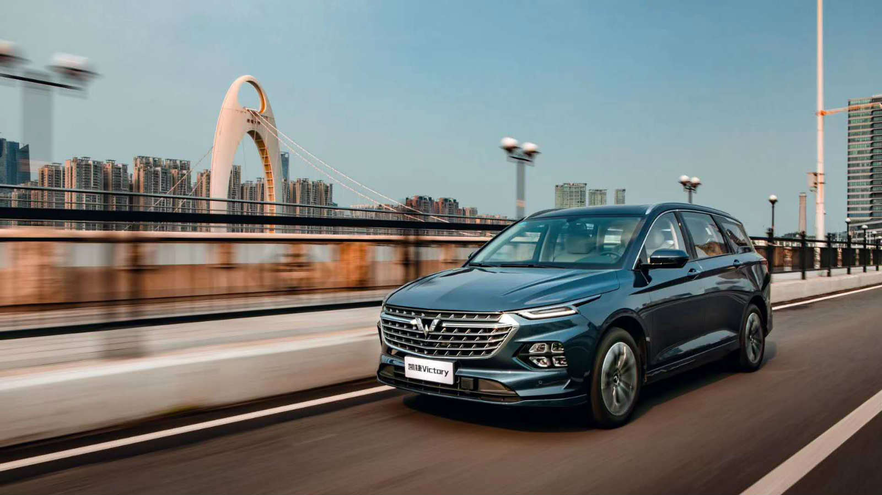
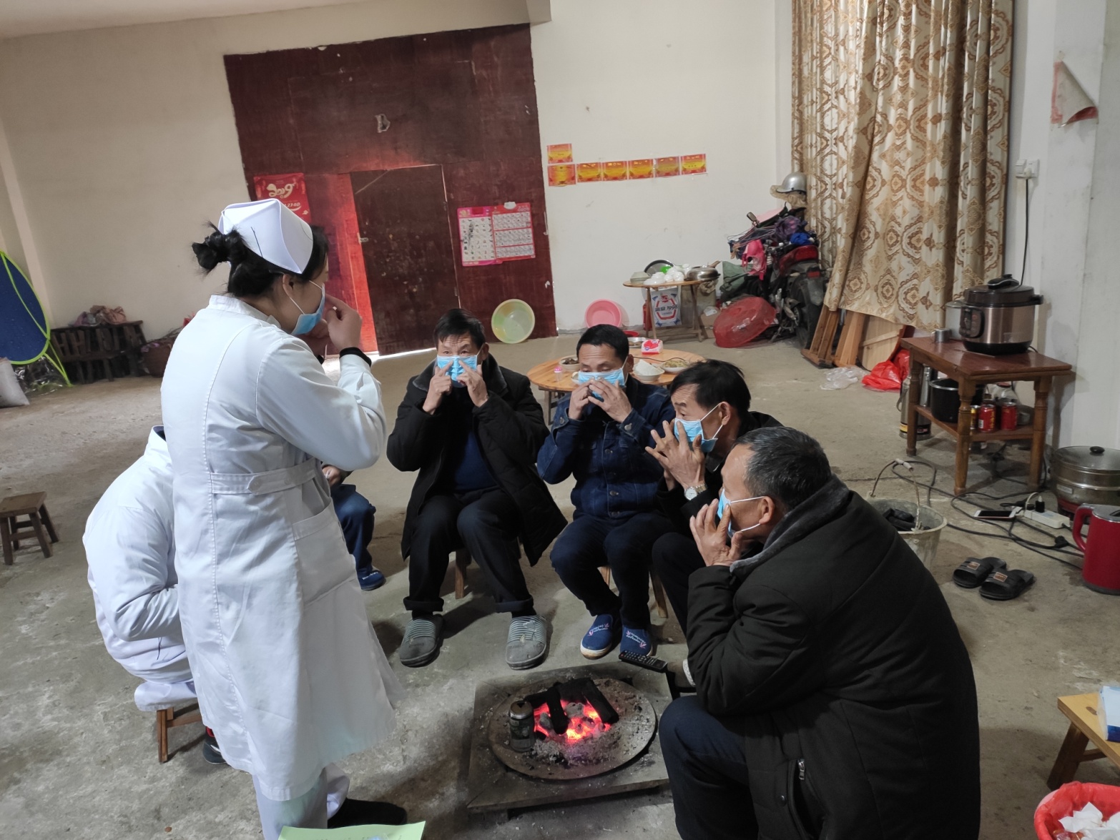
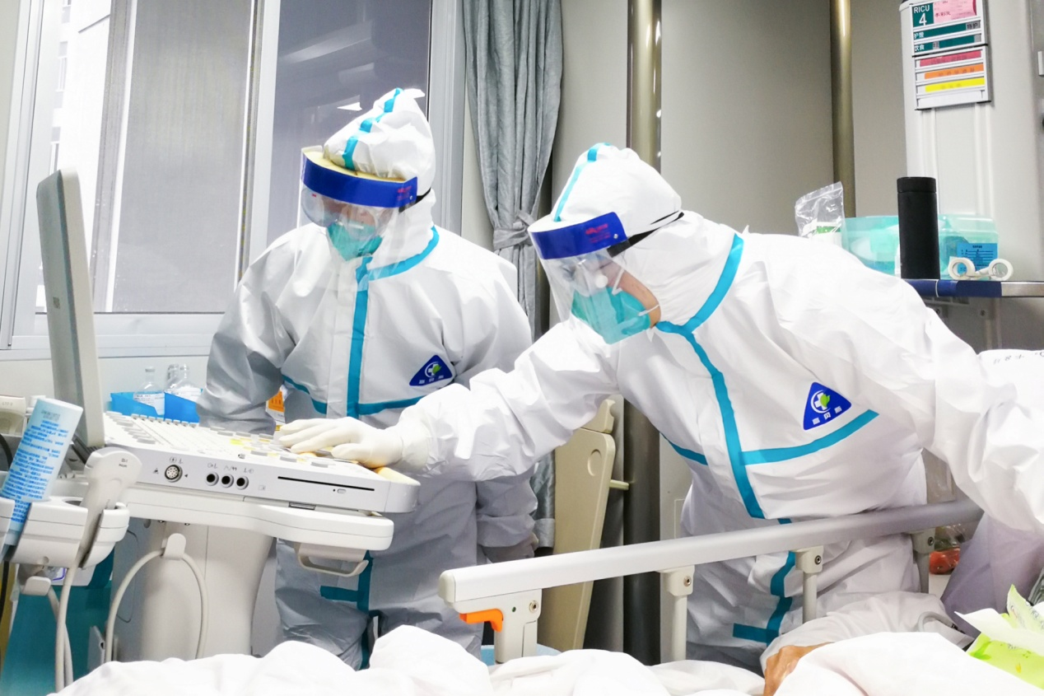
关于柳州 aBOUT Liuzhou
地理位置
Location
产业发展
Industry
疫情影响
COVID-19
抗疫经验
Experience
Notes:
Overall questions applicable for all speakers in this subplenary to consider if relevant for him to answer:
In your experience, what are the key drivers for a successful green recovery?
What aspects of the urban environment/urban services have been affected the most by Covid-19 and how will they need to be readjusted in the next years?
Which aspects of the management of urban life are unlikely to return to how they were before?
Which solutions have proven most effective in adapting, both in the short-term and into the long-term as well?
Which solutions are challenging to apply to the new circumstances, and how can they be adapted?
To which degree must you tailor your solutions, especially for vulnerable residents or certain districts in your city?
Which points are most important for other cities to know in order to replicate your measures?
...

Slide 3
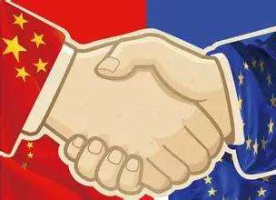
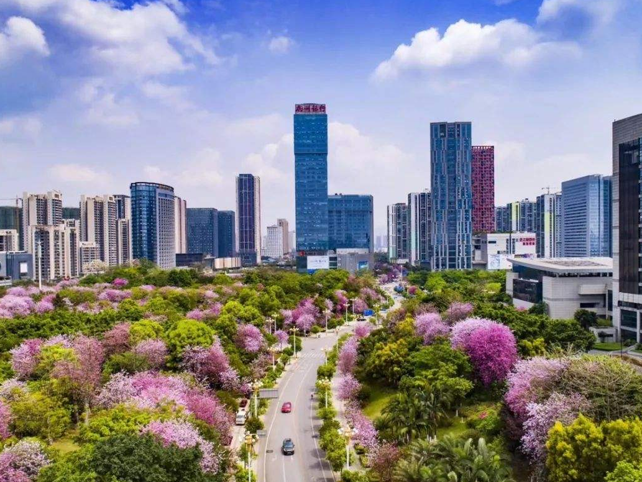
建设健康安全的城市 a healthier & safer city
软件
Software
硬件
Hardware
Notes:
Overall questions applicable for all speakers in this subplenary to consider if relevant for him to answer:
In your experience, what are the key drivers for a successful green recovery?
What aspects of the urban environment/urban services have been affected the most by Covid-19 and how will they need to be readjusted in the next years?
Which aspects of the management of urban life are unlikely to return to how they were before?
Which solutions have proven most effective in adapting, both in the short-term and into the long-term as well?
Which solutions are challenging to apply to the new circumstances, and how can they be adapted?
To which degree must you tailor your solutions, especially for vulnerable residents or certain districts in your city?
Which points are most important for other cities to know in order to replicate your measures?
...

Slide 4

推动数字城市建设 transition to a digital city
新交通技术
互联网
大数据
Internet
Big Data
List few key points here
电子支付
List few key points here
List few key points here
快递服务
构建新一代信息基础设施
New Information Infrastructure
New Traffic Technology, E-payment, Express Delivery
Notes:
Overall questions applicable for all speakers in this subplenary to consider if relevant for him to answer:
In your experience, what are the key drivers for a successful green recovery?
What aspects of the urban environment/urban services have been affected the most by Covid-19 and how will they need to be readjusted in the next years?
Which aspects of the management of urban life are unlikely to return to how they were before?
Which solutions have proven most effective in adapting, both in the short-term and into the long-term as well?
Which solutions are challenging to apply to the new circumstances, and how can they be adapted?
To which degree must you tailor your solutions, especially for vulnerable residents or certain districts in your city?
Which points are most important for other cities to know in order to replicate your measures?
...

Slide 5
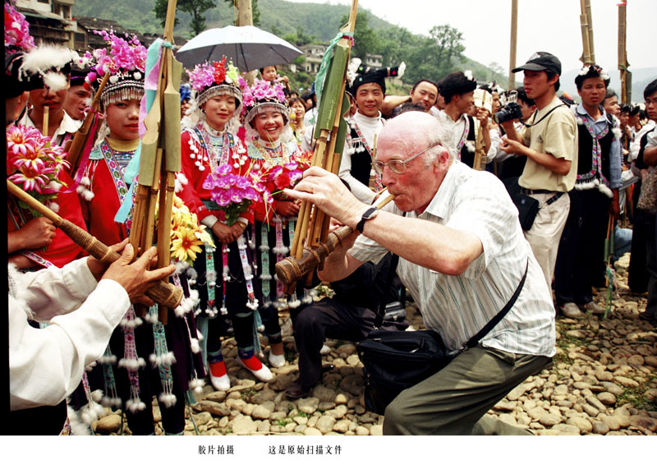
推进民生保障与改善
Improve citizens’ Well-beings
重视社会融合
Society in harmony
放大社会保障
social security
保就业促创新
Employment & innovation
Notes:
Overall questions applicable for all speakers in this subplenary to consider if relevant for him to answer:
In your experience, what are the key drivers for a successful green recovery?
What aspects of the urban environment/urban services have been affected the most by Covid-19 and how will they need to be readjusted in the next years?
Which aspects of the management of urban life are unlikely to return to how they were before?
Which solutions have proven most effective in adapting, both in the short-term and into the long-term as well?
Which solutions are challenging to apply to the new circumstances, and how can they be adapted?
To which degree must you tailor your solutions, especially for vulnerable residents or certain districts in your city?
Which points are most important for other cities to know in order to replicate your measures?
...

Slide 6
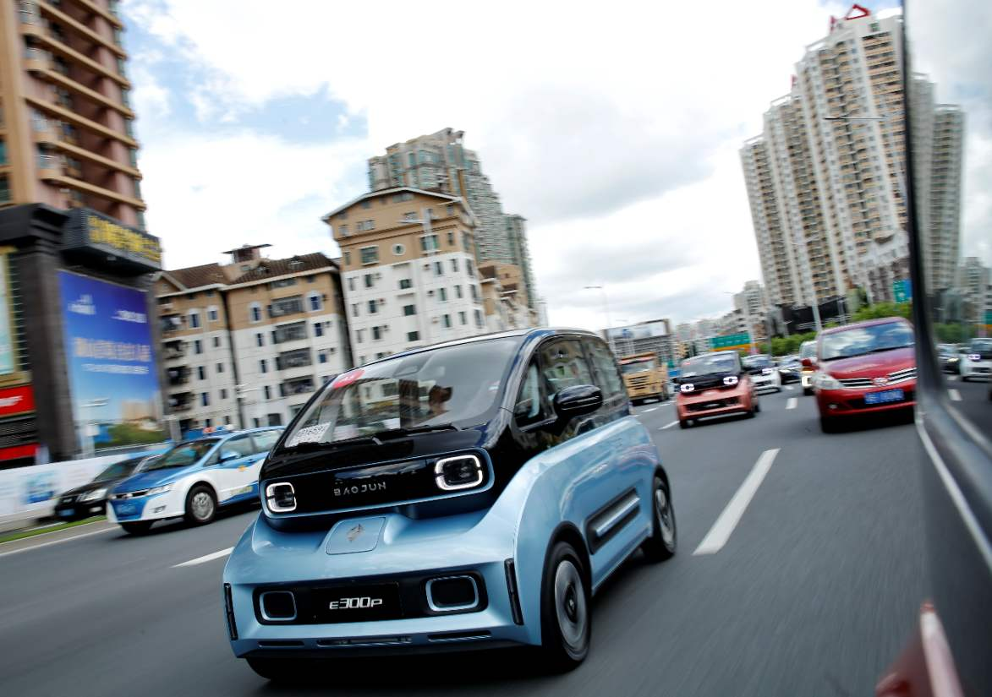
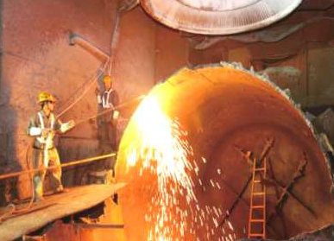
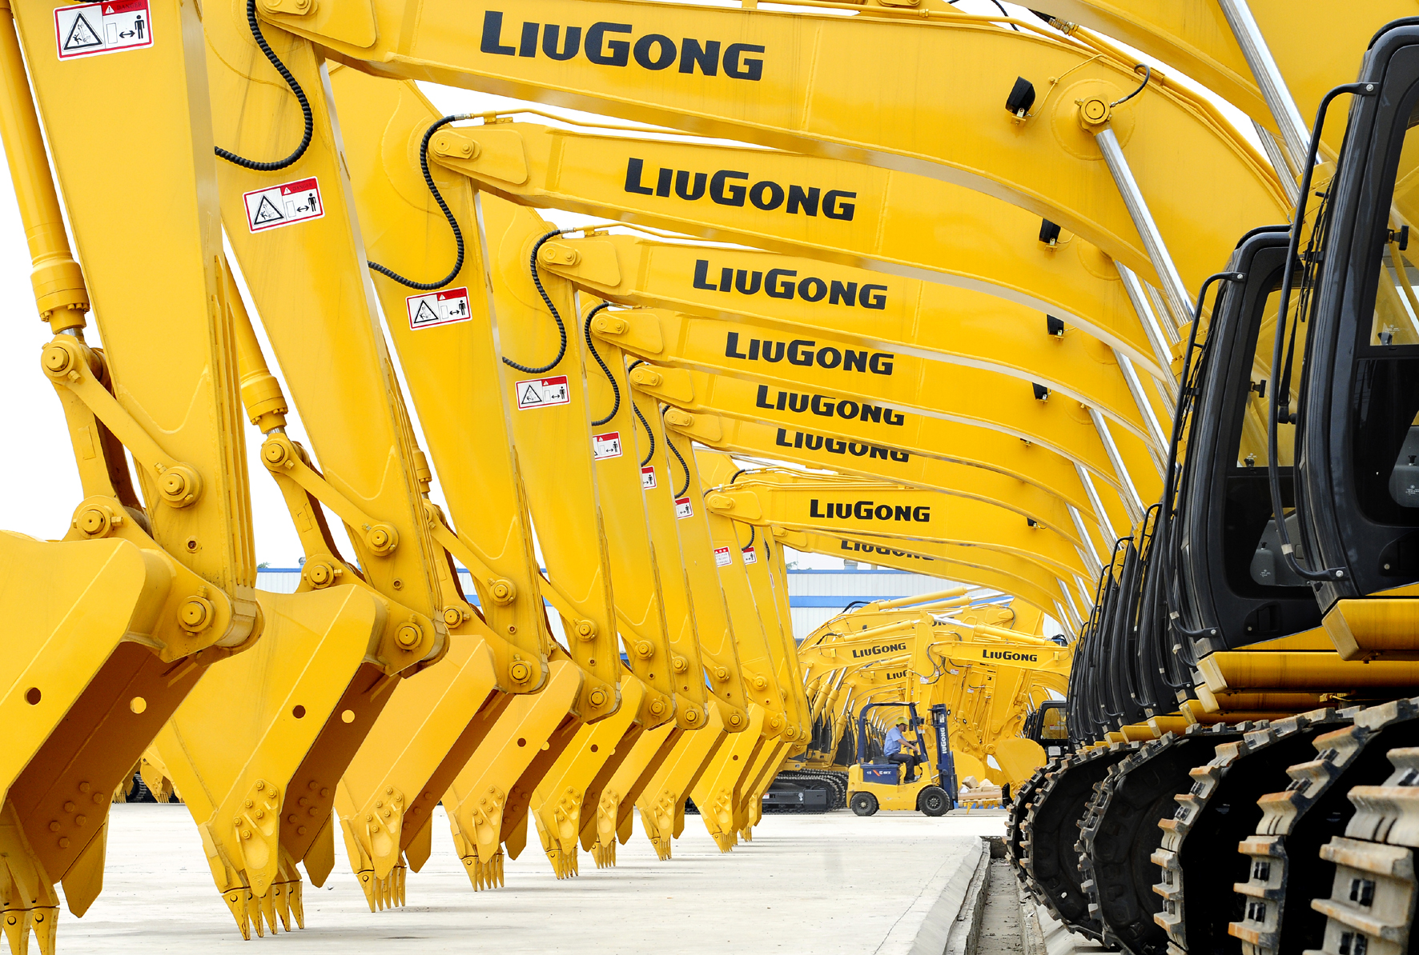
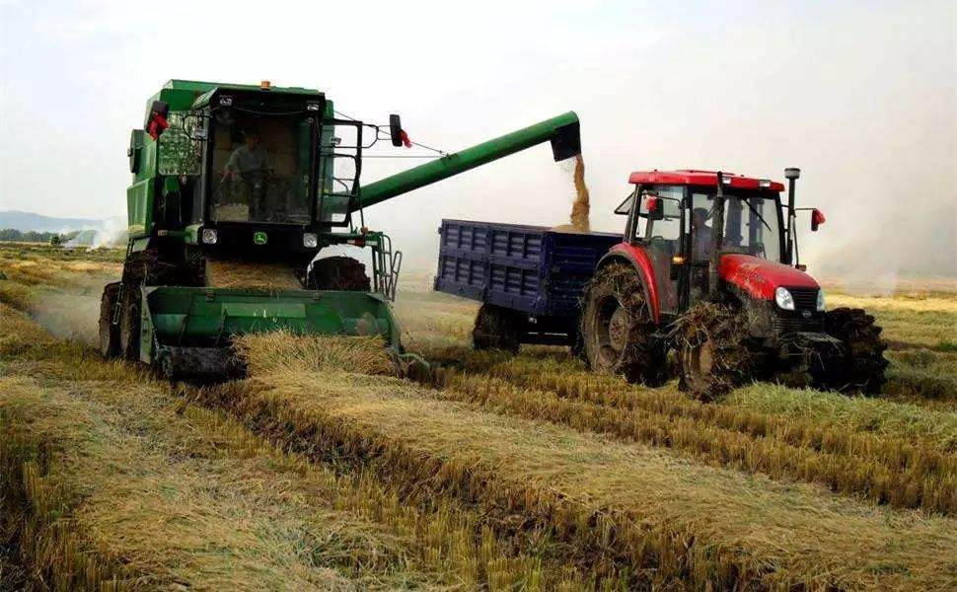

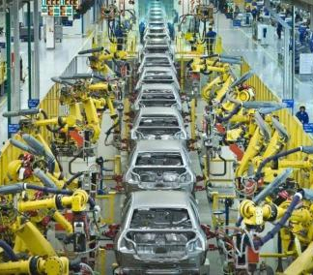
加快培育新的经济增长点 new fields of economic growth
支柱产业
Pillar Industrie
汽车 Autobile
机械 Machinery
钢铁 Steel
新兴产业
Emerging Industries
农业机械
智能装备
工业机器人
Agricultural Machinery
Intelligent Equipment
Industrial Robot
Notes:
Overall questions applicable for all speakers in this subplenary to consider if relevant for him to answer:
In your experience, what are the key drivers for a successful green recovery?
What aspects of the urban environment/urban services have been affected the most by Covid-19 and how will they need to be readjusted in the next years?
Which aspects of the management of urban life are unlikely to return to how they were before?
Which solutions have proven most effective in adapting, both in the short-term and into the long-term as well?
Which solutions are challenging to apply to the new circumstances, and how can they be adapted?
To which degree must you tailor your solutions, especially for vulnerable residents or certain districts in your city?
Which points are most important for other cities to know in order to replicate your measures?
...

Slide 7
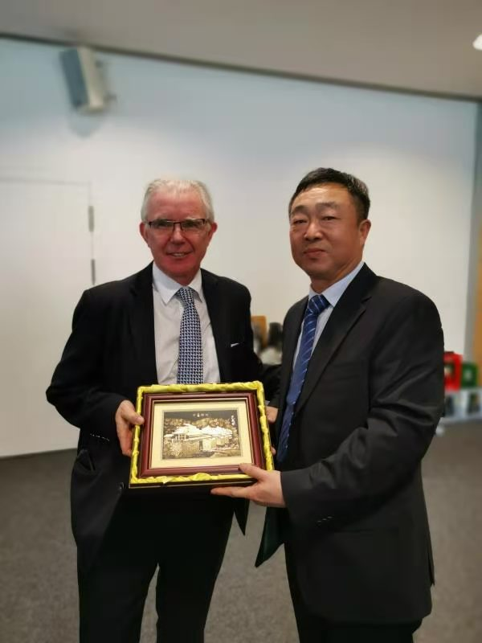
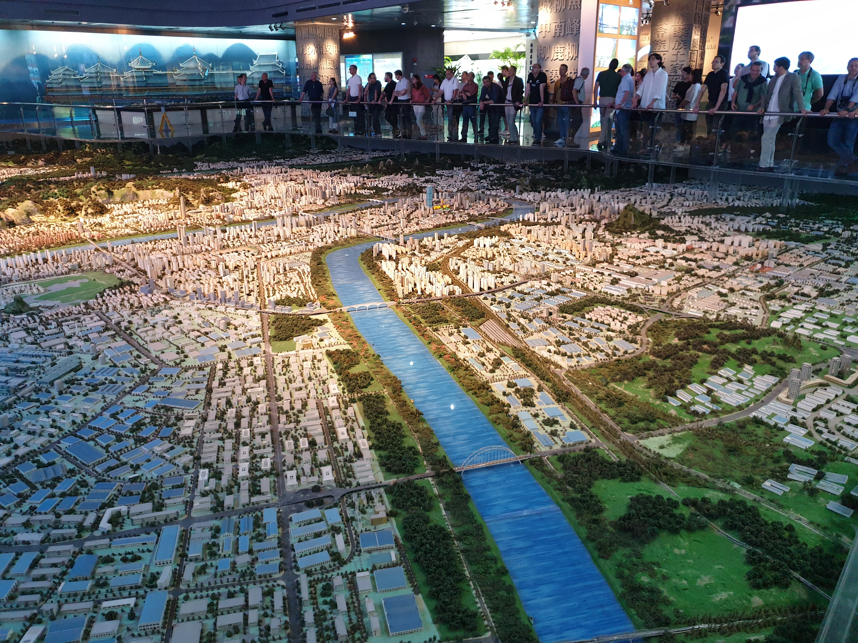
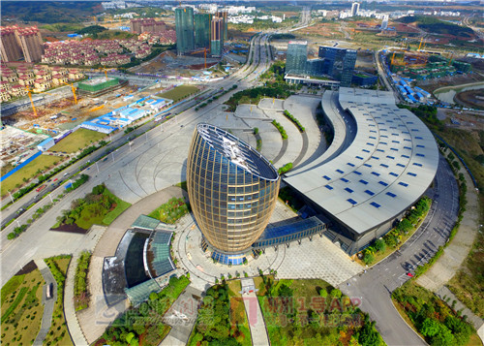
推进柳州与欧洲城市的深度合作
Cooperation with European cities
加快中欧产业园、中德（柳州）工业园建设
EU-China Industrial Park
Liuzhou-EU Cities on Urban Development
Notes:
Overall questions applicable for all speakers in this subplenary to consider if relevant for him to answer:
In your experience, what are the key drivers for a successful green recovery?
What aspects of the urban environment/urban services have been affected the most by Covid-19 and how will they need to be readjusted in the next years?
Which aspects of the management of urban life are unlikely to return to how they were before?
Which solutions have proven most effective in adapting, both in the short-term and into the long-term as well?
Which solutions are challenging to apply to the new circumstances, and how can they be adapted?
To which degree must you tailor your solutions, especially for vulnerable residents or certain districts in your city?
Which points are most important for other cities to know in order to replicate your measures?
...

Slide 8
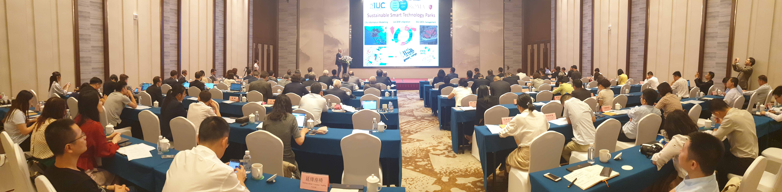
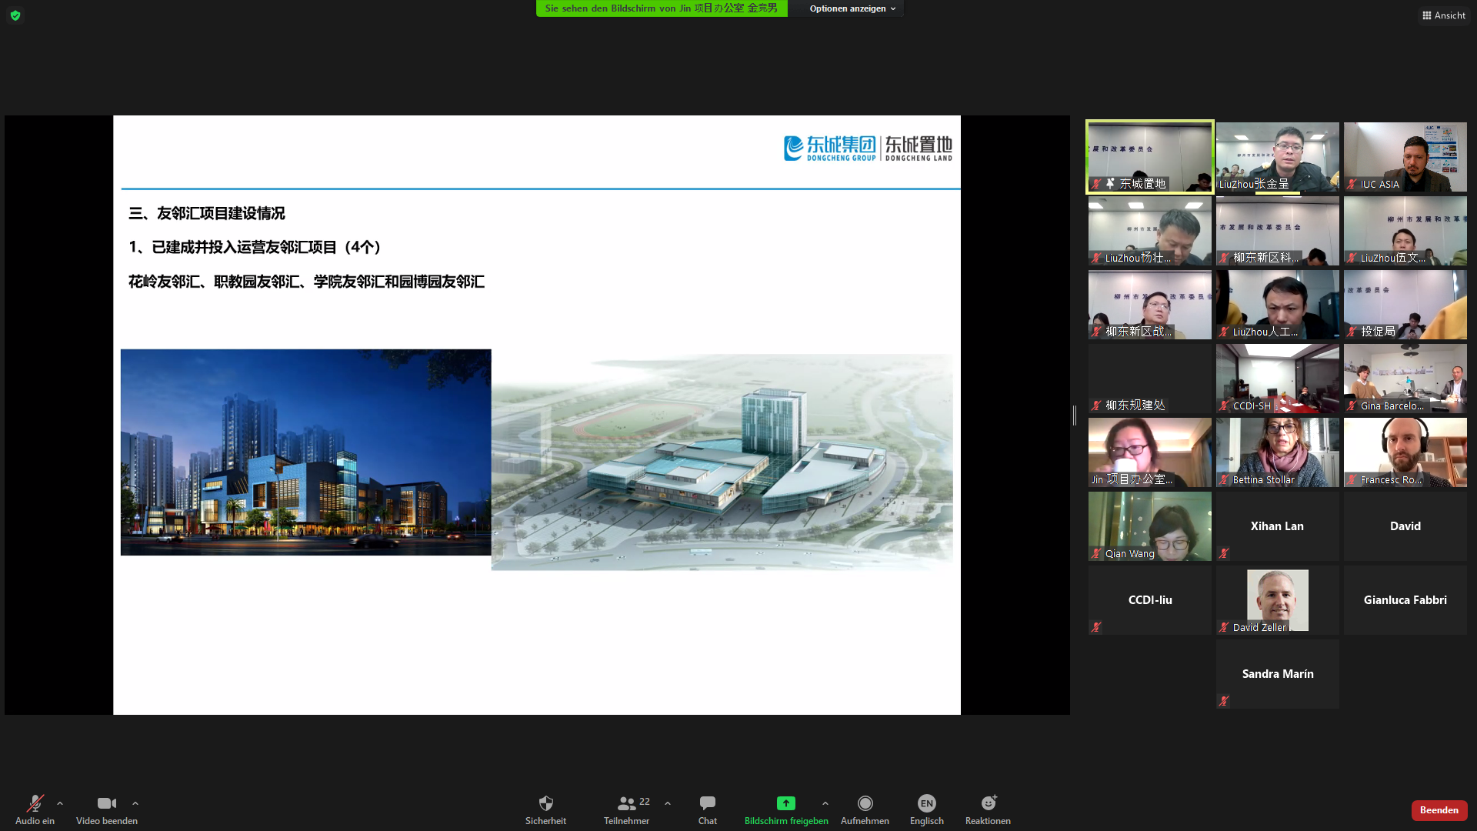
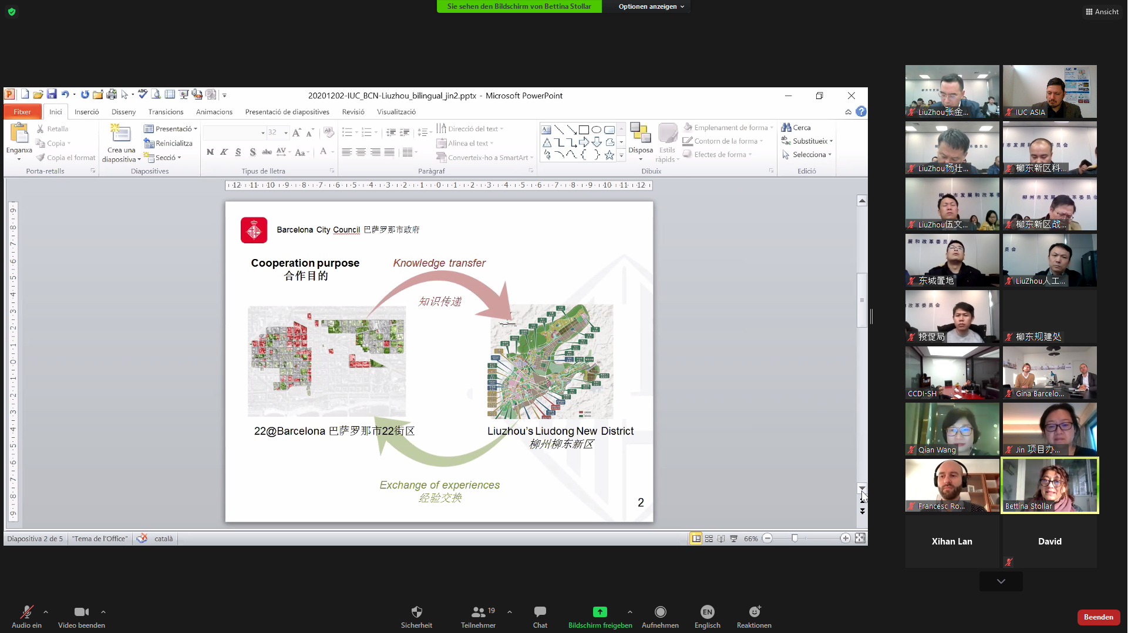
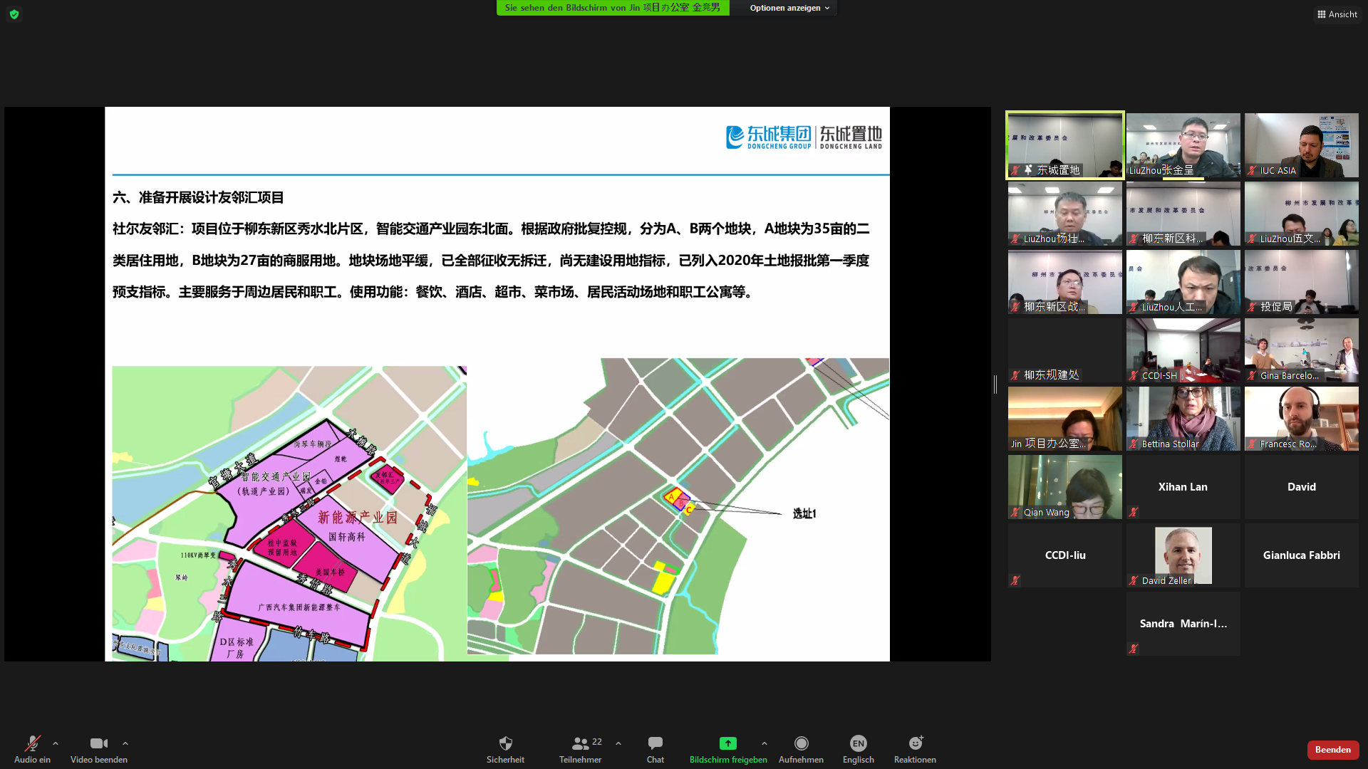
推进柳州与欧洲城市的深度合作
Cooperation with European cities
Notes:
Overall questions applicable for all speakers in this subplenary to consider if relevant for him to answer:
In your experience, what are the key drivers for a successful green recovery?
What aspects of the urban environment/urban services have been affected the most by Covid-19 and how will they need to be readjusted in the next years?
Which aspects of the management of urban life are unlikely to return to how they were before?
Which solutions have proven most effective in adapting, both in the short-term and into the long-term as well?
Which solutions are challenging to apply to the new circumstances, and how can they be adapted?
To which degree must you tailor your solutions, especially for vulnerable residents or certain districts in your city?
Which points are most important for other cities to know in order to replicate your measures?
...

Slide 9
Thank you!

