Slide 1
International Urban Cooperation Fostering Sustainable Urban Development on a global scale
Plenary: Implementing a Green Recovery
Wuhan Experience: The Green Recovery post COVID-19
Dingxian XIANG , Deputy Director, Wuhan Energy Saving Monitoring Center

Slide 2
国家中心城市 A Key City in China
Wuhan
全国经济中心 National Economic Centre
Population: 12 million, GDP per head: USD 21,000
商贸物流中心 Logistics Centre of Commerce & Trade
Railways, Highways, Waterway, International Flights
科技创新中心 Technology Innovation Centre,
89 universities & colleges, 40,000 patents a year
国际交往中心 International Communication Centre
192 countries & areas as export destinations
黑龙江
吉林
新疆
辽宁
甘肃
内蒙古
河北
北京
青海
宁夏
山西
山东
武汉wuhan
西藏
陕西
河南
江苏
四川
湖北
安徽
上海
江西
浙江
贵州
湖南
福建
云南
台湾
广东
广西
海南

Slide 3
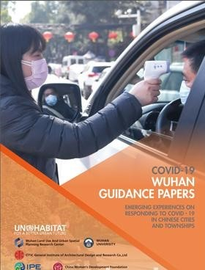
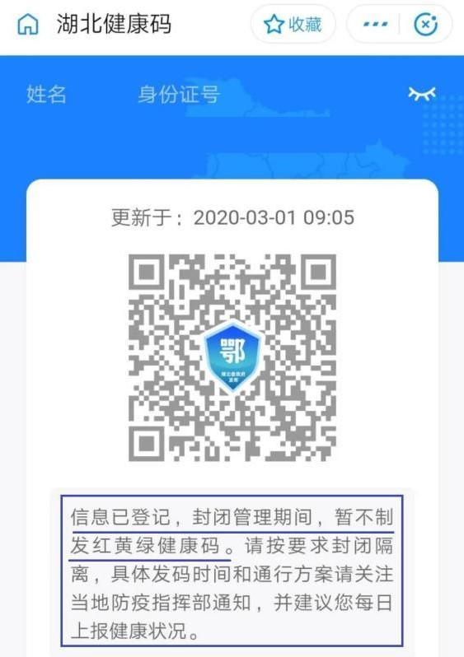
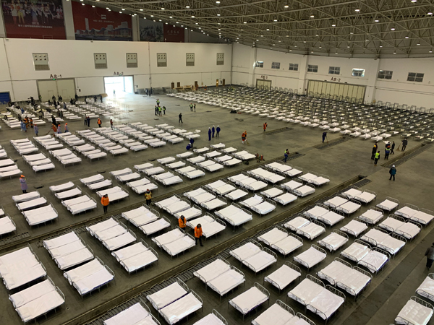
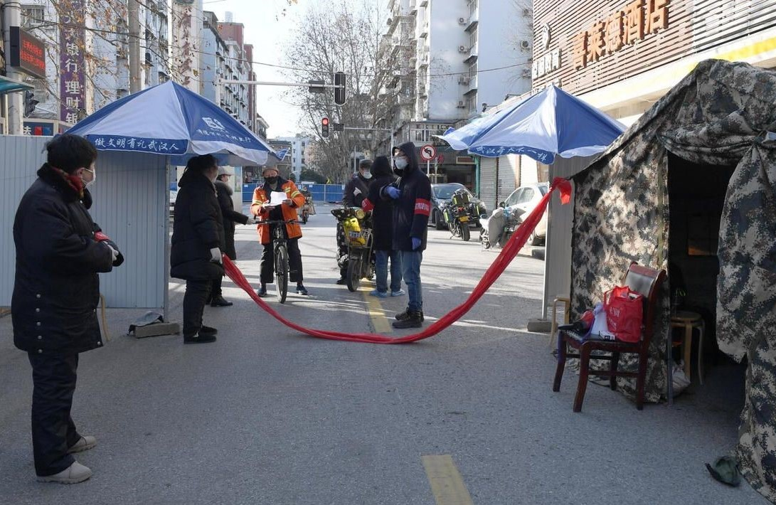
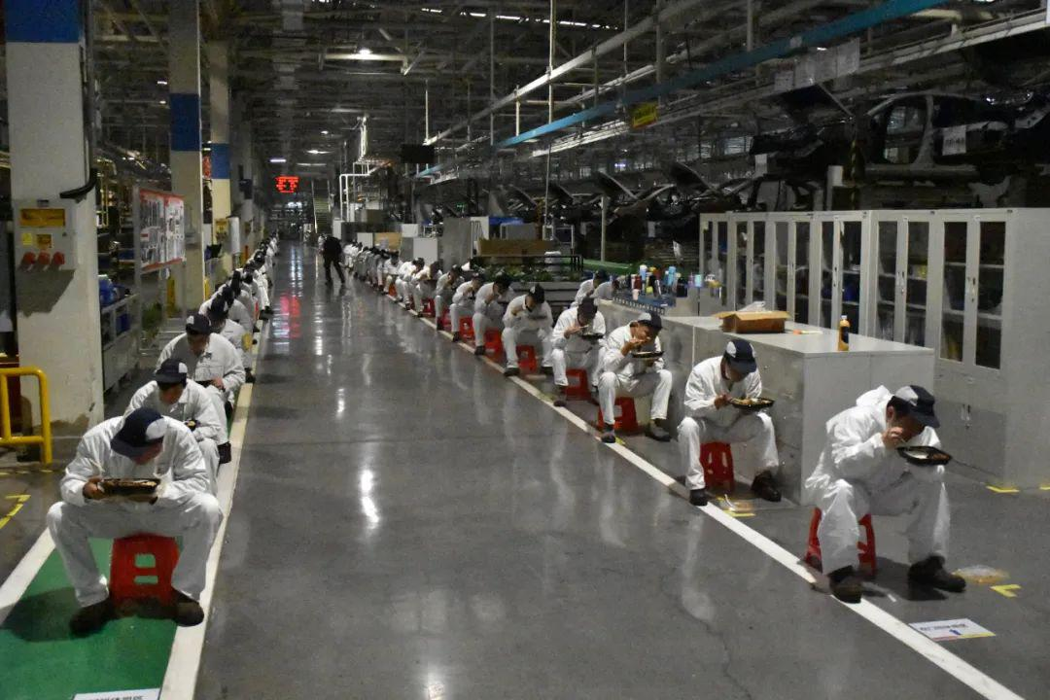
如何应对疫情 Measures against COVID-19
Wuhan
城乡社区防控
Get Urban & Rural Community under Control
方舱 Construction & Management of Ark Hospitals, Fix-points and Isolation points
健康码及大数据 Health Kit App and Big Data
常态化防控机制支持复工复产 Normalized Control Mechanisms to Support Re-manufacture
《新型冠状病毒肺炎武汉指南》
Covid-19 Wuhan Guidance Papers Published

Slide 4
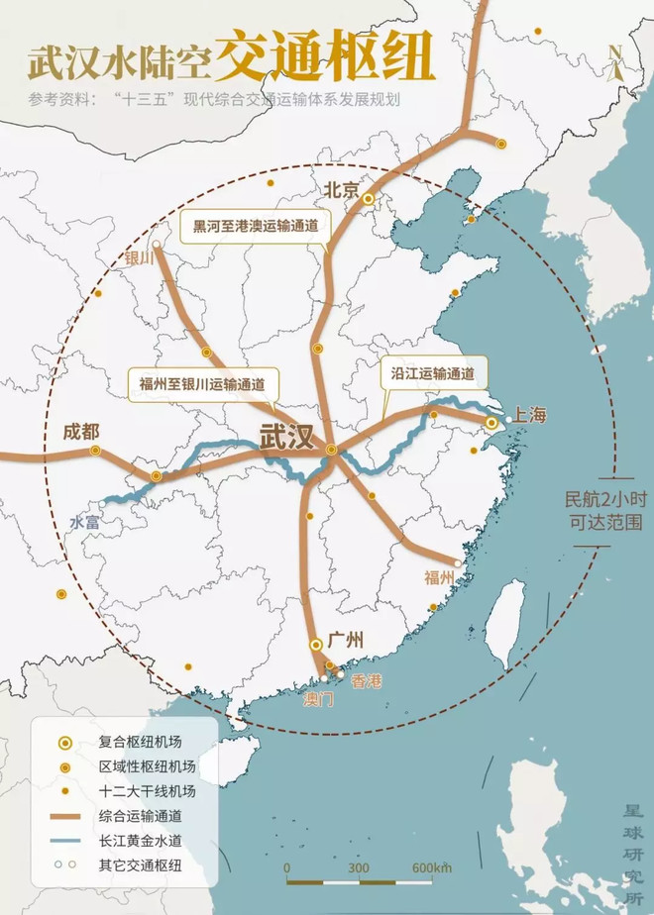
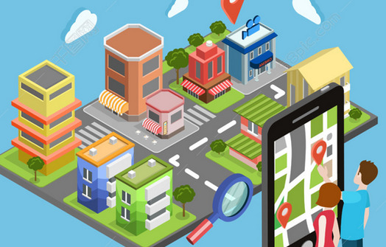
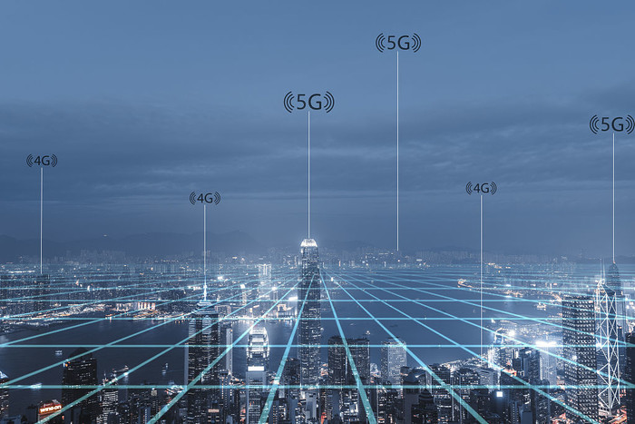
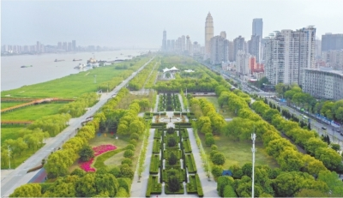
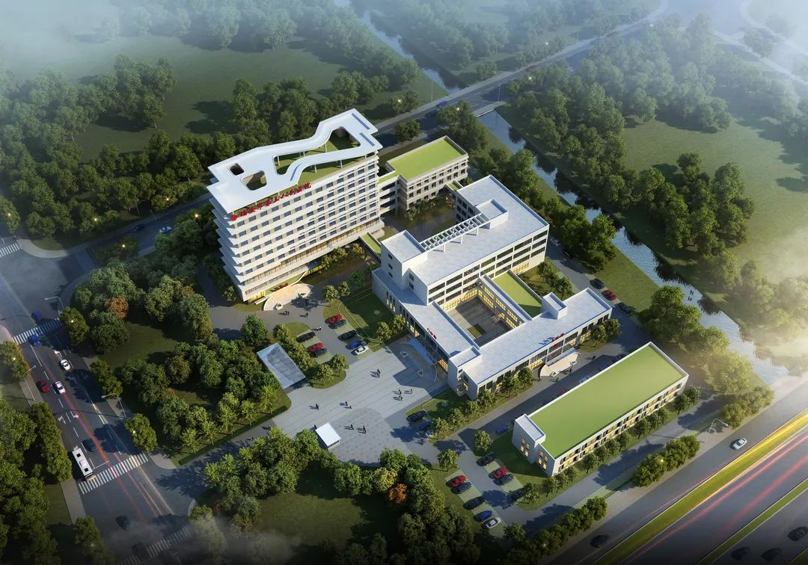
疫后绿色复苏 Green Recovery after Pandemic
Wuhan
医疗设施 Improve Medical Facilities
完整社区 Complete Community Functions
环卫应急 Household waste, Urban power grid, 5G network, Water supply, Rainwater, Sewage
城市空间 Improve Urban Living Environment
交通物流 Integrated Transport and Emergency Logistics Operations
建设功能区和亮点片区 Construction of Special Functional Areas / Highlights

Slide 5
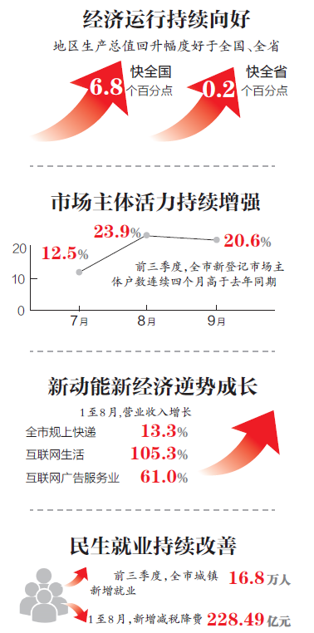
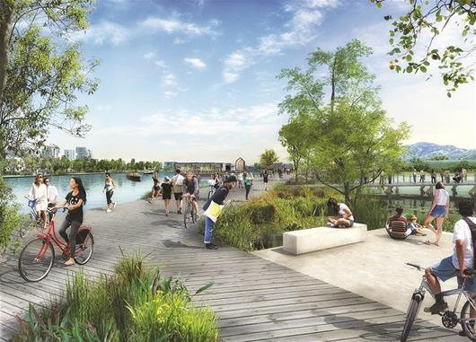
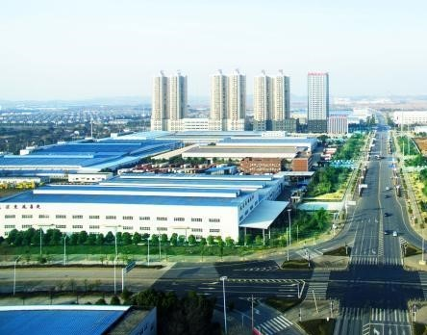
合作与经济复苏 Cooperation & Financial Recovery
Wuhan

Slide 6
Thank you for your attention!
谢谢！

